Slide 1
Disclaimer
This presentation is for educational purposes only and should not be used as a substitute for clinical judgement. GEC-KO aims to aid the practicing clinician by providing informed opinions regarding genetic services that have been developed in a rigorous and evidence-based manner. Physicians must use their own clinical judgement in addition to published articles and the information presented herein. GEC-KO assumes no responsibility or liability resulting from the use of information contained herein.

Slide 2
Hereditary Cancer Panels
Developed by Ms. Shawna Morrison, Dr. Judith Allanson and Dr. June Carroll (2017)

Slide 3

Case 1
A healthy male, age 42y
  New dad to twin daughters, 6 months
Maternal first cousin, age 37y, recently diagnosed with breast cancer
Out of concern for their daughters, he wants to be tested for hereditary cancer
There is no other significant family history
He is willing to pay

Slide 4
Case 2
Thyroid CA age 50
Breast CA age 40
Breast cancer
Age 33y
33y old, mother of two
  Recent diagnosis of breast cancer
Other CA family history:
Paternal aunt, thyroid cancer, 50y
Paternal aunt, breast cancer, 40y

Slide 5
All cancer is genetic, only 5-10% is hereditary
Later onset
No obvious pattern of inheritance
No obvious pattern of cancer types clustering
80%
2
Breast CA age 80
Colon CA age 75

Slide 6
All cancer is genetic, only 5-10% is hereditary
Earlier age of onset
Cancer occurring more frequently that statistically expected
Shared genetics (moderate risk genes) and environment
10-15%
2
Breast CA age 65
Breast CA age 80
Breast CA age 55

Slide 7
All cancer is genetic, only 5-10% is hereditary
Inherited single gene mutations cause high cancer risk
Younger age of onset
Clustering of cancers
Autosomal dominant inheritance pattern (usually)
5-10%
2
Breast CA age 49
Prostate CA d.50y
Breast CA age 33
Ovarian CA d.40y
Breast CA age 40
Ovarian CA 43y
Example of a hereditary breast and ovarian cancer syndrome family, BRCA1 or BRCA2
Notes:
BRCA1/2

Slide 8
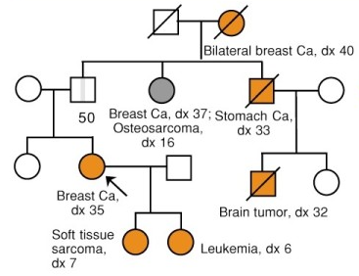
All cancer is genetic, only 5-10% is hereditary
Inherited single gene mutations cause high cancer risk
Younger age of onset
Clustering of cancers
Autosomal dominant inheritance pattern (usually)
5-10%
Example of a Li-Fraumeni syndrome family, p53
Notes:
Li Fraumeni

Slide 9
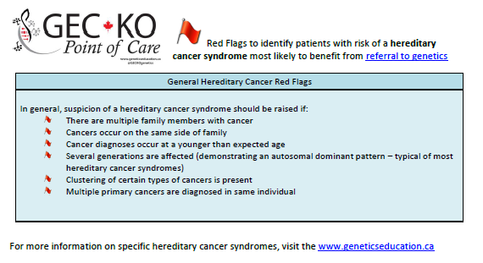
How do I identify a hereditary cancer syndrome?
Take a three generation family history
Geneticseducation.ca > Point of Care Tools > Cancer genomics

Slide 10
What are gene panels?
Panel testing examines multiple genes (2-1,000s) at one time
Technology is variable
Platforms: sophisticated vs. more sophisticated
Targeted mutations: known pathogenic variants
Next generation sequencing: read through coding regions of a gene and compare patient’s sequence to reference sequence looking for variation
Deletion/duplication: extra or missing pieces of DNA
May be disease specific (e.g. breast cancer genes only) or very broad (e.g. pan-cancer, whole exome)

Slide 11
When are gene panels useful?
Genetic heterogeneity
When a pathogenic variant in one of several genes may explain a clinical feature
Long QT syndrome: inherited risk for QT prolongation caused by mutations in LQT1, LQT2, LQT3 or ~12 others
Noonan syndrome: BRAF, KRAS, MAP2K1, NRAS, PTPN11, RAF1, RIT1, SOS1, and more
Autism spectrum disorder, plus other features: PTEN (Cowden syndrome), MeCP2 (Rett syndrome), NF1 (neurofibromatosis)

Slide 12
Five facts about hereditary cancer panels
1. Maybe more efficient and cost effective than testing gene by gene
Clinical overlap among syndromes
Syndrome | Gene(s) | Main associated cancers
Hereditary breast and ovarian cancer | BRCA1, BRCA2 | Breast, Ovarian, Prostate, Pancreatic
Lynch syndrome | MLH1, MSH2, MSH6, PMS2, EPCAM | Colorectal, Endometrial, Ovarian, Stomach
Li-Fraumeni syndrome | p53 | Soft tissue sarcoma, Osteosarcoma, Breast, Brain, Leukemias
Cowden syndrome | PTEN | Thyroid, Breast, Endometrial
Peutz-Jeghers syndrome | STK11 | Colorectal, Gastric, Pancreatic, Breast, Ovarian, Sex cord tumors
Hereditary diffuse gastric cancer | CDH1 | Diffuse gastric cancer, Lobular breast cancer
Notes:
Breast or colon cancer panel
All CA panel
High penetrant genes
Moderate genes

Slide 13

Five facts about hereditary cancer panels
1. Maybe more efficient and cost effective than testing gene by gene
2. They are extremely variable
Cancer type: e.g. breast specific or pan-cancer
Genes included: e.g. high risk (BRCA1) vs moderate risk (PALB2)
Technology: various platforms and software used
Interpretation: variant classification as per guidelines and clinical interpretation

Slide 14
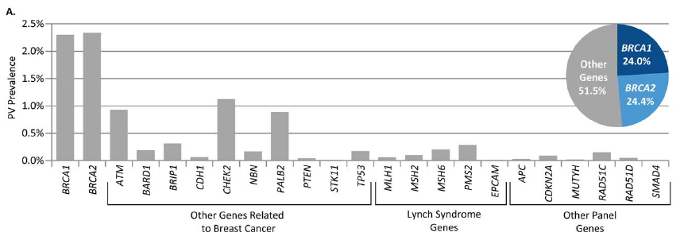
Five facts about hereditary cancer panels
1. Maybe more efficient and cost effective than testing gene by gene
2. They are extremely variable
3. There is a higher chance to identify a result with clinical utility
Retrospective study of 35,409 women with a single diagnosis of breast cancer who underwent panel testing
  93.2% (32,993) met testing criteria for BRCA1 and BRCA2
9.3% (3,305) carried at least one pathogenic gene change; 48.4% in BRCA1/2
Buys 2017 Cancer; 123

Slide 15
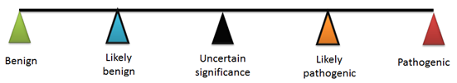
Five facts about hereditary cancer panels
1. Maybe more efficient and cost effective than testing gene by gene
2. They are extremely variable
3. There is a higher chance to identify a result with clinical utility
4. There is a higher chance to identify uncertain information
22-33% of gene panel test results are VUS
Notes:
The frequency of returning VUS in panel gene testing for cancer has been 21.9 to 33.3%. Lumish 2017 JGC

Slide 16
Five facts about hereditary cancer panels
1. Maybe more efficient and cost effective than testing gene by gene
2. They are extremely variable
3. There is a higher chance to identify a result with clinical utility
4. There is a higher chance to identify uncertain information
VUS result:
Are associated increased distress
Are higher among ethnic minority groups
Are often not well understood
  64% of those who received a VUS reported they had received a negative result
  35% reported the intention to increase cancer screening, despite recommendations for family and personal history based screening
Lumish 2017 J Genet Counsel; Epub
Notes:
The frequency of returning VUS in panel gene testing for cancer has been 21.9 to 33.3%. Lumish 2017 JGC

Slide 17
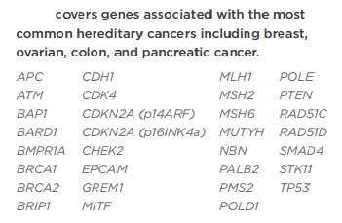
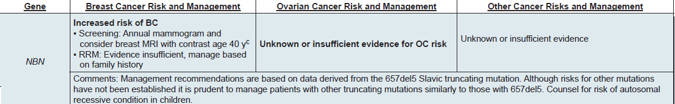

Five facts about hereditary cancer panels
1. Maybe more efficient and cost effective than testing gene by gene
2. They are extremely variable
3. There is a higher chance to identify a result with clinical utility
4. There is a higher chance to identify uncertain information
5. Not all hereditary cancer panel results are clinically actionable
Management may not be modified any more than family history-based risk assessment
Notes:
Some publications
Or limited evidence

Slide 18
Hereditary cancer panel results
True Negative:
familial pathogenic variant not found
Reassurance
Negative
Uninformative:
no known pathogenic variant found
Family/personal history based screening
Guideline-based screening & management
Positive
Pathogenic or likely pathogenic variant
Cancer risk not clear
No published guidelines
Family/personal history based screening
Variant of Uncertain Significance (VUS)
Uninformative:
Neither confirms nor rules out hereditary cancer predisposition
Periodic reclassification

Slide 19

Hereditary cancer panel results:
When can I refer to genetics?
There is no personal or family history suspicious of hereditary cancer
Guideline-based screening & management
Positive
Pathogenic or likely pathogenic variant
Cancer risk not clear
No published guidelines
Family/personal history based screening

Slide 20
Hereditary cancer panel results:
When can I refer to genetics?
You have a high degree of suspicion of a hereditary cancer based on personal and/or family history red flags, regardless of results
Negative
Uninformative:
no known pathogenic variant found
Positive
Pathogenic or likely pathogenic variant
Variant of Uncertain Significance (VUS)
Uninformative:
Neither confirms nor rules out hereditary cancer predisposition

Slide 21
Case 1
Is he a good candidate for hereditary cancer panel?
Yes
No
Maybe
Breast CA age 37
Probably not!
Best candidate is affected cousin
  A negative result for your patient would be uninformative not reassuring
Could be sporadic case
Daughters are young and information would not impact their care

Slide 22
Case 1
If he is of Ashkenazi Jewish (AJ) ancestry, he would be a eligible for referral for Genetic consultation and BRCA1 and BRCA2 screening for AJ founder mutations.
Other options?
Notes:
Positive results called to patient via WCH and patient receives GC and screening guidance
Neg and VUS, reported via Veritas and WCH available if patient requests

Slide 23

Case 1
Other options?
Private testing is available
+/- genetic counselling
BRCA1/2 only
200-600$
BRCA1/2 and other cancer genes
~600$
BRCA1/2 and other genetic (and non-genetic) conditions
250$
Notes:
Positive results called to patient via WCH and patient receives GC and screening guidance
Neg and VUS, reported via Veritas and WCH available if patient requests

Slide 24
Case 2
Thyroid CA age 50
Breast CA age 40
Breast cancer
Age 33y
Is she a good candidate for hereditary cancer panel?
Yes
No
Maybe

Slide 25
Case 2
Thyroid CA age 50
Breast CA age 40
Breast cancer
Age 33y
Maybe!
Clustering of cancers
Young-ish ages of diagnoses
Eligible for Genetic consultation and BRCA1/BRCA2 gene testing
Is she a good candidate for hereditary cancer panel?
Yes
No
Maybe

Slide 26
Case 2
Developmental delay
Thyroid CA age 50
Breast CA age 40
Breast cancer
Age 33y
Developmental delay
Uterine fibroids 30s
Benign thyroid adenoma
Autism
Is she a good candidate for hereditary cancer panel?
Yes
No
Maybe
BRCA1 and BRCA2 negative
Additional family history
Thyroid
Uterine
DD, ASD
Physical exam
PTEN, Cowden syndrome
Notes:
Maybe physical findings e.g. head circumference, skin findings

Slide 27
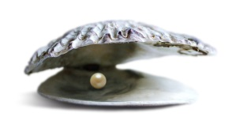
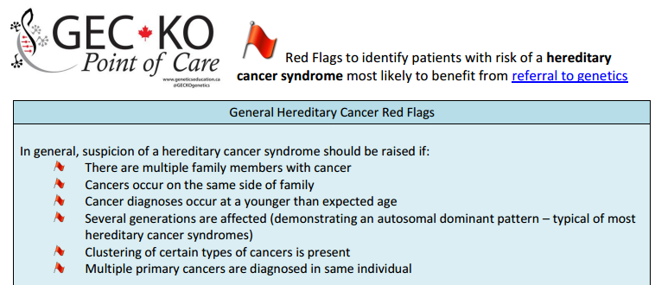
Pearls
Family history is the best tool for hereditary cancer risk assessment

Slide 28
Pearls
Family history is the best tool for hereditary cancer risk assessment
Hereditary cancer panels may be appropriate when:
One cancer syndrome can be caused by multiple genes
One type of cancer can be part of multiple syndromes
Syndrome | Gene(s) | Main associated cancers
Lynch syndrome | MLH1, MSH2, MSH6, PMS2, EPCAM | Colorectal, Endometrial, Ovarian, Stomach
Peutz-Jeghers syndrome | STK11 | Colorectal, Gastric, Pancreatic, Breast, Ovarian, Sex cord tumors

Slide 29
Pearls
Family history is the best tool for hereditary cancer risk assessment
Hereditary cancer panels may be appropriate when:
One cancer syndrome can be caused by multiple genes
One type of cancer can be part of multiple syndromes
If ordering a hereditary cancer panel, consider:
Family history
Genetic discrimination for unaffected individuals
Select panel with caution, considering:
Genes: high risk genes with screening recommendation vs. unknown risk genes and no recommendations
Cancers: breast cancer panel vs. pan-cancer panel
Credentials: Licensed by MOHLTC, CLIA certification, board certified genetic counsellors
Notes:
FDA credential: The Clinical Laboratory Improvement Amendments (CLIA)
Ontario lab credential: licensed by the Ministry of Health and Long Term Care and holds accreditation from the Ontario Laboratory Accreditation (OLA); under the direction of a Molecular/Cyto Geneticist certified by the Canadian College of Medical Geneticist (CCMG); staffed by technologists licensed by the College of Medical Laboratory Technologists of Ontario.

