Slide 1
Disclaimer
This presentation is for educational purposes only and should not be used as a substitute for clinical judgement. GEC-KO aims to aid the practicing clinician by providing informed opinions regarding genetic services that have been developed in a rigorous and evidence-based manner. Physicians must use their own clinical judgement in addition to published articles and the information presented herein. GEC-KO assumes no responsibility or liability resulting from the use of information contained herein.

Slide 2
Untangling the helix 2019:
Why family history matters
(Ontario focused)
Developed by Shawna Morrison MS CGC, June Carroll MD CCFP FCFP, Judith Allanson MB FRCPC FRCP (2019)
Notes:
Last updated Nov 2019
Originally developed for 2019 CFPC Family Medicine Forum and the 2019 OCFP Annual Scientific Assmebly

Slide 3
Learning objectives
Identify patients whose family history suggests an increased risk of a genetic condition
Modify screening and management to improve patient outcomes
Find high quality genomics educational resources appropriate for primary care
Notes:
How to elicit and identify family history red flags
In consultation with a specialist, know who to refer and who to reassure

Slide 4
Why take family history?
All common diseases have some genetic component, and the strength of the genetic component may be revealed.
92
d. 80
dx. 75
84
83
64
d. 32
75
dx.70
59
Legend
65
68
61
Breast cancer
Ovarian cancer
60
dx. 60
48
45

Slide 5
Why take family history?
All common diseases have some genetic component, and the strength of the genetic component may be revealed.
92
d. 65
dx. 63
84
83
64
dx. 62
d. 32
65
59
Legend
65
68
dx. 50
61
Breast cancer
Ovarian cancer
45
dx. 43
50
dx. 50
34
31

Slide 6

Why take family history?
All common diseases have some genetic component, and the strength of the genetic component may be revealed.
Family history is the gold standard to assess the likelihood of a genetic condition and to identify individuals who may benefit from referral to a specialist.
FH
Notes:
Even with advancing genomic technology, family history is still the gold standard to assess the likelihood of a genetic condition and to identify individuals who may benefit from referral to a specialist.

Slide 7





Why take family history?
All common diseases have some genetic component, and the strength of the genetic component may be revealed.
Family history is the gold standard to assess the likelihood of a genetic condition and to identify individuals who may benefit from referral to a specialist.
Family history can affect testing, surveillance and management recommendations.
Notes:
Family history can affect testing, treatment, surveillance and management recommendations.
I.E. A woman’s eligibility for the Ontario Breast Screening Program (OBSP) could be determined; FXS testing eligibility in a pregnant patient.

Slide 8

But how do I do it in the limited time I have?

Slide 9




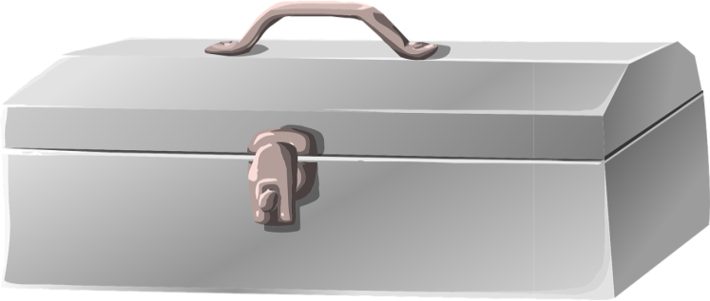
What is the best way to take a family history?
Choose a family history tool that works for you, your patient, and your setting
Notes:
Patient facing
Online/tablet
Paper
With the patient to compliment or exclusively patient-provider
https://www.genomicseducation.hee.nhs.uk/wp-content/uploads/2019/06/Game-factsheet-7-Family-history.pdf

Slide 10
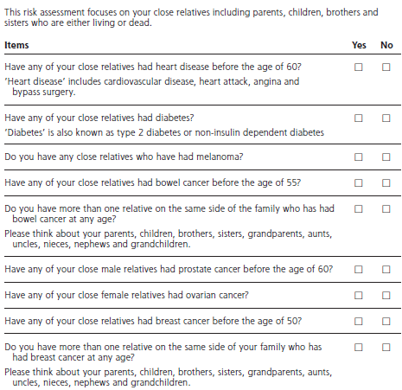
Development and validation of a family history screening questionnaire in Australian primary care. Emery 2014 Ann Fam Med
Sensitive and specific to identify individuals at increased risk for seven conditions where there is evidence for effective intervention
Breast cancer
Ovarian cancer
Colorectal cancer
Prostate cancer
Melanoma
Ischemic heart disease
Type 2 diabetes
Validated in Dutch population
Houwink 2019 Clin Trans Med

Slide 11
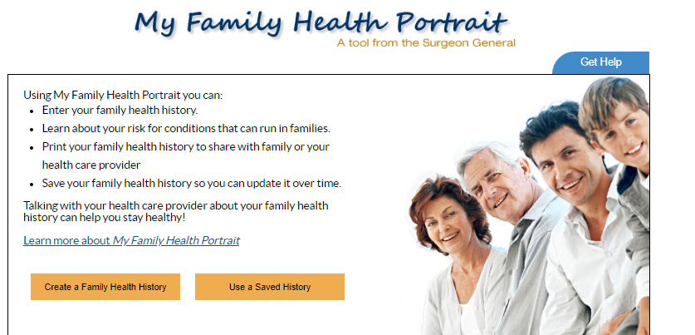
https://phgkb.cdc.gov/FHH/html/index.html

Slide 12
What is the best way to take a family history?
Choose a family history tool that works for you, your patient, and your setting
Take an initial complete family history
Then do quick, regular updates targeting red flags with life cycle- specific questions
Notes:
Patient facing
Online/tablet
Paper
With the patient to compliment or exclusively patient-provider
https://www.genomicseducation.hee.nhs.uk/wp-content/uploads/2019/06/Game-factsheet-7-Family-history.pdf

Slide 13

What to include in a family history?
All first degree relatives (parents, children, siblings)
news.umich.edu/

Slide 14
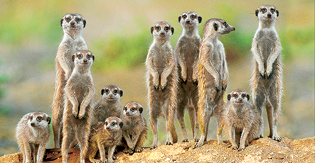
What to include in a family history?
All first degree relatives (parents, children, siblings)
If possible, include second (grandparents, aunts/uncles, half-siblings, nieces/nephews) and third (cousins) degree relatives
Both sides of the family (maternal and paternal)
thewebmate.com
news.umich.edu/

Slide 15
What to include in a family history?
All first degree relatives (parents, children, siblings)
If possible, include second (grandparents, aunts/uncles, half-siblings, nieces/nephews) and third (cousins) degree relatives
Both sides of the family (maternal and paternal)
Questions about consanguinity
Are you and your partner related by blood, such as cousins?
Are your parents or grandparents related by blood?

Slide 16
What to include in a family history?
All first degree relatives (parents, children, siblings)
If possible, include second (grandparents, aunts/uncles, half-siblings, nieces/nephews) and third (cousins) degree relatives
Both sides of the family (maternal and paternal)
What country/countries did your family live in before coming to Canada?
Questions about consanguinity
Ethnicity
What is your ancestry?

Slide 17
What to include in a family history?
All first degree relatives (parents, children, siblings)
If possible, include second (grandparents, aunts/uncles, half-siblings, nieces/nephews) and third (cousins) degree relatives
Both sides of the family (maternal and paternal)
Questions about consanguinity
Ethnicity
Age of death and cause of death, if known
Age of diagnosis in affected individual

Slide 18
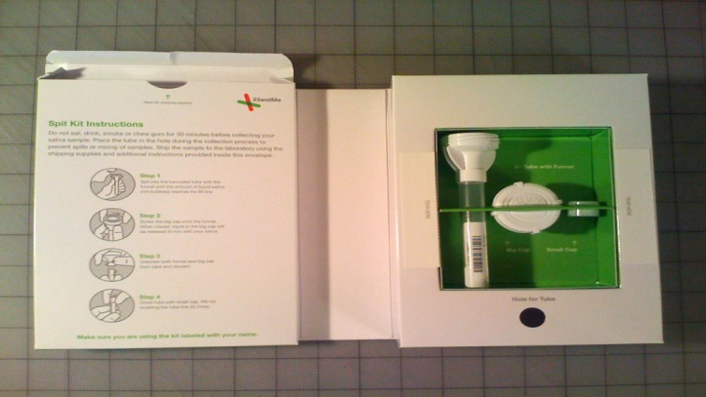

Case 1: Preconception
Bridgette and her partner are planning to start their family.
She reveals that her partner is adopted.
For fun, together they purchased an online ancestry testing kit.
Notes:
n February of this year, the Israeli newspaper Haaretz, reported that the Chief Rabbinate of Israel, the peak religious authority in the country, had been requesting DNA tests to confirm Jewishness before issuing some marriage licenses.
https://www.frontiersin.org/articles/10.3389/fmed.2019.00048/full
https://thewirecutter.com/reviews/best-dna-test/
Dr. Lawrence Brody, director of the Division of Genomics and Society at the National Institutes of Health. “There’s no single gene variant that makes you Tunisian; almost any variant that you’ll find in Tunisia you’ll also find in Argentina,” he noted. DNA tests simply look at how often these variations occur. “Let’s say there are 27 variants I find in Tunisia which occur in 1 percent of Tunisians,” Brody explained, “but those same variants are found in 50 percent of Argentines. If a DNA test shows I have 17 of those variants, it’s more likely that I’m an Argentine than a Tunisian.”

Slide 19
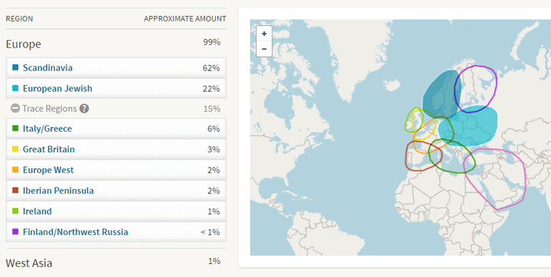
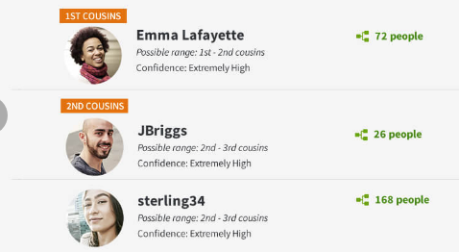
Case 1: Preconception
In addition, to finding many cousins, her partner discovers that he is Ashkenazi Jewish.
Bridgette already knows that she is French Canadian.

Slide 20
Preconception family history check list

Slide 21
Do any of the following apply to your patient, their partner, or their close family members? | Yes | No
1. Inherited condition or chromosomal disorder? Genetic disorder (e.g. neurofibromatosis, cystic fibrosis) Muscular disorder (e.g. Duchenne or Becker muscular dystrophy) Bleeding disorder (e.g. hemophilia) Down syndrome or a familial chromosomal translocation
2. Physical difference present at birth (e.g. cleft lip, heart defect)
3. Intellectual disability, developmental delay and/or autism
4. Other major health concerns such as cardiomyopathy, neurological disease, epilepsy, hearing loss, and psychiatric disorders
5. History of consanguinity
6. Ashkenazi Jewish ancestry
7. From a population qualifying for additional screening (see next)
A ‘Yes’ response to any question above should prompt a more targeted family history. Referral to appropriate specialist may be considered.
X
X
X
X
X
X
X
Notes:
6. Ashkenazi Jewish ancestry

Slide 22

Try to know your local population
IF YES, to #7 Do any of the following apply to your patient or their partner? | Yes | No
1. Belongs to any of the following populations: Mediterranean, Middle East, South East Asian, Western Pacific, Caribbean or South American………………………………………………………………….. Amish, Hutterite, or Mennonite…………………………………………………………….
2. Comes from the following Canadian regions: Saguenay Lac-Saint-Jean and Charlevoix…………………………………………….. Bas-Saint-Laurent and Gaspésie (Quebec), adjoining New Brunswick…. Newfoundland………………………………………………………………………………………….
3. Belongs to the following Canadian indigenous populations: Aboriginal Manitoba…………………………………………………………………………….. Cree………………………………………………………………………………………………………
X
X
X
Notes:
NFLD – Lng QT, cancer, Bardet Biedel

Slide 23
Case 1: Preconception
50
48
50
56
27
27
31
Bridgette
Bridgette
[Ashkenazi Jewish]
French Canadian

Slide 24
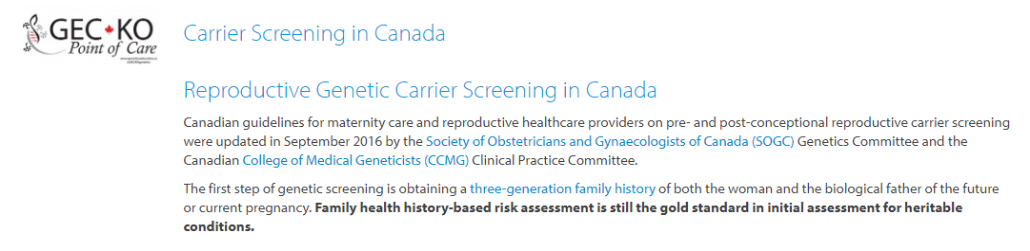
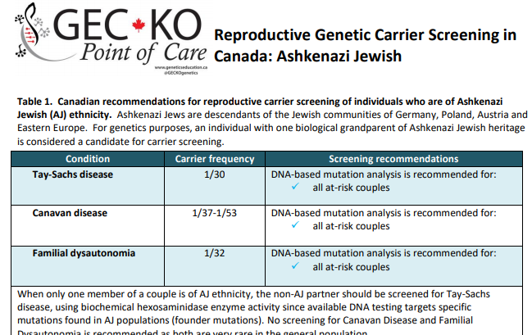
Reproductive genetic carrier screening in Canada
Geneticseducation.ca > Point of Care tools > Carrier Screening in Canada
Notes:
Goal of prenatal/preconception counselling and screening if to facilitate informed reproductive options. This is accomplished through FamHx and Ethnicity based screening

Slide 25
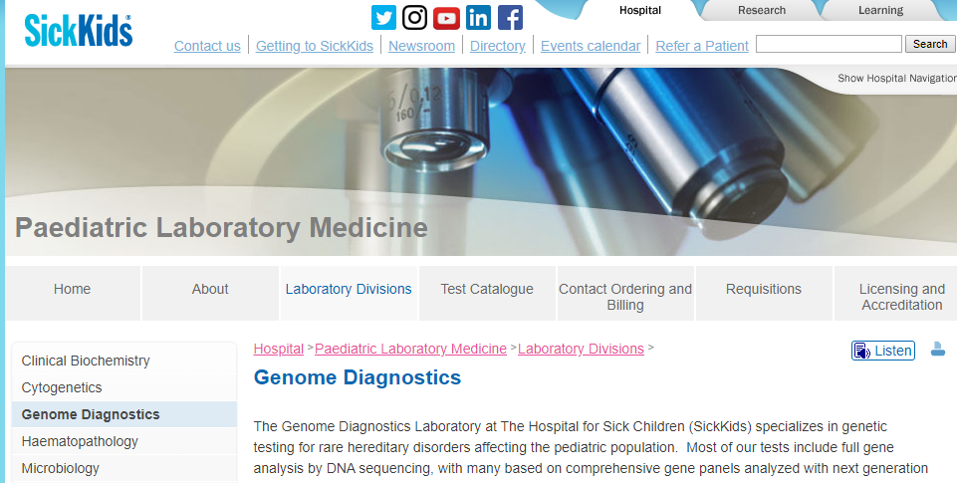
SickKids.ca > Paediatric Laboratory Medicine > Genome Diagnostics > Test Catalogue

Slide 26
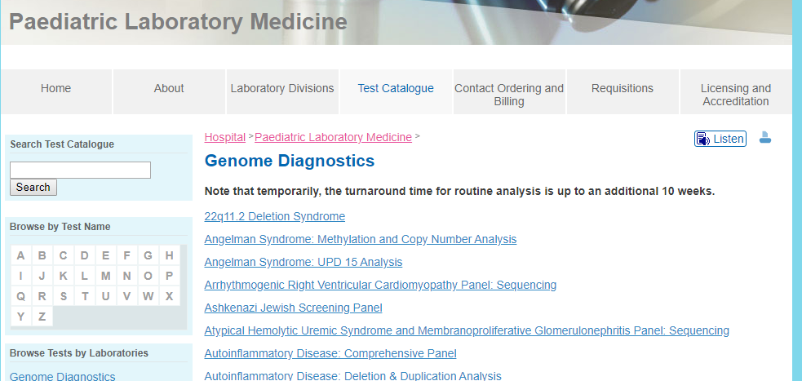
> Genome Diagnostics > Test Catalogue > AJ Screening Panel > Test Requisition

Slide 27
Disorder | Carrier frequency In AJ population | Test sensitivity in AJ population
Bloom syndrome | 1/102 | 98%
Canavan disease | 1/57 | 98%
Familial dysautonomia | 1/30 | 99%
Fanconi anemia, group C | 1/89 | 99%
Mucolipidosis IV | 1/100 | 95%
Neimann Pick Disease | 1/90 | 95%
Tay-Sachs disease | 1/29 | 99%

Slide 28
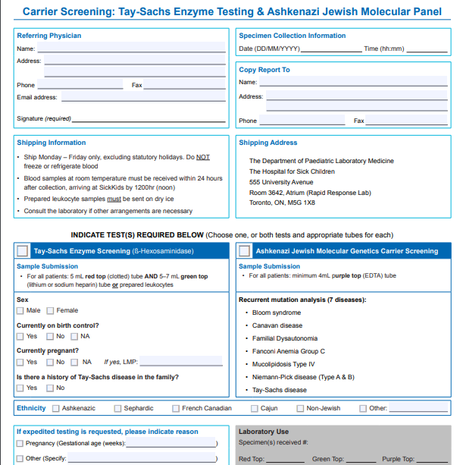
Non- Ashkenazi Jewish partner
Ashkenazi Jewish partner

Slide 29
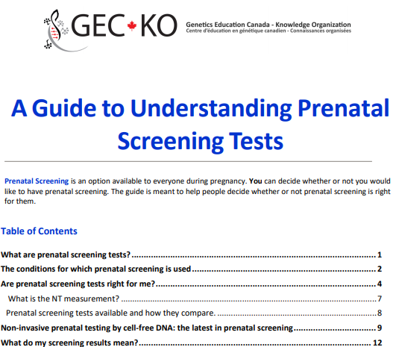

Case 2: Prenatal
Bridgette and her partner are expecting their first baby (3 years later)
She is about 6 weeks’ gestation by LMP
You provide information regarding prenatal screening (provincial program, NIPT, no test)
Update the pregnancy and family history
Geneticseducation.ca > Public resources > Prenatal and preconception genetics

Slide 30
[Preconception]Prenatal family history check list

Slide 31
Do any of the following apply to your patient, their partner, or their close family members? | Yes | No
1. Inherited condition or chromosomal disorder? Genetic disorder (e.g. neurofibromatosis, cystic fibrosis) Muscular disorder (e.g. Duchenne or Becker muscular dystrophy) Bleeding disorder (e.g. hemophilia) Down syndrome or a familial chromosomal translocation
2. Physical difference present at birth (e.g. cleft lip, heart defect)
3. Intellectual disability, developmental delay and/or autism
5. Other major health concerns such as cardiomyopathy, neurological disease, epilepsy, hearing loss, and psychiatric disorders
6. History of consanguinity
7. Ashkenazi Jewish ancestry
8. From a population qualifying for additional screening
A ‘Yes’ response to any question above should prompt a more targeted family history. Referral to appropriate specialist may be considered.
X
X
X
X
X
X
X

Slide 32
Case 2: Prenatal
53
51
53
59
30
30
34
Bridgette
P
6W

Slide 33

Case 2: Prenatal
53
51
53
59
30
30
34
Bridgette
P
6W
5
Consider urgent referral to Genetics
?ASD
Developmental delay
Appointment with developmental pediatrician pending

Slide 34
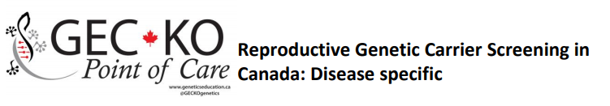
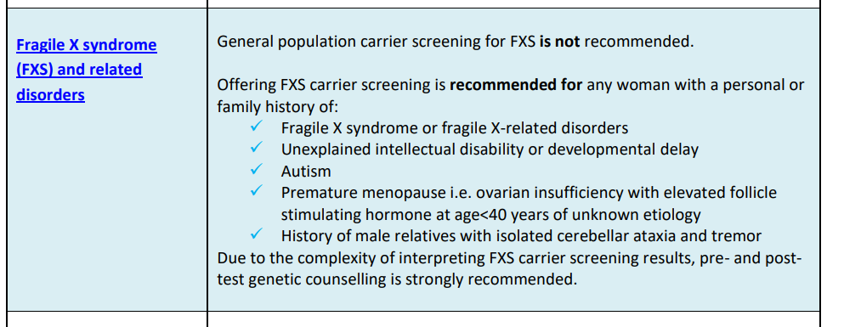
Case 2: Prenatal
Geneticseducation.ca > Point of Care tools > Carrier screening in Canada

Slide 35

Fragile X syndrome
Most common inherited form of intellectual disability
1 in 4,000 boys and 1 in 6,000 girls
Global developmental delay & intellectual disability
25% will have autism spectrum disorder
Of children with autism spectrum disorder, 1-5% will have a fragile X syndrome diagnosis
Notes:
Characteristic appearance: may not be apparent in young children: large head, long face, prominent forehead and chin, protruding ears

Slide 36

Case 3: Pediatrics
Carlos, 15, is a competitive hockey player in great health
He is here for a health assessment
Carlos has no questions or concerns
However his father raises concerns about a recent trip to the ER where Carlos was treated following fainting spell during a game
Carlos’s parents divorced 10 years ago, his father does his best to report the family history

Slide 37

Key family history questions for pediatric patients
Do any of the following criteria apply to your patient or their family members (maternal and paternal)? | Yes | No
1. Intellectual disability / developmental delay / autism spectrum disorder
2. History of a physical difference present at birth (e.g. cleft lip)
3. Death before age 50
4. Cancer diagnosis before age 50
Early heart disease (<55y men, <65y women)
6. Inherited condition
A ‘Yes’ response to any question above should prompt a more targeted family history, including additional relatives, details about the diagnosis including age of diagnosis. Referral to appropriate specialist may be considered.
X
X
X
X
X
X

Slide 38

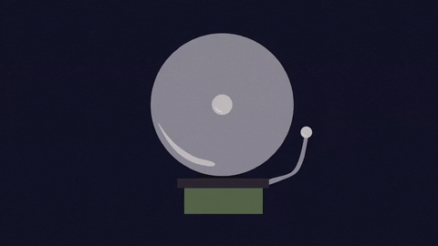

Case 3: Pediatrics
88
83
d.40
68
Dementia dx 80
MI
48
50
45
40s
d.33
Thyroid
Syncopal episodes
Thought to be stress related
?MI or seizure
6
15
13
2
2
4
Carlos
Syncope during hockey match
SIDS,
11 years ago

Slide 39

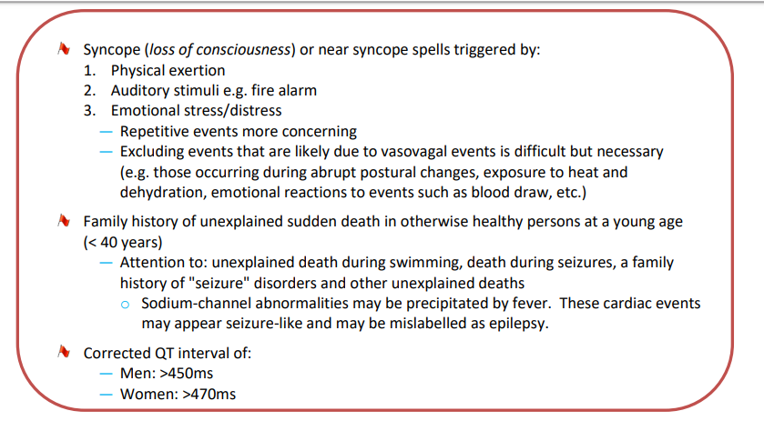
Long QT syndrome
It occurs in approximately 1 in 2,000 to 1 in 2,500 people
Most forms of long QT syndrome (LQTS) are hereditary
LQTS is usually autosomal dominant
At least 15 genes have been implicated
(panels may include 4 – 15 genes)
~ 20% of families with a clinically firm diagnosis of LQTS do not have a detectable pathogenic variant.
Family history guides screening.
Geneticseducation.ca > Point of Care tools > Cardiogenetics

Slide 40
Long QT syndrome
QTc>500 is highly suspicious for LQTS and high risk for torsades de pointes
 | Corrected QT interval cut-off (in ms)
Female | >470
Male | >450
Children >12years Female Male | >460 >450
Children <12 years | >450
ECG is neither sensitive nor specific
In 20-40% of individuals the ECG may be inconclusive
~25% of individuals with a known gene mutation will have a normal QTc on baseline ECG (reduced penetrance)
  Prolonged by LVH, ischemia or infarction, electrolyte abnormalities, ketoacidosis, anorexia nervosa, diurnal variation, medications
Treatable if diagnosed

Slide 41



Case 4: Adult
Darlene is a healthy, 45 year old, mother of two.
She expresses relief about recent direct-to-consumer genetic test results because -
she does not have the breast cancer gene.
Mygenecounsel.com

Slide 42
Key family history questions for adult patients
Do any of the following criteria apply to your patient or their family members? | Yes | No
1. History of a physical difference present at birth (e.g. cleft lip)
2. Death before age 50
3. Cancer diagnosis before age 50
4. Early heart disease (<55y men, <65y women)
5. Inherited condition
A ‘Yes’ response to any question above should prompt a more targeted family history, including additional relatives, details about the diagnosis including age of diagnosis. Referral to appropriate specialist may be considered.
X
X
X
X
X

Slide 43
Case 4: Adult
d.60s
d.90s
d.82
d.75
BrCA dx. 60s
95
d.82
74
d.78
d.90
d.85
BrCA dx. 44
BrCA dx. 62
45
3

Slide 44
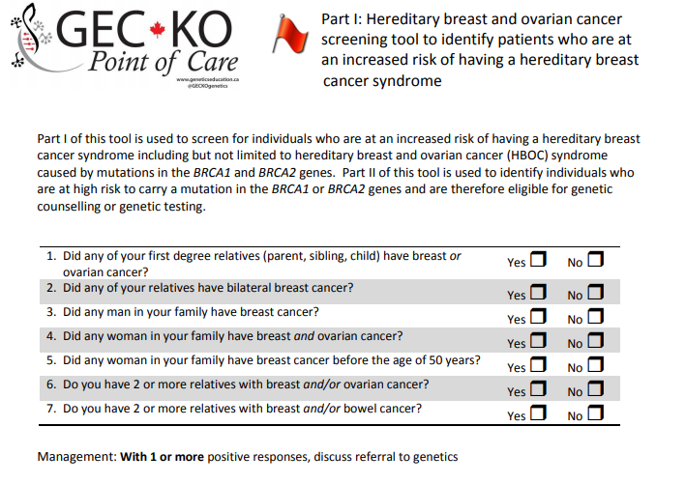

Assessing hereditary breast and ovarian cancer
X
X
X
X
X
Consider referral to Genetics
X
X
Geneticseducation.ca > Point of care tools > Cancer genomics

Slide 45

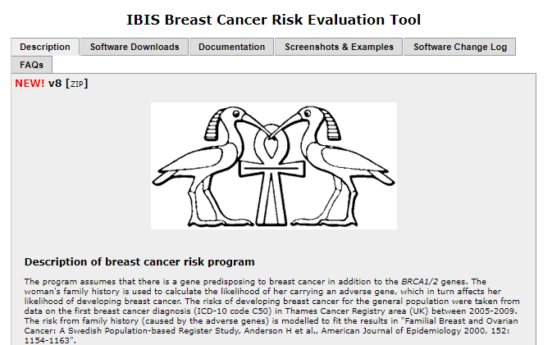
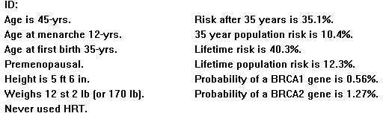

She does not meet criteria for BRCA testing (<10% chance).
The best person to offer genetic testing to is the youngest, affected individual. Another family member may be offered genetic testing.
CA risk up to age 80y
Her lifetime cancer risk is elevated (>25% using IBIS).
She does qualify for high risk cancer screening (MRI) based on family history alone.
One or more moderate risk genes could be responsible for this family’s breast cancer.
Notes:
IBIS: The Tyrer-Cuzick model is a breast cancer risk assessment tool incorporating
family history,
endogenous hormonal factors,
benign disease,
risk factors such as age and body mass index,
genetic factors (including BRCA) into a single statistical model.
The Tyrer-Cuzick model has been shown in independent studies to be the most consistently accurate when compared with other available risk assessment models. The model has been incorporated into a computer programme, the IBIS software that gives a personalised risk estimate. IBIS is available for non-exclusive licensing for stand-alone use or for incorporation into broader software platforms.

Slide 46
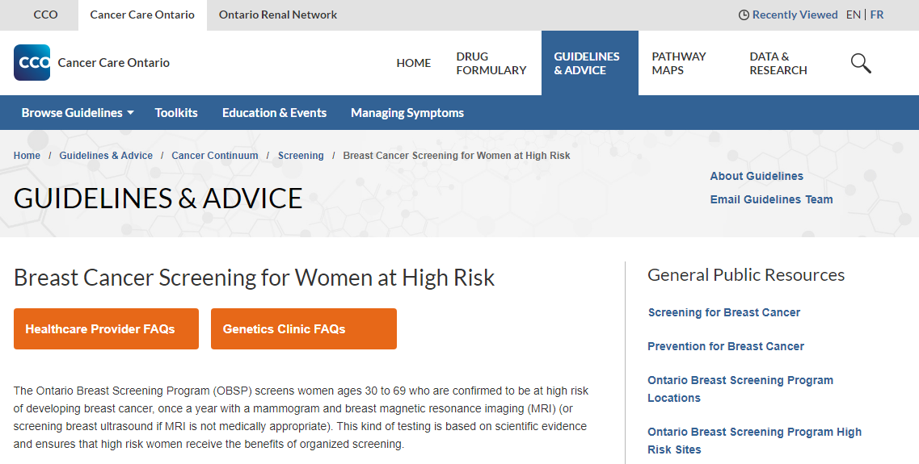
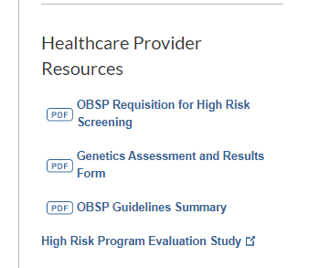

Slide 47
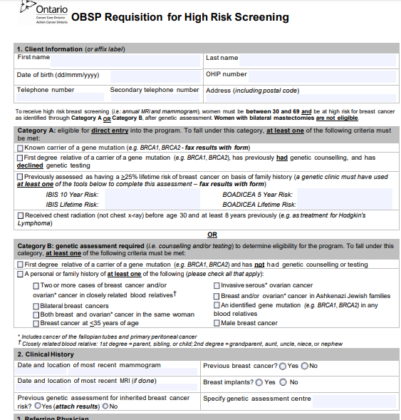
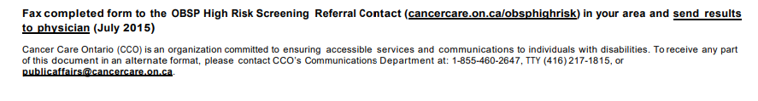
X
X

Slide 48
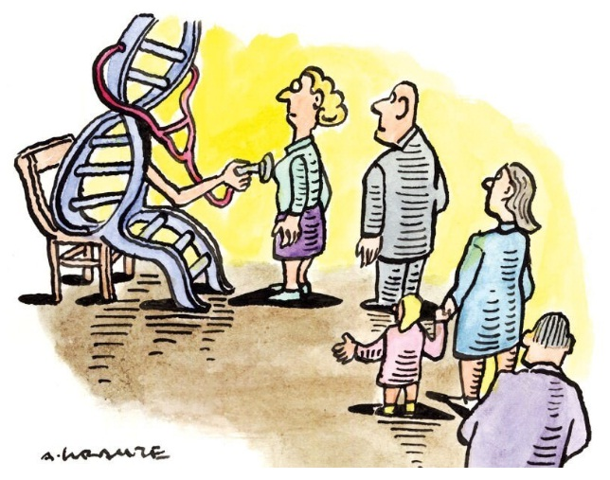
All cancer is genetic, only 5-10% is hereditary
Hereditary breast and ovarian cancer
Notes:
https://geneticliteracyproject.org/glps-aggregation-of-articles-and-use-of-images-under-the-fair-use-copyright-exception/
https://geneticliteracyproject.org/2019/07/26/knowledge-without-context-why-consumer-genetic-tests-can-spark-needless-fears-behavioral-changes/#.WPdeNczVIaI.twitter

Slide 49


Direct-to-consumer genetic testing for hereditary breast and ovarian cancer
Generally limited only to the highly penetrant BRCA1 and BRCA2 genes and the three common BRCA mutations found in Ashkenazi Jewish individuals
Negative result does not eliminate family history associated risk
There are other:
BRCA gene mutations
high risk breast cancer syndromes (e.g. Cowden syndrome)
moderate risk breast cancer genes (e.g. ATM, CHEK2)
Positive result should be confirmed in a clinical laboratory
Notes:
https://geneticliteracyproject.org/glps-aggregation-of-articles-and-use-of-images-under-the-fair-use-copyright-exception/
https://geneticliteracyproject.org/2019/07/26/knowledge-without-context-why-consumer-genetic-tests-can-spark-needless-fears-behavioral-changes/#.WPdeNczVIaI.twitter

Slide 50

Why family history matters?
Family history is the gold standard to assess the likelihood of a genetic condition and to identify individuals who may benefit from referral to a specialist.
Family history can affect testing, surveillance and management recommendations.
One thorough family history, with regular, targeted updates can help to identify red flags, facilitating personalized risk assessment, appropriate referral and intervention.

Slide 51
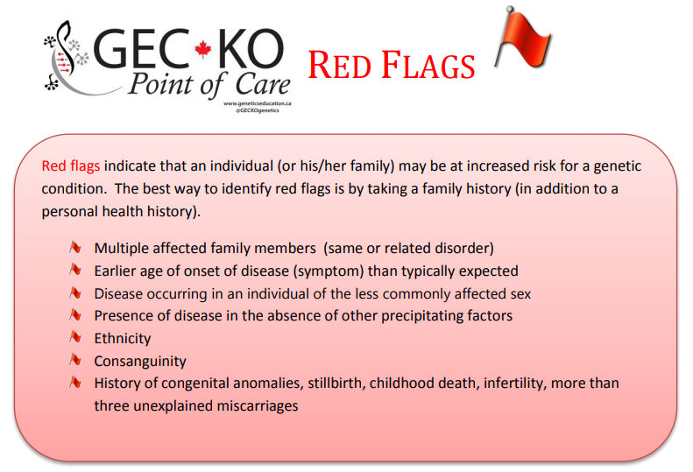
Geneticseducation.ca > Point of Care tools > Family history > Red Flags

Slide 52
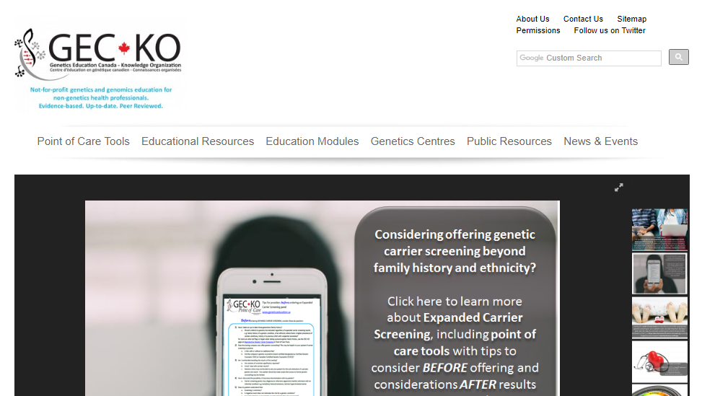
Where do I find more information?
www.geneticseducation.ca
Notes:
say the requisitions etc are there

Slide 53

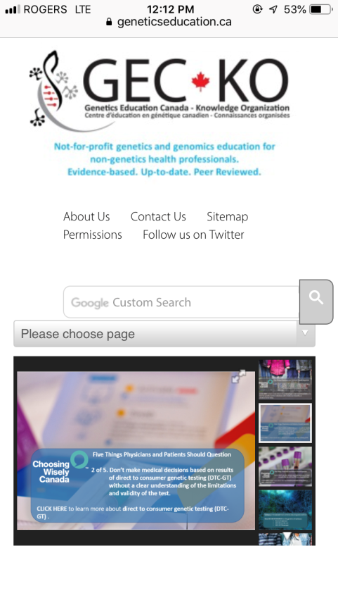

Slide 54
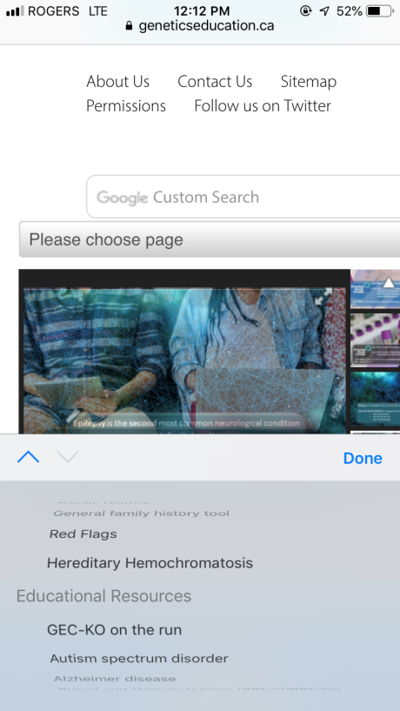

Slide 55
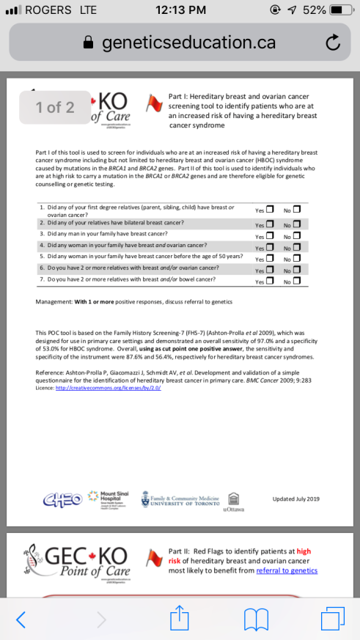

Slide 56
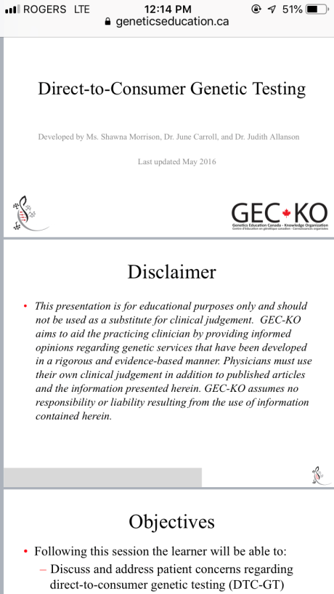

Slide 57
Geneticseducation.ca

Slide 58
Family history tool resources
Your local genetics centre:
  https://geneticseducation.ca/genetics-centres/canada/canadian_clinics/
General - For patients to complete:
  Validated, primary care family history tool: Emery JD, Reid G, Prevost AT, Ravine D, Walter FM. Development and validation of a family history screening questionnaire in Australian primary care. Ann Fam Med. 2014;12(3):241–249. doi:10.1370/afm.1617 https://www.ncbi.nlm.nih.gov/pmc/articles/PMC4018372/
  A family health history tool for patients. This tool helps you create personalized booklets to start conversations about health in one’s family and community by the Genetic Alliance http://www.familyhealthhistory.org/
  My Family Health Portrait by the US Surgeon General https://phgkb.cdc.gov/FHH/html/index.html

Slide 59
Family history tool resources
Preconception/Prenatal:
  Family health history form https://www.marchofdimes.org/pregnancy/your-family-health-history.aspx
  GEC-KO Reproductive genetic carrier screening Canada (For providers) https://geneticseducation.ca/point-of-care-tools-2/reproductive-genetic-carrier-screening-in-canada/
Cardiogenomics
  GEC-KO point of care tools for Cardiogenomics https://geneticseducation.ca/point-of-care-tools-2/hypertrophic-cardiomyopathy-tool/
  Canadian Sudden Arrhythmia Death Syndromes (SADS) Foundation www.sads.ca
Familial hypercholesterolemia
  GEC-KO point of care tool https://geneticseducation.ca/point-of-care-tools-2/familial-hypercholesterolemia/
  FH Canada www.fhcanada.net
  The FH Foundation www.thefhfoundation.org

Slide 60
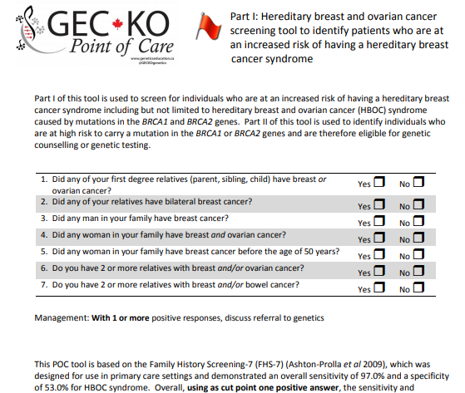
Hereditary breast and ovarian cancer family history resources
GEC-KO
https://geneticseducation.ca/point-of-care-tools-2/hereditary-cancer-tools/
Ontario Family History Assessment Tool: Gilpin CA, Carson N, Hunter AG. A preliminary validation of a family history assessment form to select women at risk for breast or ovarian cancer for referral to a genetics center. Clin Genet. 2000;58(4):299–308. [PubMed]
Referral Screening Tool: Bellcross CA, Lemke AA, Pape LS, et al. Evaluation of a breast/ovarian cancer genetics referral screening tool in a mammography population. Genet Med. 2009;11(11):783–9.
Family History Screening – 7: Ashton-Prolla P, Giacomazzi J, Schmidt AV, et al. Development and validation of a simple questionnaire for the identification of hereditary breast cancer in primary care. BMC Cancer. 2009;9:283. [PubMed]

Slide 61
Assessing hereditary breast and ovarian cancer
Risk assessment tool | Performance characteristics for predicting risk for BRCA mutations
Ontario Family History Assessment Tool (FHAT) | Sensitivity 91%–94%; specificity 15%–51%; PPV 31%
Manchester Scoring System | Sensitivity 58%–93%; specificity 33%–71%
Referral Screening Tool (RST) | Sensitivity 81%; specificity 92%; PPV 0.80
Pedigree Assessment Tool (PAT) | Sensitivity 100%; specificity 93%; PPV 0.63
FHS-7 | Sensitivity 88%; specificity 56%; PPV 0.63
Adapted from: Risk Assessment, Genetic Counseling, and Genetic Testing for BRCA-Related Cancer: Systematic Review to Update the U.S. Preventive Services Task Force Recommendation [Internet].
Notes:
CITATION:
Nelson HD, Fu R, Goddard K, et al. Risk Assessment, Genetic Counseling, and Genetic Testing for BRCA-Related Cancer: Systematic Review to Update the U.S. Preventive Services Task Force Recommendation [Internet]. Rockville (MD): Agency for Healthcare Research and Quality (US); 2013 Dec. (Evidence Syntheses, No. 101.) Table 4, Familial Risk Stratification Models to Predict Individual Risk for Deleterious BRCA Mutations in Primary Care Settings.Available from: https://www.ncbi.nlm.nih.gov/books/NBK179205/table/ch3.t2/
https://www.ncbi.nlm.nih.gov/books/NBK179205/table/ch3.t2/

