Slide 1
Disclaimer
This presentation is for educational purposes only and should not be used as a substitute for clinical judgement. GEC-KO aims to aid the practicing clinician by providing informed opinions regarding genetic services that have been developed in a rigorous and evidence-based manner. Physicians must use their own clinical judgement in addition to published articles and the information presented herein. GEC-KO assumes no responsibility or liability resulting from the use of information contained herein.

Slide 2

Familial Cancer: When does it matter and when to act
Developed by Shawna Morrison MS CGC, June Carroll MD CCFP FCFP, Judith Allanson MB FRCPC FRCP (2020)
Notes:
This webinar will use a primary care case-based approach to explore the two hereditary cancer syndromes, BRCA1 and BRCA2 Hereditary Breast and Ovarian Cancer syndrome and Lynch syndrome. Cases will highlight red flags in personal and/or family history that indicate increased risk for these genetic conditions. We will demonstrate why identifying and acting on these red flags may be important to patients or change patient outcomes. We will discuss the latest advances in genomics and their impact on practice such as panel testing and direct-to-consumer testing. Participants will be introduced to the GEC-KO genomics resource website (www.geneticseducation.ca) and tools to use in practice. Bring your clinical genetics questions!
At the conclusion of this activity, participants will be able to:
• Identify patients whose family history suggests increased risk of a hereditary cancer syndrome
• Tailor screening and management to genetic risk to improve patient outcomes
• Find high quality genomics educational resources appropriate for primary care

Slide 3
Objectives
At the conclusion of this activity, participants will be able to:
Identify patients whose family history suggests increased risk of a hereditary cancer syndrome
Tailor screening and management to genetic risk to improve patient outcomes
Find high quality genomics educational resources appropriate for primary care

Slide 4
While all cancer is genetic (caused by an accumulation of genetic mutations), only 5-10% of breast cancer is hereditary, where an individual is born with an inherited predisposition
Later onset
No obvious pattern of inheritance
No obvious cluster of cancer types
80%
2
Breast CA age 80
Colon CA age 75

Slide 5
While all cancer is genetic (caused by an accumulation of genetic mutations), only 5-10% of breast cancer is hereditary, where an individual is born with an inherited predisposition
Earlier age of onset
Cancer occurring more frequently than statistically expected
Shared genetics (moderate risk genes) and environment
10-15%
2
Breast CA age 65
Breast CA age 80
Breast CA age 55

Slide 6
While all cancer is genetic (caused by an accumulation of genetic mutations), only 5-10% of breast cancer is hereditary, where an individual is born with an inherited predisposition
Inherited single gene mutations associated with high lifetime cancer risk
Younger age of onset
Clustering of related cancers
Autosomal dominant inheritance pattern (usually)
5-10%
2
Breast CA age 49
Prostate CA d.50y
Breast CA age 33
Ovarian CA d.40y
Breast CA age 40
Ovarian CA 43y
Example of a hereditary breast and ovarian cancer syndrome family, BRCA1 or BRCA2
Notes:
BRCA1/2

Slide 7





Identifying hereditary cancer families
Take a family history, ideally asking about three generations
There are multiple family members with cancer
Two or more generations are affected (demonstrating an autosomal dominant pattern – typical of most hereditary cancer syndromes)
At least one cancer diagnosis occurring at a younger than expected age
Cancers occur on the same side of family
Clustering of certain types of cancers is present
Multiple primary cancers diagnosed in same individual
Geneticseducation.ca > Point of Care Tools > Cancer genomics

Slide 8



Case example
45 year old mother of two
She mentions her relief because recently she found out from her direct-to-consumer test results that
She does not carry the ‘breast cancer gene’

Slide 9
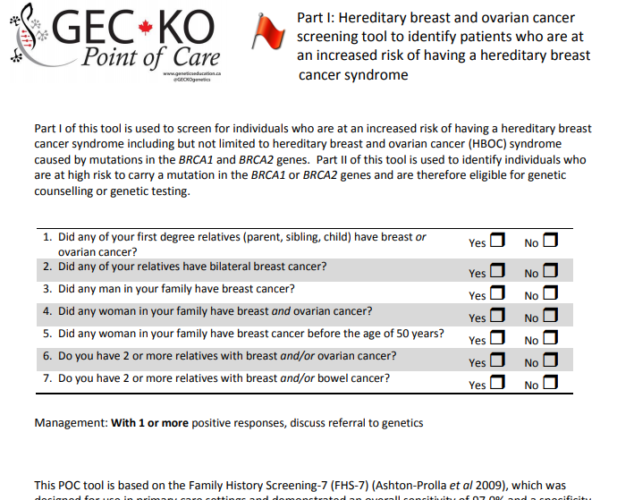

How can I identify a high risk breast cancer family?
Geneticseducation.ca > Point of care tools > Cancer genomics
Notes:
This POC tool is based on the Family History Screening-7 (FHS-7) (Ashton-Prolla et al 2009), which was designed for use in primary care settings and demonstrated an overall sensitivity of 97.0% and a specificity of 53.0% for HBOC syndrome. Overall, using as cut point one positive answer, the sensitivity and specificity of the instrument were 87.6% and 56.4%, respectively for hereditary breast cancer syndromes.

Slide 10
POLL
What might be your next step:
send an eConsult or call your local genetics expert
refer to your local genetics centre
take a targeted family history
any of the above

Slide 11

d.60s
d.90s
d.82
d.75
BrCA dx. 60s
95
d.82
74
d.78
d.90
d.85
BrCA dx. 44
BrCA dx. 62
45
2

Slide 12


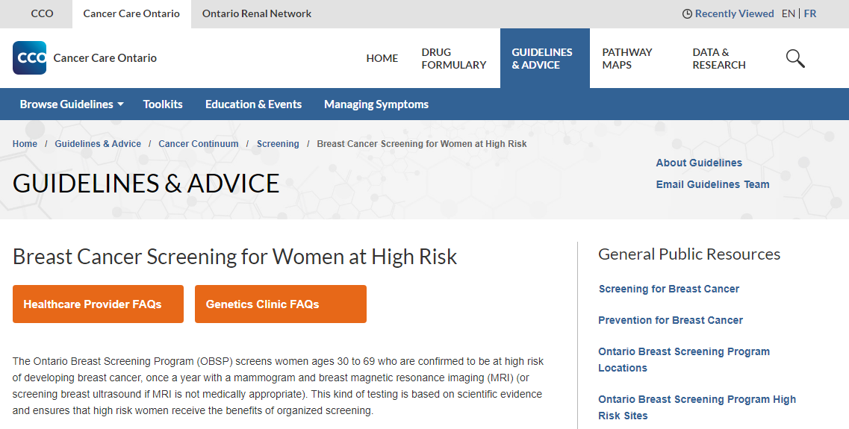
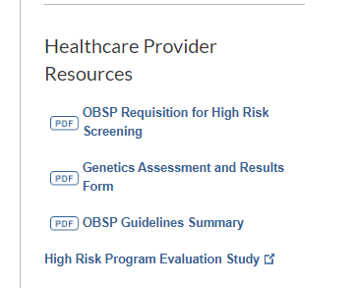

Slide 13
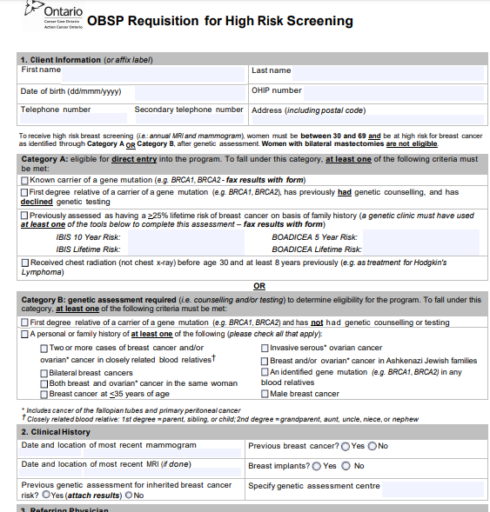
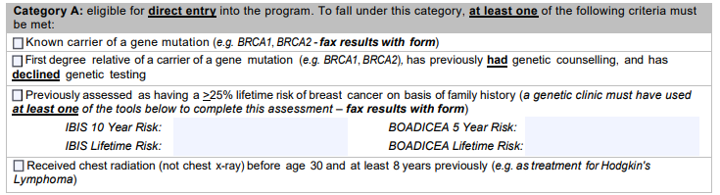

Slide 14
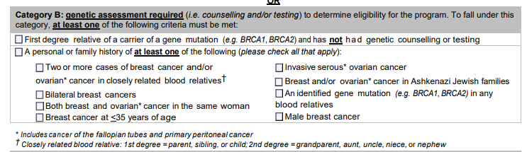
Between ages 30-69

Slide 15
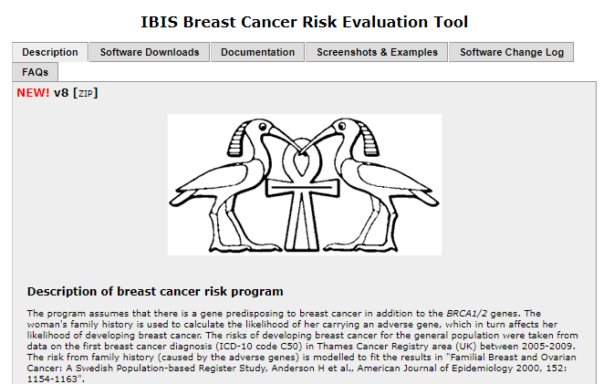


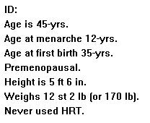
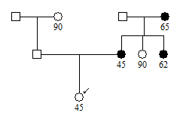
She would not meet criteria to be offered BRCA testing (<10% chance to carry a mutation in BRCA1 and BRCA2)
The best person to offer genetic testing to is the youngest, affected individual. Another family member (e.g. her mother) may be offered genetic testing
While not very suspicious of a high risk hereditary cancer predisposition syndrome, one or more moderate risk genes could be responsible for this family’s breast cancer

Slide 16

Her risk of developing breast cancer up to age 80 versus a 45 year old woman at population risk
Her lifetime breast cancer risk is elevated
(>25% using IBIS)
She does qualify for high risk cancer screening (MRI) based on risk assessment

Slide 17
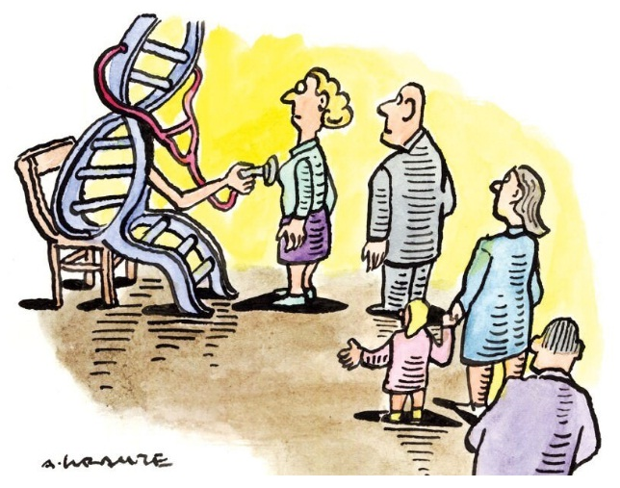
Direct-to-consumer genetic testing and hereditary breast cancer
Notes:
https://geneticliteracyproject.org/glps-aggregation-of-articles-and-use-of-images-under-the-fair-use-copyright-exception/
https://geneticliteracyproject.org/2019/07/26/knowledge-without-context-why-consumer-genetic-tests-can-spark-needless-fears-behavioral-changes/#.WPdeNczVIaI.twitter

Slide 18
While all cancer is genetic (caused by an accumulation of genetic mutations), only 5-10% of breast cancer is hereditary, where an individual is born with an inherited predisposition
Notes:
https://geneticliteracyproject.org/glps-aggregation-of-articles-and-use-of-images-under-the-fair-use-copyright-exception/
https://geneticliteracyproject.org/2019/07/26/knowledge-without-context-why-consumer-genetic-tests-can-spark-needless-fears-behavioral-changes/#.WPdeNczVIaI.twitter

Slide 19



Direct-to-consumer genetic testing for hereditary breast cancer
Generally limited only to the highly penetrant BRCA1 and BRCA2 genes and the three common BRCA mutations found in Ashkenazi Jewish individuals
Negative result does not eliminate family history associated risk
There are other:
BRCA gene mutations
high risk breast cancer syndromes (e.g. Cowden syndrome)
moderate risk breast cancer genes (e.g. ATM, CHEK2)
Positive result should be confirmed in a clinical laboratory
Notes:
https://geneticliteracyproject.org/glps-aggregation-of-articles-and-use-of-images-under-the-fair-use-copyright-exception/
https://geneticliteracyproject.org/2019/07/26/knowledge-without-context-why-consumer-genetic-tests-can-spark-needless-fears-behavioral-changes/#.WPdeNczVIaI.twitter

Slide 20

Case example continued
Your patient’s mother had genetic testing
Cheo.on.ca > Clinics, Services & Programs > Genetics Clinic > Hereditary Cancer Clinic
Geneticseducation.ca > Genetics Centres
Her mother was found to carry a pathogenic variant in the BRCA2 gene

Slide 21
POLL
Your patient’s chance to carry the same gene mutation is:
25%
50%
Not possible to know
0%, she already had genetic testing

Slide 22
Case example continued
Your patient’s chance to carry the same BRCA2 gene mutation is 50%
She must now decide whether or not to have genetic testing
What would this mean for my insurance?
How can genetic testing help me?
Can I still have high risk screening without having genetic testing?
I don’t have daughters, so it doesn’t really matter.

Slide 23

Genetic testing for a known familial mutation will either be:
Positive
The individual does carry the familial gene change
Negative
The individual does not carry the familial gene change

Slide 24

Positive for a BRCA gene mutation means…
An increased lifetime risk to develop cancer
*
increased
2-6x increase
Increased (but not quantified) risk for melanoma, pancreatic and gallbladder/bile duct cancers
* Increased risk for contralateral breast cancer
83% BRCA1 and 62% BRCA2

Slide 25
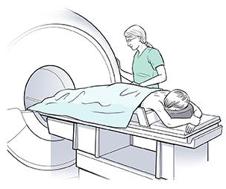

Positive for a BRCA gene mutation means…
Enhanced screening and management options are available to improve outcomes
    Yearly breast MRI, in addition to mammography, for women age 30-69
    If your patient declines genetic testing following genetic counselling, she would still qualify for high risk breast cancer screening
Notes:
With a history of a breast cancer diagnosis prior to age 30, individualize family screening may be recommended
Mammography is less sensitive for women with deleterious genetic mutations (e.g., BRCA1, BRCA2, TP53, PTEN, CDH1) due to the faster growth of cancer among these women
Magnetic resonance imaging (MRI) technology addresses some of the screening limitations of mammography for women at high risk. When used in combination, mammography and MRI find more cancers in women at high risk for breast cancer than using mammography or MRI alone.

Slide 26

Positive for a BRCA gene mutation means…
Enhanced screening and management options are available to improve outcomes
Ovarian cancer screening is not routinely recommended
The available screening methods have not been proven to reliably detect ovarian cancer at an early stage
All women should be aware of the symptoms of ovarian cancer
May benefit from the use of an oral contraceptive to reduce the risk of ovarian cancer
Notes:
About a 50% risk reduction of OvCA risk with oral contraceptives
ovariancanada.org
Common symptoms include:
Bloating - increased abdominal size/persistent bloating
Eating - difficulty eating or feeling full quickly
Pain - in pelvic or abdominal areas
Urinary symptoms - urgency or frequency
Occasionally there can be other symptoms such as changes in bowel habits, extreme fatigue or unexplained weight loss.
Medical attention if the symptoms are:
New – they are not normal for you and may have started in the last year
Persistent – they have been present for more than 3 weeks
Frequent – you notice the symptoms happen frequently

Slide 27

Positive for a BRCA gene mutation means…
Enhanced screening and management options are available to improve outcomes
Ovarian cancer screening is not routinely recommended
The available screening methods have not been proven to reliably detect ovarian cancer at an early stage
All women should be aware of the symptoms of ovarian cancer
May benefit from the use of an oral contraceptive to reduce the risk of ovarian cancer
Breast self-exams and annual clinical breast exam from age 35
Prostate cancer screening with PSA and/or digital rectal exam by a physician at age 40-50 for BRCA2 carriers (consider for BRCA1 carriers)

Slide 28

Positive for a BRCA gene mutation means…
Enhanced screening and management options are available to improve outcomes
      Chemoprevention e.g. with Selective Estrogen Receptor Modulators (SERMs) like Tamoxifen
    Tamoxifen has been shown to provide a 62% reduction in breast cancer risk in healthy BRCA2 mutation carriers (not the same results for BRCA1 mutation carriers)
    Tamoxifen has been shown to provide a 45-65% reduction in contralateral breast cancer in BRCA1/2 mutation carriers
Notes:
Screening etc in addition to healthy lifestyle
Chemoprevention: Selective estrogen receptor modulators (SERMs) e.g. Tamoxifen
~50% reduction in recurrence risk of breast cancer
~60% reduction in breast cancer risk in healthy BRCA2 carriers

Slide 29

Positive for a BRCA gene mutation means…
Enhanced screening and management options are available to improve outcomes
      Risk-reducing surgery
      Bilateral total mastectomy can reduce breast cancer risk by at least 90%
      Bilateral salpingo-oophorectomy can reduce ovarian and fallopian tube cancer risk by 80%
      Can also add to breast cancer risk reduction, if performed before age 40
Notes:
RRSPO before age 35-40 for BRCA1 mutation carriers
age 40-45 for BRCA2 mutation carriers as OvCA risk is later, maybe earlier – famhx dependent

Slide 30





Positive for a BRCA gene mutation means…
Genetic testing for at risk family members
Matthew Knowles
BRCA2 mutation carrier
50%
25%
25%

Slide 31


Negative for a familial BRCA gene mutation means…
Population risk and screening recommendations

Slide 32


On May 4, 2017 the Genetic Non-Discrimination Act (GNA) was passed into law in Canada
GNA was created to remove barriers to the appropriate use of genetic services by the public
GNA protects individuals from discrimination based on genetic test results in areas such as insurance and employment governed by federal regulations
Recently challenged and upheld and Quebec (2020)

Slide 33


A thorough family history, with regular, targeted updates can help to identify red flags, facilitating personalized risk assessment, appropriate referral and intervention
Most cancer is not due to an inherited predisposition
Hereditary cancer red flags may be:
relatives affected by related cancers
successive generations affected
relative was diagnosed before age 50
Screening and surveillance recommendations may be modified based on family history alone
Use eConsult or call your local genetics specialist for questions about referrals and more

Slide 34
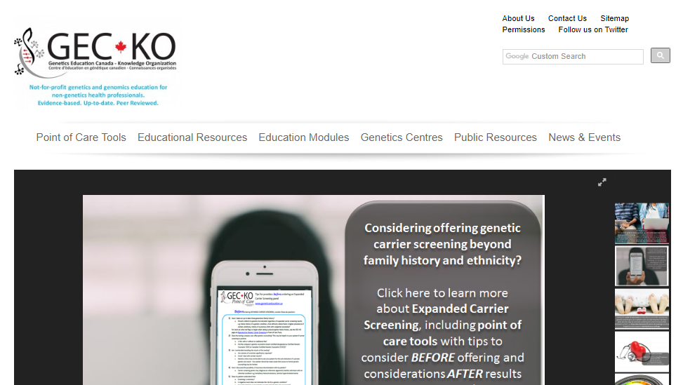
Where do I find more information?
www.geneticseducation.ca
Notes:
say the requisitions etc are there

Slide 35

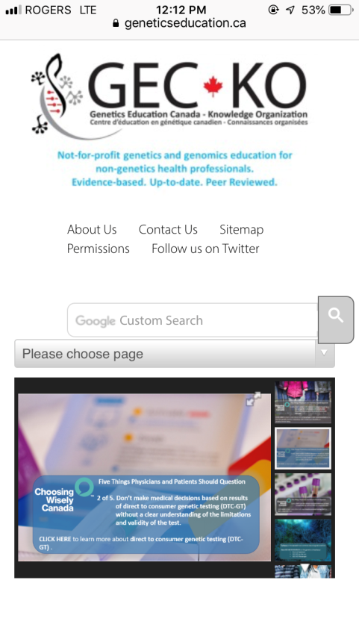

Slide 36

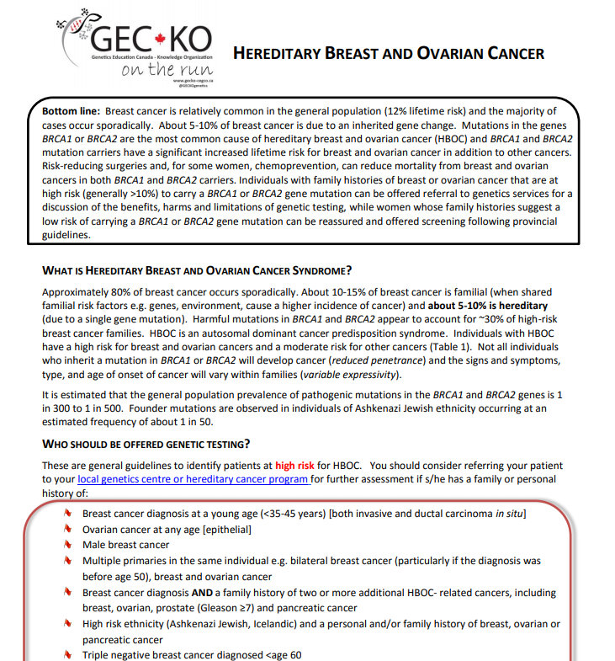
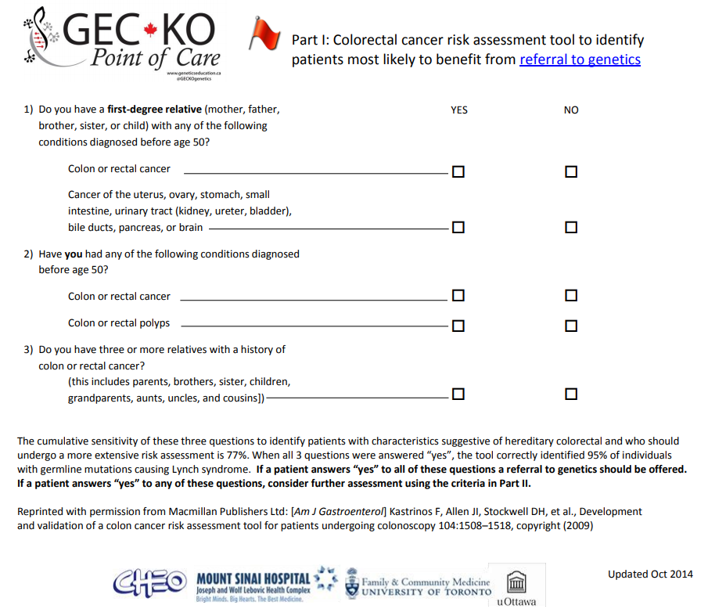
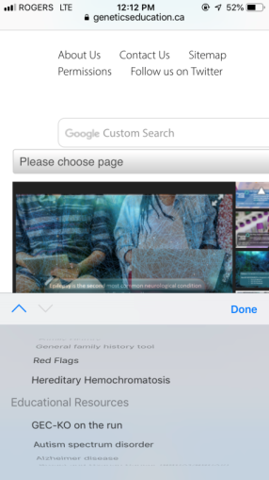

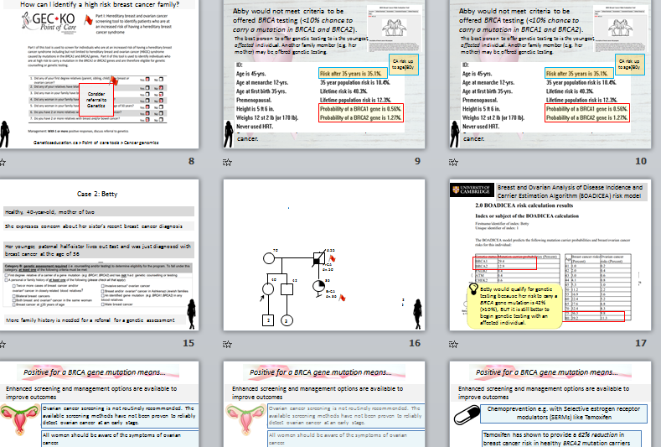
Resources www.geneticseducation.ca
Educational resources > GEC-KO on the run >
Point of care tools > Cancer genomics
PowerPoint Seminars >

Slide 37

Resources www.champlainbaseeconsult.com
eConsult > reach local genetic and other specialists with your clinical questions

Slide 38

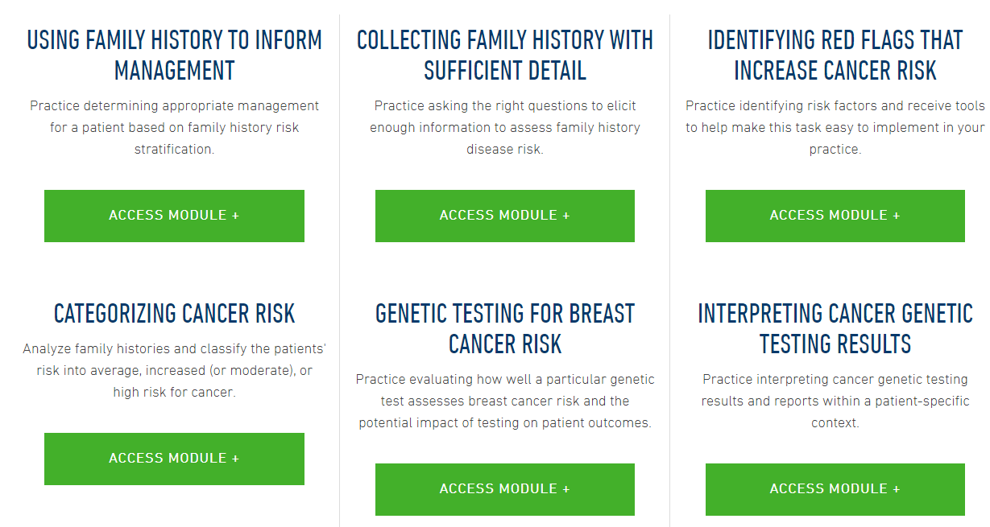
Resources www.jax.org
Education and Learning > Clinicians > Cancer Genetic Clinical Education

Slide 39
Resources Provincial resources
Cancer Care Ontario (CCO). https://www.cancercare.on.ca/
ColonCancerCheck: (CCC) http://www.health.gov.on.ca/en/pro/programs/coloncancercheck/

Slide 40

Resources Guidelines
Canadian Task Force on Preventative Health Care https://canadiantaskforce.ca/
NCCN Clinical Practice Guidelines in Oncology (NCCN Guidelines®) www.nccn.org

Slide 41

Resources Risk assessment tools
Ontario Family History Assessment Tool: Gilpin CA, Carson N, Hunter AG. A preliminary validation of a family history assessment form to select women at risk for breast or ovarian cancer for referral to a genetics center. Clin Genet. 2000;58(4):299–308. [PubMed]
Referral Screening Tool: Bellcross CA, Lemke AA, Pape LS, et al. Evaluation of a breast/ovarian cancer genetics referral screening tool in a mammography population. Genet Med. 2009;11(11):783–9.
Family History Screening – 7: Ashton-Prolla P, Giacomazzi J, Schmidt AV, et al. Development and validation of a simple questionnaire for the identification of hereditary breast cancer in primary care. BMC Cancer. 2009;9:283. [PubMed]
The PREMM₅ model is a clinical prediction algorithm that estimates the cumulative probability of an individual carrying a germline mutation in the MLH1, MSH2, MSH6, PMS2, or EPCAM genes. Mutations in these genes cause Lynch syndrome.
Cleveland Clinic PTEN Risk Calculator https://www.lerner.ccf.org/gmi/ccscore/

