Slide 1
Disclaimer
This presentation is for educational purposes only and should not be used as a substitute for clinical judgement. GEC-KO aims to aid the practicing clinician by providing informed opinions regarding genetic services that have been developed in a rigorous and evidence-based manner. Physicians must use their own clinical judgement in addition to published articles and the information presented herein. GEC-KO assumes no responsibility or liability resulting from the use of information contained herein.

Slide 2
Case 5: Adult (Evan)

Slide 3
Case 5: Adult
Evan, 35yo male with LDL-C 6.9mmol/L
Evan, 40yo male with LDL-C 6.9mmol/L
Prescribed a statin
Prescribed a statin
Follow up LDL-C 7.2mmol/L
Follow up LDL-C 7.2mmol/L
Patient admits being non-compliant, wishes to treat hyperlipidemia with natural, lifestyle changes e.g. plant-based diet, exercise
Explore the family history

Slide 4
Key family history questions for adult patients
Do any of the following criteria apply to your patient or their family members? | Yes | No
1. History of a physical difference present at birth (e.g. cleft lip)
2. Death before age 50
3. Cancer diagnosis before age 50
4. Early heart disease (<55y men, <65y women)
5. Inherited condition
A ‘Yes’ response to any question above should prompt a more targeted family history, including additional relatives, details about the diagnosis including age of diagnosis. Referral to appropriate specialist may be considered.
X
X
X
X
X

Slide 5
Case 5: Adult
d.65
74
HTN
IDDM
MI @40y
CoD:MI
40
42
d.50
Evan
MI
hyperlipidemia
3
2

Slide 6
Case 5: Adult
92
dementia
stroke @60s
d.65
74
75
HTN
IDDM
MI @60s
MI @40y
CoD:MI
55
40
42
d.50
2
MI @50s
Evan
MI
hyperlipidemia
3
2

Slide 7
Familial hypercholesterolemia
About 1 in 250 Canadians is thought to be affected, but it is significantly underdiagnosed
Autosomal dominant disorder resulting in 20x increased risk of cardiovascular disease (CVD) and death
Increased risk for atherosclerotic disease (e.g. stroke, peripheral vascular disease)
Early diagnosis and treatment (statin+) can normalize life expectancy
Cascade screening of family members allows for early identification and treatment of at-risk individuals

Slide 8
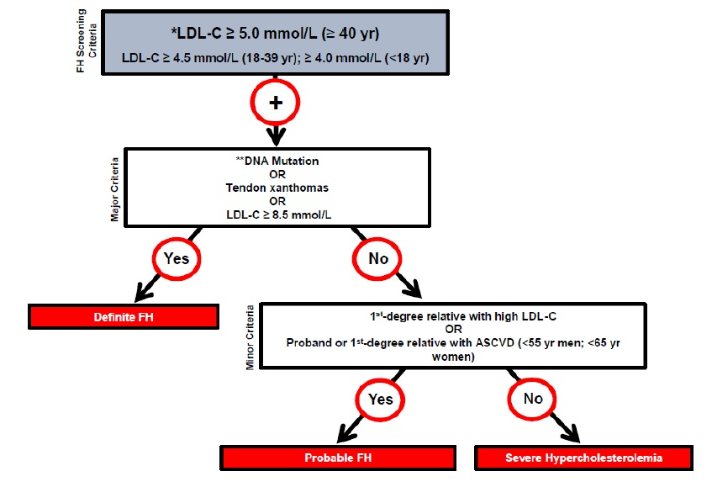
Familial hypercholesterolemia
Canadian criteria for the clinical diagnosis of FH.
Ruel 2018 Can J Cardiol. Reprinted with permission under the CC BY-NC-ND license
Find on www.FHCanada.net
ASCVD: atherosclerotic cardiovascular disease
Consider referral to lipid specialist
Notes:
ASCVD: atherosclerotic cardiovascular disease; LDL-C: low-density lipoprotein cholesterol. * Secondary causes of high LDL-C should be ruled out (severe or untreated hypothyroidism, nephrotic syndrome, hepatic disease [biliary cirrhosis], medication, especially antiretroviral agents) ** Causal DNA mutation refers to the presence of a known FH-causing variant in the LDLR, APOB, or PCSK9 gene in the individual or a first-degree relative. FH diagnosis in a patient with a DNA mutation but normal LDL-C levels is unclear. Yearly follow-up of the individual is suggested and cascade screening of family members should be initiated.

