Slide 1
Disclaimer
This presentation is for educational purposes only and should not be used as a substitute for clinical judgement. GEC-KO aims to aid the practicing clinician by providing informed opinions regarding genetic services that have been developed in a rigorous and evidence-based manner. Physicians must use their own clinical judgement in addition to published articles and the information presented herein. GEC-KO assumes no responsibility or liability resulting from the use of information contained herein.

Slide 2
Cardiogenomics: genetics and the heart
Developed by Ms. Shawna Morrison, Dr. Judith Allanson and Dr. June Carroll with help from Mrs. Julie Rutberg (2020)
Notes:
Image: https://chicagogenetics.com/cardiogenetics/

Slide 3
Objectives
Identify who and when to refer
Describe screening for genetic cardiac diseases

Slide 4
Cardiac Diseases with a Heritable Component
Familial Aneurysms (Thoracic)
Coronary Artery Disease
Congenital Heart Disease
Familial hypercholesterolemia and dyslipidemias
Isolated or syndromic
Muscular Dystrophy (MD) and Cardiomyopathy
Cardiomyopathies
Duchenne and Becker MD
Hypertrophic Cardiomyopathy
Carriers of Duchenne and Becker MD
Dilated Cardiomyopathy
Myotonic Dystrophy
Cardiac Amyloidosis
Limb-Girdle Muscular Dystrophy
Arrhythmogenic Right Ventricular Dysplasia (ARVC)
Arrhythmia Syndromes
Thrombophilia
Atrial Fibrillation
Factor V Leiden deficiency
Long QT Syndrome
Valvular Disease
von Willebrand disease

Slide 5
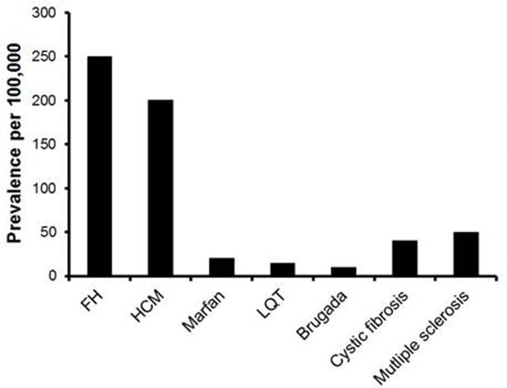
Cardiac Diseases with a Heritable Component
Slide by Euan Ashley, MD
Stanford Center for Inherited Cardiovascular Disease

Slide 6
Common cardiac presentations and family histories to be aware of:
Sudden death < 40 years, including SIDS
Inherited arrhythmia or cardiomyopathy

Slide 7
Common cardiac presentations and family histories to be aware of:
Sudden death < 40 years, including SIDS
Syncope or pre-syncope with exercise, intense emotional, stressful, or startling events
Inherited arrhythmia e.g. catecholaminergic polymorphic ventricular tachycardia (CPVT)

Slide 8
Common cardiac presentations and family histories to be aware of:
Sudden death < 40 years, including SIDS
Syncope or pre-syncope with exercise, intense emotional, stressful, or startling events
Seizures/Drowning/Unexplained single MVA
Long QT syndrome or another channelopathy e.g. Brugada syndrome

Slide 9
Common cardiac presentations and family histories to be aware of:
Sudden death < 40 years, including SIDS
Syncope or pre-syncope with exercise, intense emotional, stressful, or startling events
Seizures/Drowning/Unexplained single MVA
Cardiac Device (ICD, pacemaker) at young age
Cardiomyopathy

Slide 10
Common cardiac presentations and family histories to be aware of:
Sudden death < 40 years, including SIDS
Syncope or pre-syncope with exercise, intense emotional, stressful, or startling events
Seizures/Drowning/Unexplained single MVA
Familial hypercholesterolemia
Cardiac Device (ICD, pacemaker) at young age
Cardiac disease without usual risk factors

Slide 11
Referral for genetic assessment
Genetic testing
Family history
Individuals with a clinical/ suspected diagnosis
Suspicious family histories with unexpected or unexplained deaths, suspected diagnosis
First-degree relatives of those with a positive genetic test result
Events specifics
Age of individual
Relation to patient
Notes:
Two common misconceptions in sequential screening in families.
worrying about kids or one side of the family only. Often, because people are more worried about their active children, the kids get referred for evaluations before the parents. Also, pts don’t want to burden elderly relatives, but helps id side of family.
not recommending repeat cardiac testing, to look for later onset. Often if normal ECG, pt thinks it means they don’t need further investigations.\
Getting info on relatives evaluated elsewhere always difficult. Don’t assume that the assessment done elsewhere was complete. Ask about evaluation, and if doesn’t make sense, re-educate and re-inforce recommendations.

Slide 12
Case 1
You are seeing 10yo Adam for a complaint of possible growing pains
His mother attends the appointment with him
She reports a new family history of hypertrophic cardiomyopathy (HCM) in Adam’s paternal grandfather and is highly anxious about the implications for Adam

Slide 13
Hypertrophic cardiomyopathy
Onset is variable, from infancy to late adulthood
Prevalence is about 1 in 500 in the general population
Most common presentation is isolated, adult onset, mid-septal hypertrophy
While risk of sudden cardiac death is rare (0.5-1% per year), it can often be the first manifestation of the condition
Mainly autosomal dominant, meaning a 50% risk to first-degree relatives of affected individuals
The principal role of genetic testing is to identify the causative gene in the affected individual and to provide a clinical tool for screening family members at risk of developing the disease
Notes:
Most common is adult onset, mid-septal hypertrophy
Syndrome and metabolic rare
Pathologic hypertrophy is considered in the presence of unexplained wall thickness > 15 mm in any myocardial segment or asymmetric septal hypertrophy with a septal to posterior wall thickness ratio > 1.3 in normotensive individuals or > 1.5 in hypertensive individuals. The use of a wall thickness ratio in those with wall thickness < 15 mm remains controversial in some arenas and is less secure than absolute width. In those with an established diagnosis of HCM in a first-degree family member lower cutoff values might be used; an absolute wall thickness 13 mm is diagnostic of HCM.
The most feared complication of HCM is SCD. Although the incidence of SCD in the entire HCM population is low (0.5 to 1% per year), there is a small subgroup of patients who are at an increased risk (Cooper 2017)
SCD was defined as death from a cardiovascular cause within 12 h of apparent well-being. SCD was the first manifestation of HCM in the majority (78%) of cases, and only 50 (26%) decedents had reported cardiac symptoms prior to death.(Finocchiario 2019)

Slide 14
Hypertrophic cardiomyopathy
Individuals with a positive genetic test are at risk to develop HCM at any point in time (not just adulthood)
They should be followed with regular echocardiographic and ECG surveillance
In individuals at high risk for sudden cardiac death, an implantable cardioverter-defibrillator is indicated
All first-degree relatives of an affected person should have regular cardiac exams, unless they test negative for a known disease-causing familial mutation
Notes:
They should be followed with regular⁺ echocardiographic and ECG surveillance
Knowing the gene mutation does not predict disease course or response to treatment
⁺ For example, surveillance schedule followed by CHEO:
For teenagers and children, every 12-18 months
For adults, every 3-5 years

Slide 15
59
60
61
60
Confirmed HCM diagnosis @60y
For Adam to be at risk, his father would have to be affected.*
Adam’s father is the most appropriate person to refer for expert evaluation.
All HCM surveillance recommendations are for first-degree relatives. There are none for second-degree relatives.
39
42
38
35
8
2
P
Adam

Slide 16
Case 2
Beth, 35yo female, BMI >30
As part of a weight-loss clinic work up LDL-C was found to be 6.9mmol/L
You prescribed a statin
On follow up LDL-C was 7.2mmol/L
Patient admits being non-compliant, wishes to treat hyperlipidemia with natural, lifestyle changes e.g. weight-loss, plant-based diet, exercise
Explore the family history

Slide 17
d.65
74
High BP
IDDM
MI @40y
Cause of death:MI
Statin treated
35
42
51
Beth
MI@50y
Statin treated
hyperlipidemia
3
2

Slide 18
92
dementia
stroke @50s
d.65
74
75
High BP
IDDM
MI @40s
MI @40y
Cause of death: MI
Statin treated
45
35
42
51
2
Statin treated
Beth
MI@50y
Statin treated
hyperlipidemia
3
2

Slide 19
Familial hypercholesterolemia (FH)
About 1 in 250 Canadians is thought to be affected, but it is significantly underdiagnosed (<5%) and the clinical presentation is often an acute coronary syndrome
Autosomal dominant disorder resulting in 20x increased risk of cardiovascular disease (CVD) and death
Increased risk for atherosclerotic disease (e.g. stroke, peripheral vascular disease)
Early diagnosis and treatment (statin+) can normalize life expectancy

Slide 20
Diagnosis
Screening
Genetics
Management
Brunham 2018 Can J Cardiol
Notes:
Recent Canadian Cardiovascular Society Position Statement on Familial Hypercholesterolemia: Update 2018 Canadian Journal of Cardiology 34 (2018) 1553e1563

Slide 21
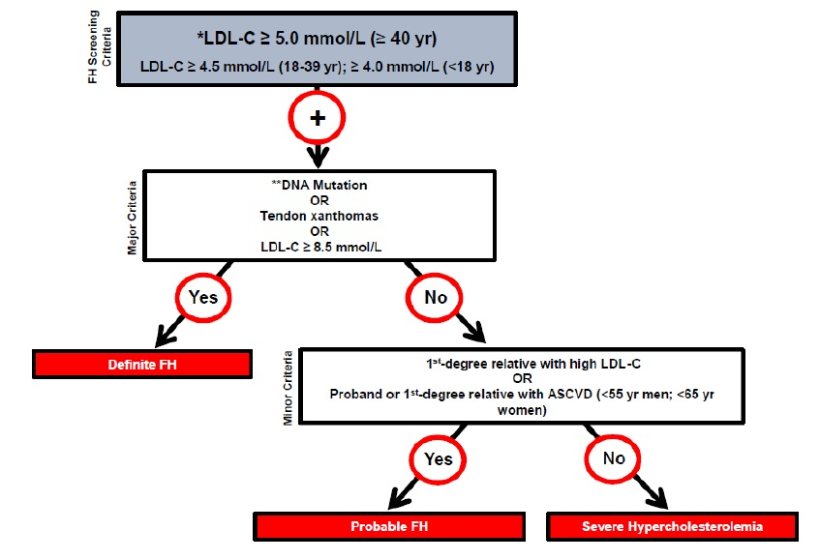
Diagnosis
Screening
Genetics
Management
Consider referral to lipid specialist
ASCVD: atherosclerotic cardiovascular disease
Brunham 2018 Can J Cardiol

Slide 22
Diagnosis
Screening
Genetics
Management
Cascade screening by lipid levels of first-degree relatives of individuals with FH
3
2
Brunham 2018 Can J Cardiol
Notes:
General population screening recommendation is universal screening of lipid levels beginning at 40y for men and 50y for women – or earlier if other ASCVD risk factors are present
There remains controversy as to whether screening in childhood (ie, around age 10 years) for FH should be implemented. This approach would be expected to identify some cases of FH. (Brunham)

Slide 23
Diagnosis
Screening
Genetics
Management
Genetic testing is not clinically available in Canada, except in Quebec
If a mutation is identified, results are useful to complement the clinical diagnosis, cascade testing of family members, and risk stratification
Individuals with FH-causing variants in the LDLR, APOB, or PCSK9 genes are at a 5- to 22-fold increased risk of atherosclerotic cardiovascular disease
Brunham 2018 Can J Cardiol

Slide 24
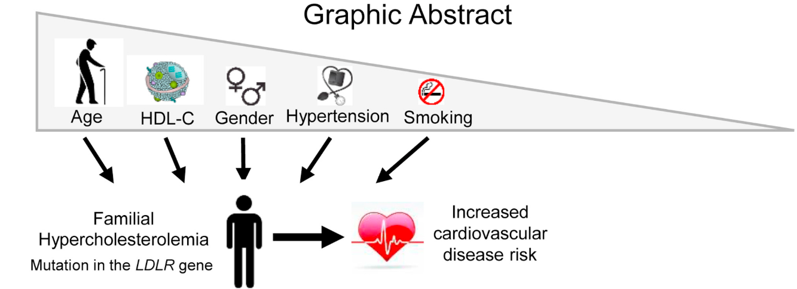
Diagnosis
Screening
Genetics
Management
Framingham risk score
www.circl.ubc.ca/cardiorisk-calculator.html
Montreal-FH-SCORE to predict CV events in FH
Pauquette 2017 J Clin Lipidol
Brunham 2018 Can J Cardiol

Slide 25
Diagnosis
Screening
Genetics
Management
The therapeutic goal is a 50% reduction from baseline (untreated LDL-C) and LDL-C <3.5 mmol/L
Statins are the drug class of choice for FH
Statin-treated patients with FH have cardiovascular outcomes similar to an age- and sex-matched population without FH
Brunham 2018 Can J Cardiol

Slide 26
Many cardiac conditions have a hereditary component
Presentations that point to possible hereditary cardiac conditions and prompt further investigation include:
Sudden death < 40 years, including SIDS
Syncope or pre-syncope with exercise, intense emotional, stressful, or startling events
Seizures/Drowning/Unexplained single MVA
Cardiac device at a young age (ICD, pacemaker)
Cardiac disease without usual risk factors
Identification of at-risk family members allows for early intervention and life saving surveillance and management
Notes:
Cascade testing: Provide education for patient and family -Balance fear of diagnosis with hope that education & intervention will prevent deaths

Slide 27
resources www.geneticseducation.ca
Point of care tools > Cardiogenomics
Educational resources > GEC-KO on the run

Slide 28
resources www.sads.ca
The Canadian Sudden Arrhythmia Death Syndromes Foundation

Slide 29
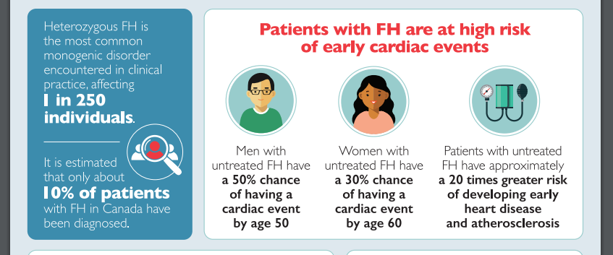
resources www.fhcanada.net
FH Canada Familial Hypercholesterolemia

Slide 30
Family history tool resources
Your local genetics centre:
https://geneticseducation.ca/genetics-centres/canada/canadian_clinics/
General - For patients to complete:
Validated, primary care family history tool: Emery JD, Reid G, Prevost AT, Ravine D, Walter FM. Development and validation of a family history screening questionnaire in Australian primary care. Ann Fam Med. 2014;12(3):241–249. doi:10.1370/afm.1617 https://www.ncbi.nlm.nih.gov/pmc/articles/PMC4018372/
A family health history tool for patients by the Genetic Alliance. This tool helps you create personalized booklets to start conversations about health in one’s family and community http://www.familyhealthhistory.org/
My Family Health Portrait by the US Surgeon General https://phgkb.cdc.gov/FHH/html/index.html

Slide 31
Geneticseducation.ca

