Slide 1
Disclaimer
This presentation is for educational purposes only and should not be used as a substitute for clinical judgement. GEC-KO aims to aid the practicing clinician by providing informed opinions regarding genetic services that have been developed in a rigorous and evidence-based manner. Physicians must use their own clinical judgement in addition to published articles and the information presented herein. GEC-KO assumes no responsibility or liability resulting from the use of information contained herein.

Slide 2
Familial Hypercholesterolemia
Developed by Ms. Shawna Morrison, Dr. Judith Allanson and Dr. June Carroll (2016)

Slide 3
Objectives
Following this session, for each of the topics discussed, the learner will be able to:
  Identify patients for whom referral to genetics or other specialty and/or consideration of genetic testing is appropriate
  Discuss and address patient concerns about the genomic technology and genetic contribution to the illness
  Find high quality genomics educational resources appropriate for primary care

Slide 4
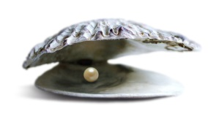


Pearls
Familial hypercholesterolemia
Common autosomal dominant disorder resulting in 20x increased risk of cardiovascular disease (CVD) and death
Early diagnosis and treatment (statin+) can normalize life expectancy
Cascade screening of family members allows for early identification and treatment of at-risk individuals
Key features:
Elevated LDL-C ≥ 5mmol/L with one or more features below
Early onset CVD (<55 years in men, <65 years in women)
Cholesterol deposition in the tendons (xanthomata)
Arcus cornealis onset <45years
Family history of early onset CVD or hyperlipidemia requiring treatment
Notes:
Cascade screening of family members by genetic testing for the familial gene mutation or LDL-C levels allows for early identification and treatment of at-risk individuals, with statins as first-line treatment.

Slide 5

Case 1: Jason
A healthy 38-year-old male
  He has been training for half marathon
  Motivated by his brother’s heart attack and death at age 42 years, about 6 months ago
Complaining of bilateral heel pain
Wondering if he sustained an injury during training
Excellent health
Non smoker
Social drinker (~ 10/week)
Healthy BMI
No medications
Case: NCHPEG

Slide 6
Case 1: Jason
66
64
MI @50y
Treated for dyslipidemia
HTN
IDDM
d.42
39
38
MI @42y
Jason
Case: NCHPEG

Slide 7
What is familial hypercholesterolemia?
Familial hypercholesterolemia (FH) is an autosomal dominant genetic condition
The uptake of low-density lipoprotein cholesterol (LDL-C) into cells is either decreased or inhibited
Results in lifetime exposure to very high levels of LDL-C
FH is the most common genetic disorder causing premature cardiovascular disease and death in both men and women
At least 1 in 500 Canadians is thought to have FH
More common in certain populations due to founder effects
(e.g. 1/270 in French Canadians, 1/67 in Ashkenazi Jews)
FH is underdiagnosed: estimated <15% of affected Canadians have been diagnosed

Slide 8
What do I need to know about the genetics of familial hypercholesterolemia?
Most cases (80-90%) of FH are caused by mutations in the LDL receptor gene, LDLR
Can be present in a heterozygous form (HeFH)
Where an individual has a mutation in one copy of a FH-causing gene
Can be present in a homozygous form (HoFH)
Where an individual has a mutation in both copies of a FH-causing gene
All individuals with HoFH have an extremely high risk of early onset cardiovascular disease
Notes:
Over 900 different mutations have been identified in LDR

Slide 9
Clinical features of familial hypercholesterolemia
Clinical features | HeFH | HoFH
Genetics | Mutation in one FH gene | Mutation in both copies of a FH gene
LDL-C levels | ≥ 5mmol/L with at least one of the additional features (see below) | >12 mmol/L lower LDL-C levels, especially in children or in treated patients, do not exclude dx
Cardiovascular disease onset | <55 years of age in men <65 years of age in women | <20 years of age (can be as early as the first year of life)
Physical findings | Cholesterol deposits in the tendons (xanthomata) and/or around the eyes (xanthelasma) Arcus cornealis (white, grey, or blue opaque ring in the corneal margin) onset <45years
Family history | Early onset CVD Hyperlipidemia, often requiring treatment

Slide 10


Familial hypercholesterolemia Red Flags which should prompt referral to lipid specialist
 | Likelihood of FH diagnosis
LDL-C ≥5mmol/L AND at least one other red flag | Possible
LDL-C ≥ 5mmol/L AND 2 other red flags | Probable
Personal or family history of clinical stigmata of FH
Personal or family history of premature CVD
Family history of significant hypercholesterolemia, often requiring treatment
Notes:
Exclusion of secondary causes of elevated LDL-C, e.g. obstructive liver disease, hypothyroidism, nephrotic syndrome, anorexia nervosa

Slide 11
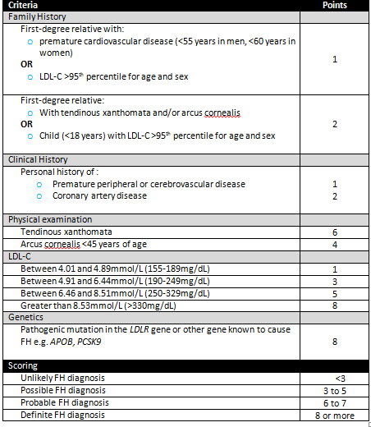
Diagnosis of familial hypercholesterolemia
While there are no Canadian-specific FH diagnostic criteria, the Canadian Cardiovascular Society (CCS) recommends using those published by the Dutch Lipid Clinic Network
Geneticseducation.ca > Point of Care Tools > Familial hypercholesterolemia
Notes:
While there are no Canadian-specific FH diagnostic criteria, the Canadian Cardiovascular Society (CCS) recommends using those published by the Dutch Lipid Clinic Network
Alternatively, criteria from the Simon Broome Registry can be used, and include lower thresholds for children with suspected FH
Both sets of diagnostic criteria are internationally accepted and used for diagnosis of FH, although neither is designed to diagnose HoFH;
in this case, other criteria have been suggested
They have comparable utility for diagnosing HeFH in adults

Slide 12
Family physician role in cascade screening for familial hypercholesterolemia
Screen first-, second- and third-degree relatives of the first individual with a confirmed diagnosis
Screening can be done by:
  LDL-C measurements
  Genetic testing for a known familial gene mutation
  Use of diagnostic criteria
Notes:
Anderson 2016 CCS recommendations:
In contrast to changes seen in triglycerides following a large oral fat load, triglyceride and low density lipoprotein cholesterol (LDL-C) levels change relatively little after normal meals in the majority of the population.
Compared to fasting lipid values, there will be minimal change with non HDL-C, a slight decrease in LDL-C and small increase in triglyceride concentrations when individuals do not fast.
We recommend non-fasting lipid and lipoprotein testing which can be performed in adults in whom screening is indicated as part of a comprehensive risk assessment to reduce CVD events (Strong Recommendation, High Quality Evidence).
We suggest that for individuals with a history of triglyceride levels > 4.5 mmol/L that lipid and lipoprotein levels be measured fasting (Conditional Recommendation, Low
Quality Evidence).

Slide 13
What do the genetic test results mean?
Positive test result: Pathogenic gene mutation found
Confers a definite diagnosis
~100% of individuals will develop hypercholesterolemia
Individuals with HeFH have a 20-fold higher risk of premature CVD
Untreated, a fatal or non-fatal coronary event will occur in about 50% of males by age 50 and about 30% of females by age 60
Offers the opportunity for cascade screening (1st, 2nd, 3rd degree relatives)
Notes:
On average, cascade screening identifies 8 new cases of FH for every proband. Turgeon 2016 CFP

Slide 14
What do the genetic test results mean?
Negative test results
Familial mutation not found
True negative
No further testing indicated
Reassurance for offspring
Notes:
When an individual is classified on the basis of the Simon Broome Registry about 60% with a definite FH diagnosis and about 30% with a possible FH diagnosis have identifiable mutations in an FH-causing gene¹¹.
When an individual is classified on the basis of the Dutch Lipid Clinic Network Criteria about 70% with a definite FH diagnosis, about 29% with a probable FH diagnosis, and about 11% with a possible FH diagnosis have an identifiable mutation in an FH-causing gene¹¹.
Evidence suggests that in most of the individuals with a negative result (~80%) hypercholesterolemia is the result of multiple small effect LDL-C raising alleles¹².

Slide 15
What do the genetic test results mean?
Negative test results
Affected individual, no mutation identified and no known familial mutation
This result is uninformative
For individuals who meet definite, probable or possible FH criteria → FH diagnosis is not ruled out
Chance of diagnosis based on Dutch Lipid Network Clinic | Chance of finding a gene mutation
Definite | 70%
Probable | 29%
Possible | 11%
Notes:
When an individual is classified on the basis of the Simon Broome Registry about 60% with a definite FH diagnosis and about 30% with a possible FH diagnosis have identifiable mutations in an FH-causing gene¹¹.
Evidence suggests that in most of the individuals with a negative result (~80%) hypercholesterolemia is the result of multiple small effect LDL-C raising alleles¹².

Slide 16
Surveillance and Management
Medications and Healthy Lifestyle
Statins are the drug class of choice
Observational studies have shown a dramatic decrease in cardiac events in statin-treated individuals
Notes:
The use of high-dose statins alone is usually sufficient to achieve LDL-C reduction, however, some individuals with FH will require combination and/or emerging therapy to obtain optimal LDL-C. Specialist referral is recommended
In patients with heterozygous FH, moderate- to high-intensity statin therapy lowered the risk for CAD and mortality by 44%. Besseling JACC 2016 68:(3)
Anderson 2016 CCS Lipid Guidelines
Ezetimibe resulted in a significant (albeit relatively small) reduction in clinical events
routine use of niacin, added to statin therapy for CV prevention in patients who have achieved lipid targets, cannot be recommended in light of recent clinical trials. Use in subjects who do not achieve appropriate LDL-C levels despite statins could be considered
clinicians may consider fenofibrate in high-risk patients with residual high TG/low HDL, recognizing that the potential for benefit on CVD is based on pooled sub-group analysis, and far from definitive
Bay be reasonable to consider adding a bile acid sequesterants e.g. Cholestyramine to maximally tolerated statin therapy +/- ezetimibe in high risk patients who are unable to achieve LDL-C targets.
1. We recommend ezetimibe as second-line therapy to lower LDL-C in patients with clinical cardiovascular disease if targets are not reached on maximally tolerated statin therapy. (Strong Recommendation, High Quality evidence)
2. We recommend that niacin not be added to statin therapy for CVD prevention in patients who have achieved LDL-C targets. (Strong Recommendation, High Quality Evidence)
3. We recommend that fibrates not be added to statin therapy for CVD event prevention in patients who have achieved LDL-C targets (Strong recommendation, High Quality evidence).
Bouharie 2015 CARDIO CLIN
LDL apheresis is an important treatment modality for homozygous FH patients and for heterozygous patients who have not met treatment goals despite optimal tolerated medical therapy. Apheresis is generally done every 1 to 2 weeks, with each session taking about 3 hours and removing greater than 60% of Apo-B-containing lipoproteins
The most promising new therapeutic approach for FH involves monoclonal antibodies to PCSK9. PCSK9 increases LDL-C by binding to the epidermal growth factor-like repeat A domain of the LDLR, causing LDL-receptor degradation, thus reducing the amount of LDL cleared from the plasma.7 Gain-of-function mutations of PCSK9 result in elevation of LDL, whereas loss-of-function mutations lead to life-long low LDL levels and are associated with decreased risk of cardiovascular disease.50
Given by subcutaneous injection once every 2 to 4 weeks, monoclonal antibodies that inhibit the binding of PCSK9 to LDLRs have produced 40% to 70% reductions of LDL-C in a variety of clinical situations, including FH.51–55 Cardiovascular outcomes trials with several of these antibodies are in progress

Slide 17
Case 1: Jason
A healthy 38-year-old male
Complaining of bilateral heel pain
66
64
MI @50y
Treated for hyperlipidemia
HTN
IDDM
d.42
39
38
MI @42y
Jason
Case: NCHPEG

Slide 18

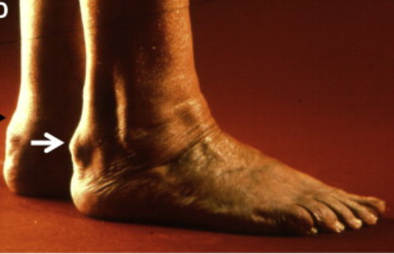
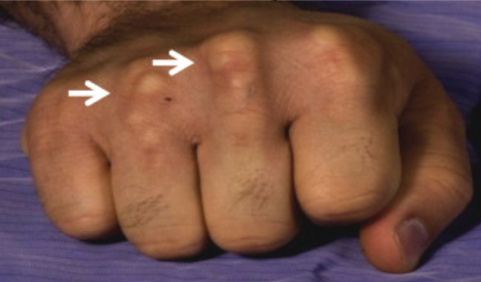
Case 1: Jason
On examination:
Jason has evidence of xanthoma on hands and feet
Case: NCHPEG
Image: Genest Can J Cardio 2014

Slide 19
Case 1: Jason
Jason has evidence of xanthoma on hands and feet
Family history of premature CVD
Family history of significant hypercholesterolemia
LDL-C is ordered. LDL-C = 6.9mmol/L
Definite diagnosis of familial hypercholesterolemia
Begin statin treatment
Refer to lipid specialist
Screen family members (1st, 2nd, 3rd degree)

Slide 20
Pearls
Familial hypercholesterolemia
Common autosomal dominant disorder resulting in 20x increased risk of cardiovascular disease (CVD) and death
Early diagnosis and treatment (statin+) can normalize life expectancy
Cascade screening of family members allows for early identification and treatment of at-risk individuals
Key features:
Elevated LDL-C ≥ 5mmol/L with one or more features below
Early onset CVD (<55 years in men, <65 years in women)
Cholesterol deposition in the tendons (xanthomata)
Arcus cornealis onset <45years
Family history of early onset CVD or hyperlipidemia requiring treatment

