Slide 1
Disclaimer
This presentation is for educational purposes only and should not be used as a substitute for clinical judgement. GEC-KO aims to aid the practicing clinician by providing informed opinions regarding genetic services that have been developed in a rigorous and evidence-based manner. Physicians must use their own clinical judgement in addition to published articles and the information presented herein. GEC-KO assumes no responsibility or liability resulting from the use of information contained herein.

Slide 2
Expanded carrier screening
Developed by Ms. Shawna Morrison, Dr. Judith Allanson and Dr. June Carroll (2016)

Slide 3
Objectives
Following this session, for each of the topics discussed, the learner will be able to:
Identify patients for whom referral to genetics or other specialty and/or consideration of genetic testing is appropriate
Discuss and address patient concerns about the genomic technology and genetic contribution to the illness
Find high quality genomics educational resources appropriate for primary care

Slide 4
Pearls
Expanded carrier screening
Family history-based risk assessment is still the gold standard in initial assessment for heritable conditions
Currently, expanded carrier screening (beyond family history and ethnicity) is not standard of care, however providers may consider making patients aware of the option
Physicians ordering testing need to be aware of the conditions on the expanded carrier panels and prepared to provide pre- and post-test counselling
More carriers of serious inherited disorders are expected to be identified
Expanded carrier screening may help some couples obtain timely genetic test results

Slide 5
Case 1: Julie and Chris
A healthy non-consanguineous couple
Both are 33 years old
Julie is of French Canadian and Northern European ancestry
Chris is of German and English ancestry and he believes there may be some Ashkenazi Jewish ancestry
There is no significant family history for either member of the couple
Planning to start their family

Slide 6
Case 1: Julie and Chris
Julie’s cousin, Jean, is the same age and also recently married
Jean lives in Boston, MA and was offered a family planning carrier screening panel which was partly covered by her health insurance
Julie would also like to have this panel and understands that she would have to pay for the test herself
She needs you to order the test
She has brought all the completed paperwork to you
Physician signature here____________
Notes:
Highlight MD needed to obtain vs dtc

Slide 7
Why offer traditional reproductive carrier screening?
To facilitate informed reproductive decision making by identifying those couples at risk of having an affected child with an (autosomal or X-linked) recessive disorder
Notes:
First let’s talk about

Slide 8
How is traditional reproductive carrier screening offered?
Screening is ideally offered to all individuals considering a pregnancy (pre-conception) and to women presenting at their first prenatal visit, regardless of gestational age
Allows for the greatest number of options with more time to make an informed decision
Adoption
Egg or Sperm donor
Assisted reproductive technology (i.e. in vitro fertilization with preimplantation genetic diagnosis (IVF with PGD))
Prenatal diagnosis with the option of termination
Consideration of a different reproductive partner
Limitation of family size or not have children
Wilson 2016 JOGC

Slide 9
How is traditional reproductive carrier screening offered?
Screening is ideally offered to all individuals considering a pregnancy (pre-conception) and to women presenting at their first prenatal visit, regardless of gestational age
Allows for the greatest number of options with more time to make an informed decision
Discussion about the value and risk of carrier screening
Wilson 2016 JOGC

Slide 10
How is traditional reproductive carrier screening offered?
Screening is ideally offered to all individuals considering a pregnancy (pre-conception) and to women presenting at their first prenatal visit, regardless of gestational age
Offered following guidelines which are based on family history and ethnicity
Remember: Family history-based risk assessment is still the gold standard in initial assessment for heritable conditions
Wilson 2016 JOGC
Notes:
Henneman 2016 Eur J Hum Genet

Slide 11
What are the Canadian recommendations for reproductive carrier screening?
Notes:
SOCG and CCMG recently updated their statements on carrier screening
Contains recommendations for various ethnic groups and what to target when taking a family history

Slide 12
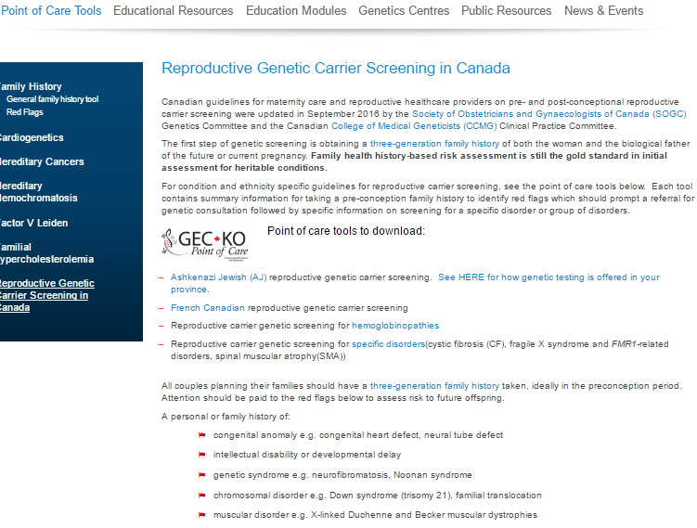
What are the Canadian recommendations for reproductive carrier screening?
Geneticseducation.ca > Point of Care Tools > Reproductive genetic carrier screening in Canada

Slide 13
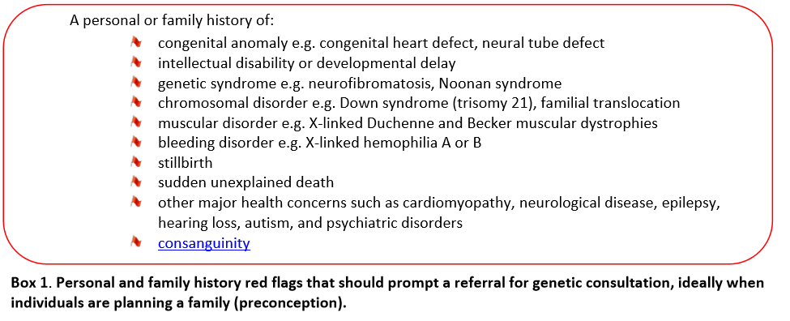
What are the Canadian recommendations for reproductive carrier screening?
Geneticseducation.ca > Point of Care Tools > Reproductive genetic carrier screening in Canada

Slide 14
What are the Canadian recommendations for reproductive carrier screening?
Geneticseducation.ca > Point of Care Tools > Reproductive genetic carrier screening in Canada

Slide 15
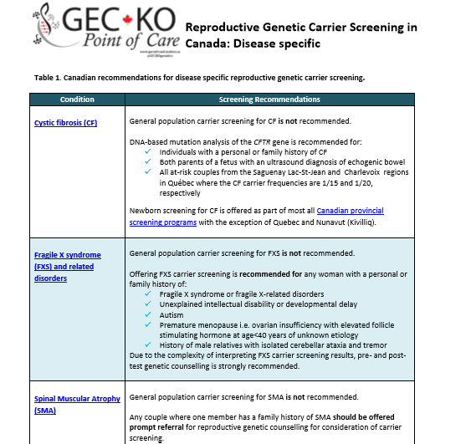
What are the Canadian recommendations for reproductive carrier screening?
Geneticseducation.ca > Point of Care Tools > Reproductive genetic carrier screening in Canada

Slide 16
Why offer expanded carrier screening?
Screening beyond family history and ethnicity
Allows testing of all individuals regardless of family history, ethnicity or geographic origin
Notes:
Henneman 2016 Eur J Hum Genet
Lazarin 2013 Genet in Med
Haque 2016 JAMA

Slide 17
Why offer expanded carrier screening?
Screening beyond family history and ethnicity
Allows testing of all individuals regardless of family history, ethnicity or geographic origin
Increased detection of carriers of serious inherited disorders
Notes:
Henneman 2016 Eur J Hum Genet
Lazarin 2013 Genet in Med
Haque 2016 JAMA

Slide 18
Why offer expanded carrier screening?
Screening beyond family history and ethnicity
Allows testing of all individuals regardless of family history, ethnicity or geographic origin
Increased detection of carriers of serious inherited disorders
Technology is rapidly advancing and the costs are decreasing
Notes:
Henneman 2016 Eur J Hum Genet
Lazarin 2013 Genet in Med
Haque 2016 JAMA

Slide 19
Why offer expanded carrier screening?
Screening beyond family history and ethnicity
Allows testing of all individuals regardless of family history, ethnicity or geographic origin
Increased detection of carriers of serious inherited disorders
Technology is rapidly advancing and the costs are decreasing
Supports patient autonomy
Notes:
Henneman 2016 Eur J Hum Genet
Lazarin 2013 Genet in Med
Haque 2016 JAMA

Slide 20
Expanded carrier screening
Notes:
Advertising is here and directed to individuals planning their families - Counsyl
Julie has seen the ads for family planning expanded carrier screening

Slide 21
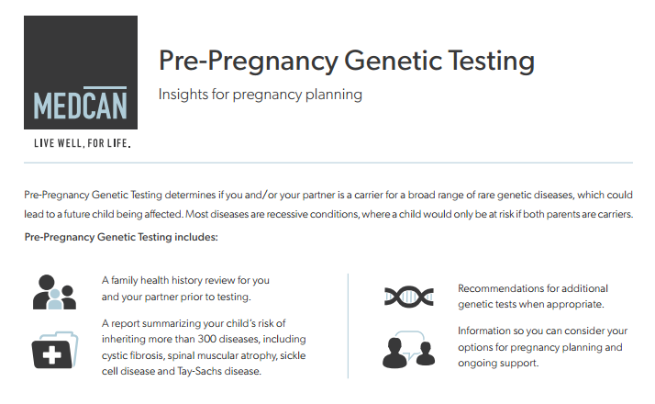
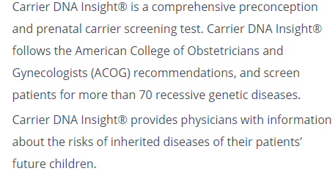
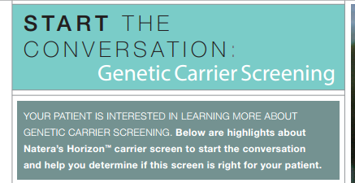
Expanded carrier screening
Notes:
GeneYouIn
Pathway genomics
Medcan
Naterra Horizon
Costs: monthly payment plans available
Life lable 995$ - GeneYouIn Its price is $2,999 + HST. If you and your partner both purchase PregnaSeq, you would save $400+HST, as the total would be $5,600 + HST.

Slide 22
Expanded carrier screening
Is generally a self-pay service
Provincial funding has been approved in ON
Individuals with a limited family history (e.g. adopted)
Individuals whose partner is a carrier of a condition on a panel
Individuals of Ashkenazi Jewish descent
Consanguineous couples
Notes:
Covered by MOH on case-by-case > Lifelabs genetics > Counsyl family prep > OOC forms and requisition semi-completed online

Slide 23
Expanded carrier screening
Is generally a self-pay service
Is not standard of care and does not replace current guidelines
SOGC/CCMG (2016) state, “The option of this technology should be part of the informed consent process.”
Unclear clinical utility and relevance in reproductive planning
Panels do not typically distinguish between serious and mild, or early-onset and late-onset conditions
Most individuals prefer test to be offered via their family physician [Plantinga 2016 EJHG]
Notes:
PLANTINGA 504 RESPONDENTS
May get a lot of results and not know what to do with – may be overwhelmed by a lot of things that may have little to do with the indication for testing

Slide 24
Pre-test counselling checklist
Patient is aware that expanded carrier screening panels:
Are voluntary
Screen for conditions of variable severity
Screen for conditions with different modes of inheritance e.g. not all are recessive
Assume accurate paternity for risk assessment
Do not rule out risk in the event results are negative
May be diagnostic or reveal information about an individual’s personal health
Do not necessarily contain all conditions recommended be screened e.g. α-thalassemia, family history
Access to genetic counselling or confirmatory testing may be limited
Notes:
If one chooses to order ECS, some things to consider
for these disorders is usually predicated on the expectation that at least some families will want to avoid the birth of affected children, either through termination of affected pregnancies or perhaps through the use of preimplantation genetic diagnosis (PGD) or donor gametes if risk is identified prior to conception.
However, many other disorders for which carrier testing seems less compelling but perhaps not harmful are being tested, including phenylketonuria and medium-chain acyl-CoA dehydrogenase (MCAD) deficiency; these are disorders for which newborn screening and excellent treatments are available. (Beaudet, 2015, GIM)
In rare cases, an individual learns from carrier screening that he or she may have a genetic condition such as Gaucher disease, a thrombophilia, or atypical cystic fibrosis. In such cases, referral to an appropriate specialist for medical management and genetic counseling is indicated to review the inheritance patterns, recurrence risks,clinical features and possible treatment. Allen 2016 Seminars in Perinatology

Slide 25
Pre-test considerations
Most companies test using whole exome sequencing as the testing method (vs. targeted mutation analysis)
Whole exome sequencing is reading of the coding region (exons) of a gene
Notes:
IMAGE: National Human Genome Research Institute - http://www.genome.gov/Images/EdKit/bio2i_large.gif Public Domain

Slide 26
Pre-test considerations
Most companies test using whole exome sequencing as the testing method (vs. targeted mutation analysis)
This method improves sensitivity of testing across ethnicities
Limited detection of some types of mutations
Laboratories are likely to report variants which are classified as ‘likely’ pathogenic
How would you counsel/follow-up for a variant?
Will your local genetics clinic provide support?
Notes:
Test limitations: Large del/dupl, balanced rearrangements, coverage dependant – some ‘less significant’ genes may have poor coverage and limiited interpretation

Slide 27
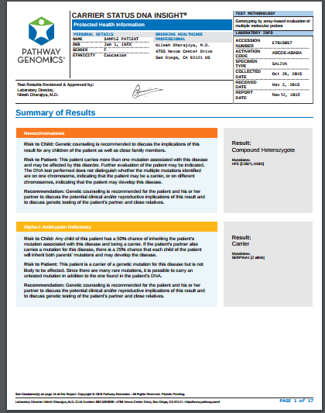
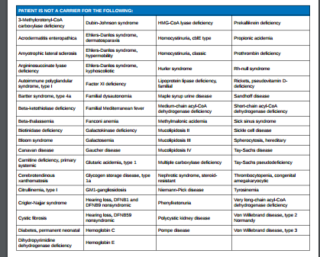
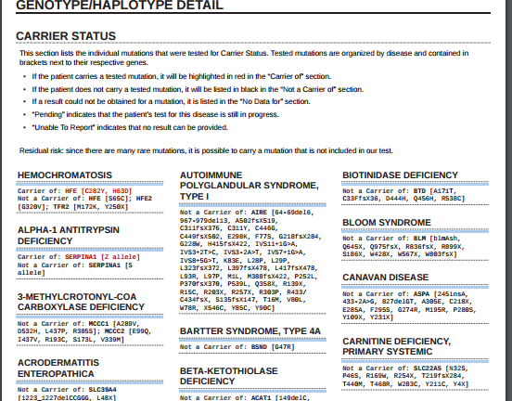
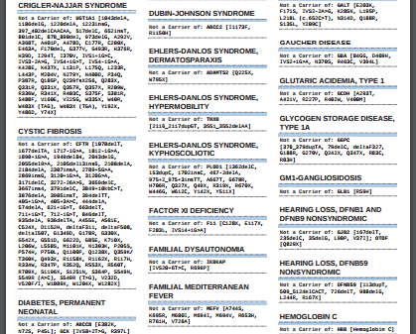
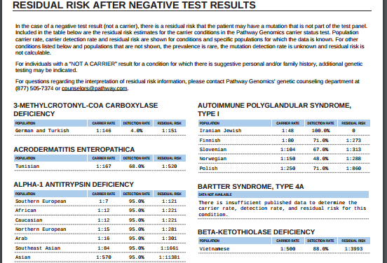
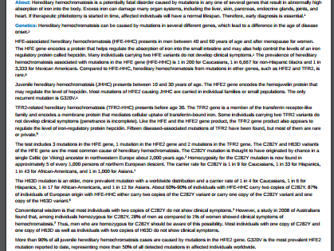
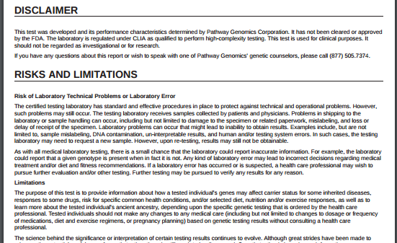
Post-test counselling and considerations
Genetic counselling through testing company may be available +/- extra fee
Notes:
Sample report from pathway genomics https://d2q8958pmybfsy.cloudfront.net/wp-content/uploads/2014/07/CARRIER-STATUS-DNA-INSIGHT_MD_Positive_watermarked.pdf?a69d25

Slide 28
Post-test counselling and considerations
Genetic counselling through testing company may be available +/- extra fee
You (ordering provider) should have a plan to provide accurate information and follow up to patients, including:
Risk counselling and review of options
Test partner if one member of the couple is a carrier
Significance of this information for other family members who may also be carriers
Additional testing e.g. biochemical testing for non-Ashkenazi Jewish (AJ) member of a couple where the AJ member is a carrier of Tay Sachs disease

Slide 29
Post-test counselling and considerations
Genetic counselling through testing company may be available +/- extra fee
You (ordering provider) should have a plan to provide accurate information and follow up to patients
A negative result does not eliminate risk

Slide 30
Post-test counselling and considerations
Genetic counselling through testing company may be available +/- extra fee
You (ordering provider) should have a plan to provide accurate information and follow up to patients
A negative result does not eliminate risk
Access to formal genetic counselling or confirmatory testing may be required but limited by local resources

Slide 31
Back to Julie and Chris
Julie and Chris are found to both be carriers of known pathogenic mutations in the cystic fibrosis gene, CFTR
You refer the couple to your local genetics for follow-up counselling

Slide 32
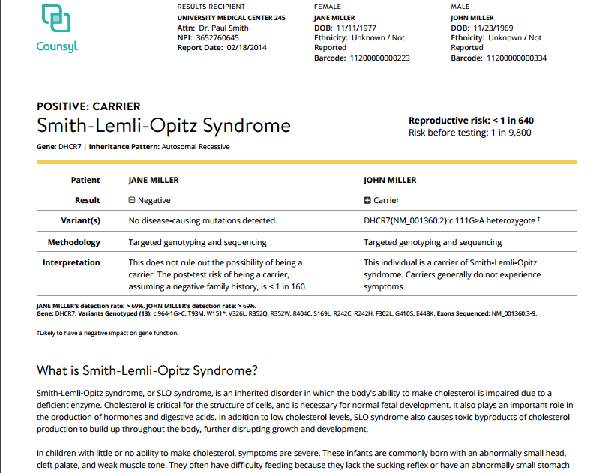
Sample report
Notes:
Sample report from Counsyl http://www.lifelabsgenetics.com/wp-content/uploads/2015/04/Sample-Report-Individual-Carrier.pdf

Slide 33
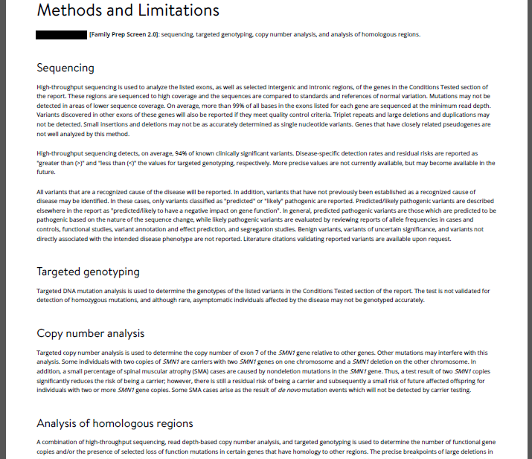
Sample report

Slide 34
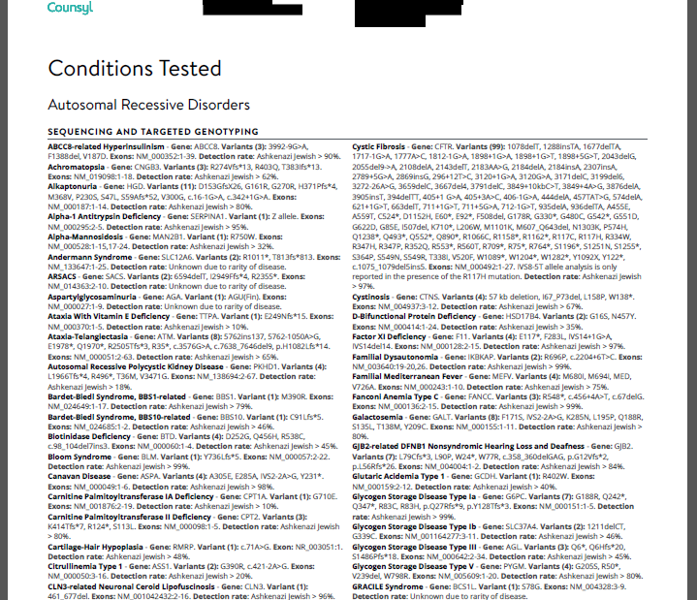
Sample report

Slide 35
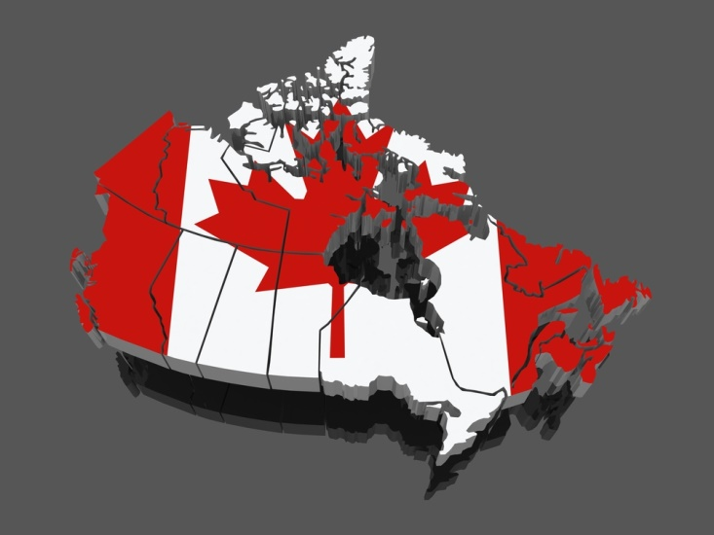
Your local genetics centre
Geneticseducation.ca > Genetics Centres

Slide 36
Pearls
Expanded carrier screening
Family history-based risk assessment is still the gold standard in initial assessment for heritable conditions
Currently, expanded carrier screening (beyond family history and ethnicity) is not standard of care, however providers may consider making patients aware of the option
Physicians ordering expanded carrier testing need to be aware of the conditions on the panels and prepared to provide pre- and post-test counselling
More carriers of serious inherited disorders are expected to be identified
Expanded carrier screening may help some couples avoid long wait times for genetics consults
Notes:
If one follows SOGC guidelines then you should be making patients aware of the option for ECS, and discuss in detail if desired

