Slide 1
Long QT Syndrome
Developed by Ms. Shawna Morrison, Dr. Judith Allanson and Dr. June Carroll
Last updated October 2016

Slide 2
Disclaimer
This presentation is for educational purposes only and should not be used as a substitute for clinical judgement. GEC-KO aims to aid the practicing clinician by providing informed opinions regarding genetic services that have been developed in a rigorous and evidence-based manner. Physicians must use their own clinical judgement in addition to published articles and the information presented herein. GEC-KO assumes no responsibility or liability resulting from the use of information contained herein.

Slide 3
Objectives
Following this session the learner will be able to:
Appropriately refer to their local genetics centre and/or arrhythmia specialist for long QT syndrome
Discuss and address patient concerns regarding family history of long QT syndrome
Find high quality genomics educational resources appropriate for primary care

Slide 4
Pearls
Long QT syndrome (LQTS)
One of several inherited heart disorders that can lead to sudden cardiac death
Treatable if diagnosed
The ECG is neither sensitive nor specific for LQTS
A QTc ≥ 500ms is considered high risk for LQTS
Individuals with clinical features (e.g. syncope, repeat corrected QT interval of >450ms for men and >470ms for women) should be referred to both cardiac arrhythmia and genetics specialists for assessment
Family physicians play a crucial role in identifying individuals with suspected LQTS and referring first degree relatives of those with confirmed or suspected LQTS diagnoses
Notes:
QTc>500ms increased risk of torsades de pointes

Slide 5
Case 1: John
A healthy 20-year-old male
Finishing up police foundations program at local college
Successfully applied for and was offered employment with provincial police force
One of the final requirements is a medical assessment
John’s ECG shows a corrected QT interval (QTc) of 500ms
You repeat the ECG and the QTc is 480ms

Slide 6
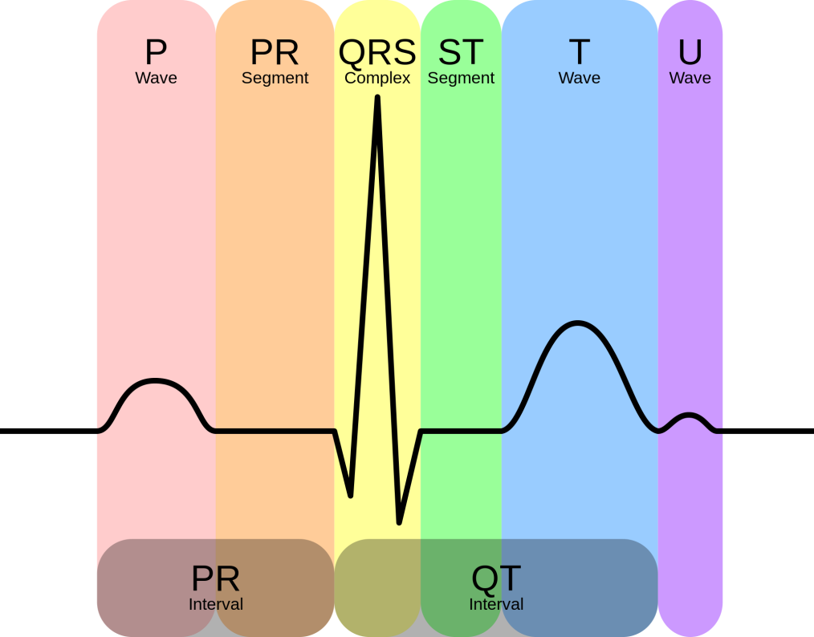
What is long QT syndrome?
Involves cardiac ion channels resulting in prolongation of the ventricular action potential during cardiac repolarization (i.e. prolonged QT interval on electrocardiogram)
Trademark event is the potentially lethal ventricular dysrhythmia called torsades de pointes
Can precipitate syncope, seizures or sudden death depending on whether rhythm spontaneously reverts to sinus or patient is defibrillated
Treatable if diagnosed
It occurs in approximately 1 in 2,000 to 1 in 2,500 people

Slide 7
What do I need to know about the genetics of long QT syndrome?
Most forms of long QT syndrome (LQTS) are hereditary
LQTS is usually autosomal dominant
First degree family members have a 50% risk to be affected
50% risk
LQTS
50% risk
25% risk
50% risk
50% risk
Notes:
LQTS with extracardiac signs can be inherited in an autosomal dominant or autosomal recessive manner. Timothy syndrome and Andersen-Tawil syndrome are inherited in an autosomal dominant manner. Jervell and Lange-Nielsen syndrome is inherited in an autosomal recessive manner.

Slide 8
What do I need to know about the genetics of long QT syndrome?
Most forms of long QT syndrome (LQTS) are hereditary
LQTS is usually autosomal dominant
At least 15 genes have been implicated
Genes are generally involved in or associated with cardiac potassium and sodium ion channels
The 3 most common genes are:
LQT1 (KCNQ1) encodes potassium channel subunits
LQT2 (HERG, KCNH2) encodes potassium channel subunits
LQT3 (SCN5A) encodes sodium channel subunits
Notes:
Pathogenic variants in KCNQ1, KCNH2, and SCN5A represent the most common causes of LQTS, accounting for 60%-75%. [GeneReviews]

Slide 9
What do I need to know about the genetics of long QT syndrome?
Most forms of long QT syndrome (LQTS) are hereditary
LQTS is usually autosomal dominant
At least 15 genes have been implicated
Genes are generally involved in or associated with cardiac potassium and sodium ion channels
LQTS can also be acquired due to causes such as:
Medical conditions e.g. anorexia nervosa
Medications e.g. erythromycin or citalopram

Slide 10
Red flags which should prompt referral to cardiac arrhythmia and genetics specialists for assessment

Slide 11
Red flags which should prompt referral to cardiac arrhythmia and genetics specialists for assessment
Triggers:
Physical exertion
Auditory stimuli e.g. fire alarm
Emotional stress/distress
Excluding events that are likely due to vasovagal events is difficult but necessary
Repetitive events more concerning
Events may occur from infancy through middle age but are most common from the pre-teen years through the 20s
Notes:
(e.g. those occurring during abrupt postural changes, exposure to heat and dehydration, emotional reactions to events such as blood drawing, etc.)

Slide 12
Red flags which should prompt referral to cardiac arrhythmia and genetics specialists for assessment
Attention to:
Unexplained death during swimming
Death during seizures
A family history of "seizure" disorders and other unexplained deaths
Notes:
Sodium-channel abnormalities may be precipitated by fever. These cardiac events may appear seizure-like and may be mislabelled as epilepsy.

Slide 13
Red flags which should prompt referral to cardiac arrhythmia and genetics specialists for assessment
On repeated 12-lead ECG
The QT interval shortens at faster heart rates and lengthens at slower ones
A prolonged QT interval is associated with an increased risk of torsade de pointe

Slide 14
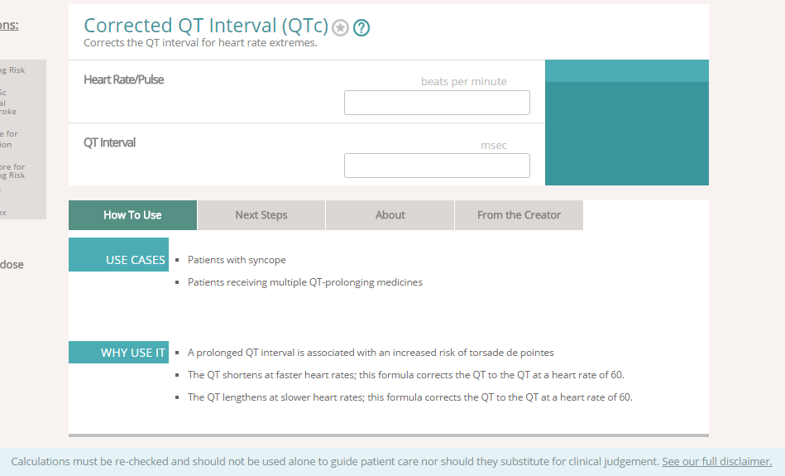
www.mdcalc.com/corrected-qt-interval-qtc/

Slide 15
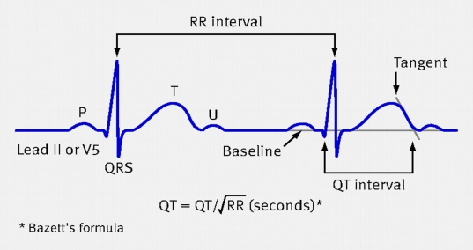
QT interval
c
Normal QTc is between 350-440 ms
Borderline QTc: 440-470 men, 460-480 women
(Up to 15% of population have borderline QT)
QTc > 500 is highly suspicious for LQTS and high risk for torsades de pointes
QT interval is a fluid measurement
Prolonged by LVH, ischemia or infarction, electrolyte abnormalities (hypo K, Mg, Ca), ketoacidosis, anorexia nervosa, diurnal variation (longer during sleep), medications
Overlap in QTc between healthy and genetically confirmed LQTS
~25% of individuals with a known gene mutation will have a normal QTc on baseline ECG (reduced penetrance)
Notes:
25-35% of genotyped LQTS patients had QTc values < 440ms

Slide 16
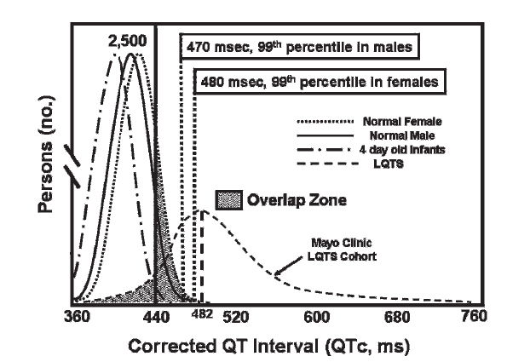
QTc comparison
Johnson and Ackerman Br J Sports Med 2009
Notes:
License Number: 3940340216296; License date: Sep 01, 2016; Licensed Content Publisher: BMJ Publishing Group Ltd.

Slide 17
How is the genetic testing done?
Genetic testing is usually done with multi-gene panels using next-generation sequencing (NGS)
NGS describes the approach to identifying genetic variation within many genes or many samples at the same time
NGS identifies variation in a DNA sequence by utilizing the human genome as a reference and comparing that to a given patient sample
Notes:
Cincinati 12-14 genes

Slide 18
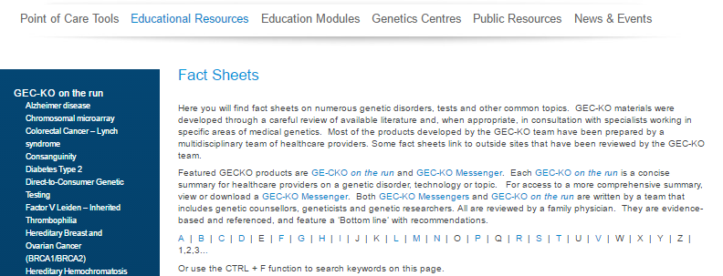
Resources on Next-Generation Sequencing
Notes:
NGS guide for providers – considerations prior to offering NGS
http://www.sickkids.ca/pdfs/Paediatric%20Laboratory%20Medicine/info-sheets/64477-NGS%20Info%20Sheet%20updated.pdf

Slide 19
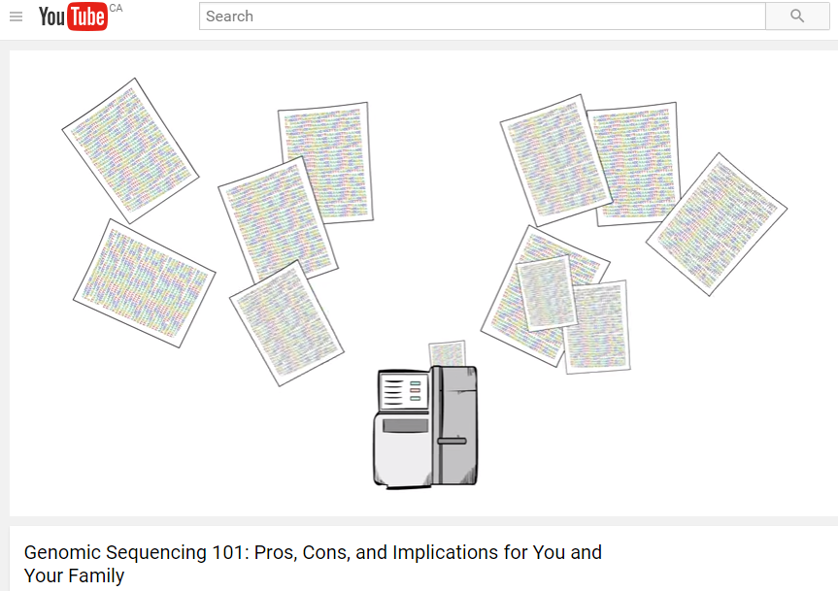
Resources on Next-Generation Sequencing
Genomic Sequencing 101
www.evanshealthlab.com | YouTube - DocMikeEvans

Slide 20
How is the genetic testing done?
Genetic testing is by multi-gene panels using next-generation sequencing (NGS)
Individuals with a known familial mutation will be offered targeted mutation analysis
Panels will have 5 to 14+ genes
Turnaround time varies usually from 4-12 weeks depending on the laboratory and panel size
Notes:
Cincinati 12-14 genes

Slide 21
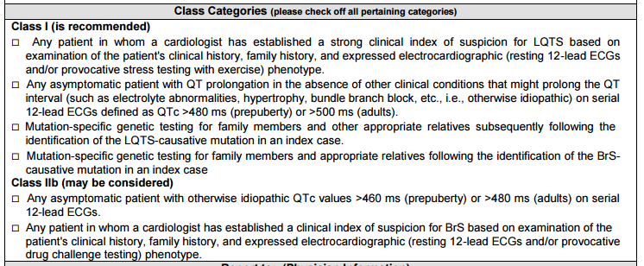
How do I order the genetic test?
Notes:
Genetic testing in Ontario and Canada
5 genes – account for majority of LQTS
Expanded panels offered through other labs – can use Gene Test Registry (GTR) to find
KGH > Healthcare provider > Laboratory Services > Scroll down to requisitions http://www.kgh.on.ca/file/1811

Slide 22
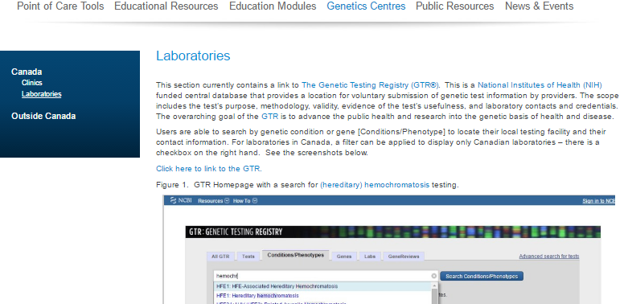
How do I order the genetic test?
Notes:
Labs offering expanded LQTS panels

Slide 23
What do the genetic test results mean?
Positive test result: Pathogenic gene mutation found
Individual has an increased risk for cardiac events
Individuals at higher risk for events are those with:
High QTc
History of syncope or cardiac arrest <7 years of age
Certain gene mutations (genotype-phenotype correlation)

Slide 24
What do the genetic test results mean?
Positive test result: Pathogenic gene mutation found
Individual has an increased risk for cardiac events
Management recommendations can be applied
Pharmacology, e.g. beta-blockers
Implantable cardioverter defibrillators (ICD)
Avoidance of competitive sports and electrolyte imbalances
Avoidance of QT-prolonging medications www.crediblemeds.org

Slide 25
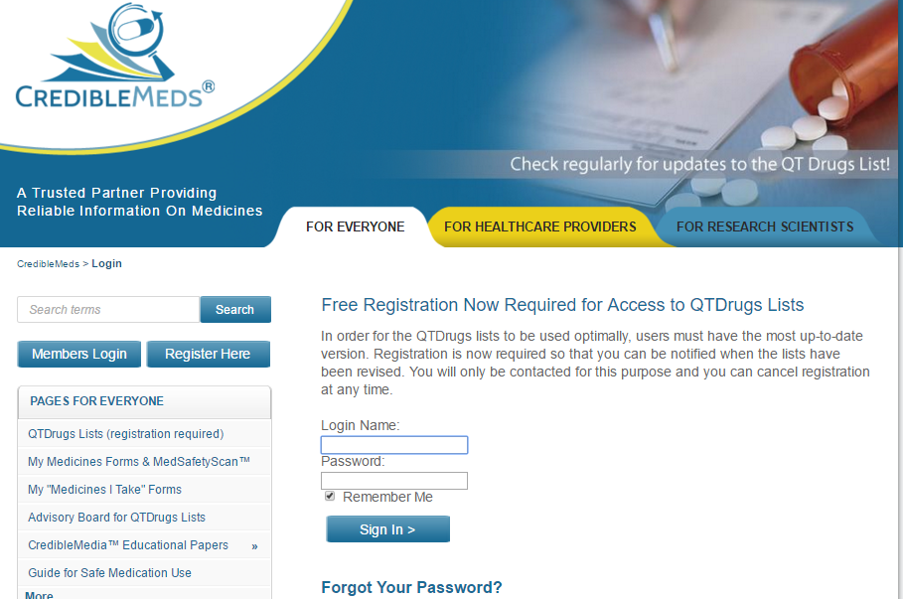
www.crediblemeds.org

Slide 26
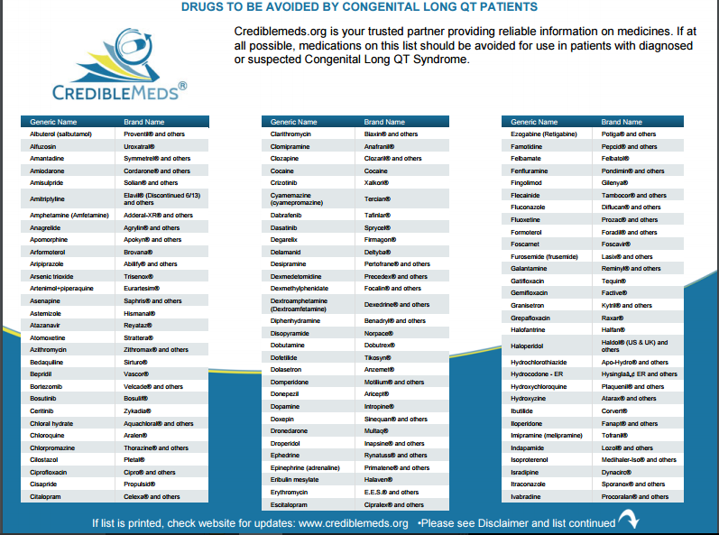
www.crediblemeds.org

Slide 27
What do the genetic test results mean?
Positive test result: Pathogenic gene mutation found
Individual has an increased risk for cardiac events
Management recommendations can be applied
First degree family members have a 50% chance of having the same gene mutation (autosomal dominant) and a similar risk for cardiac events (family screening)
Notes:
In about 4%-10% of individuals with LQTS, two pathogenic variants are found (digenic/biallelic inheritance). These individuals have a more severe phenotype compared to those with one pathogenic variation with a longer QT interval, a younger age of onset of events, and a higher risk of events [GeneReviews - Alders M, Christiaans I. Long QT Syndrome. 2003 Feb 20 [Updated 2015 Jun 18]. In: Pagon RA, Adam MP, Ardinger HH, et al., editors. GeneReviews® [Internet]. Seattle (WA): University of Washington, Seattle; 1993-2016. Available from: http://www.ncbi.nlm.nih.gov/books/NBK1129/]

Slide 28
What do the genetic test results mean?
Negative test results
Familial mutation not found
Affected individual, no mutation identified and no known familial mutation
True negative
No further testing indicated
Reassurance for offspring
This result is uninformative
In the absence of another explanation for long QTc (e.g. medication, electrolyte imbalance) first-degree family members should still have cardiac screening
Notes:
Genetic screening for LQTS as part of a molecular autopsy in autopsy-negative young sudden death can reveal a diagnosis in 15-20% of cases [Waddell-Smith 2016]
Approximately 20% of families with a clinically firm diagnosis of LQTS do not have a detectable pathogenic variant in one of the fifteen genes (KCNQ1, KCNH2, SCN5A, ANK2, KCNE1, KCNE2, CAV3, KCNJ2, CACNA1C,SCN4B, AKAP9, SNTA1, KCNJ5, CALM1, and CALM2) known to be associated with LQTS, suggesting that pathogenic variants in other genes can also cause LQTS and/or that current test methods do not detect all pathogenic variants in the known genes. [GeneReviews]

Slide 29
What do the genetic test results mean?
Variant of uncertain significance (VUS)
Gene change that has not yet been categorized as benign or as pathogenic
The diagnosis of hereditary long QT syndrome is neither confirmed nor ruled out
Some variants may be interpreted as ‘likely pathogenic’, generally meaning greater than 90% certainty of being disease-causing
First-degree family members may be offered genetic testing and subsequent screening if testing is positive

Slide 30
Case 1: John
John’s corrected QTcs were 500 ms and 480ms
John’s family history is significant
d.34
Drowning
John
SIDS

Slide 31
Case 1: John
John is not on any medications and no pre-existing medical condition explains the prolonged QT interval
You refer John to an arrhythmia specialist and to your local genetics clinic for assessment
You suggest he speak to relatives about relevant medical records prior to these appointments e.g. autopsy reports on nephew who died from SIDS, father’s drowning
You and John discuss the possibility of alternative career options

Slide 32
Pearls
Long QT syndrome (LQTS)
One of several inherited heart disorders that can lead to sudden cardiac death
Treatable if diagnosed
The ECG is neither sensitive nor specific for LQTS
A QTc ≥ 500ms is considered high risk for LQTS
Individuals with clinical features (e.g. syncope, repeat corrected QT interval of >450ms for men and >470ms for women) should be referred to both cardiac arrhythmia and genetics specialists for assessment
Family physicians play a crucial role in identifying individuals with suspected LQTS and referring first degree relatives of those with confirmed or suspected LQTS diagnoses
Notes:
QTc>500ms increased risk of torsades de pointes

