Slide 1
Hereditary Breast and Ovarian Cancer Syndrome
Developed by Ms. Shawna Morrison, Dr. June Carroll, and Dr. Judith Allanson
Last updated May 2016

Slide 2
Disclaimer
This presentation is for educational purposes only and should not be used as a substitute for clinical judgement. GEC-KO aims to aid the practicing clinician by providing informed opinions regarding genetic services that have been developed in a rigorous and evidence-based manner. Physicians must use their own clinical judgement in addition to published articles and the information presented herein. GEC-KO assumes no responsibility or liability resulting from the use of information contained herein.

Slide 3
Objectives
Following this session the learner will be able to:
Refer to their local genetics centre and/or order genetic testing appropriately regarding hereditary breast and ovarian cancer
Discuss and address patient concerns regarding family history of hereditary breast and ovarian cancer syndrome
Find high quality genomics educational resources appropriate for primary care

Slide 4
Pearls
5-10% of breast cancer is hereditary
Mutations in BRCA1 and BRCA2 account for ~30% of high-risk breast cancer families
HBOC is an autosomal dominant condition that results in an increased lifetime risk of breast and ovarian cancer in addition to other cancers
High risk individuals should be referred for a genetic consultation for consideration of genetic testing
Surveillance and management of breast, ovarian and other cancers should be guided by genetic test results and/or family/ personal history
Studies show that conversations between patients and their healthcare providers are the strongest driver of screening participation

Slide 5
Case 1: Judy
What is my cancer risk?
40 years old
In good health
Has a family history of both breast and ovarian cancer
Notes:
Judy - healthy 40 year old
Concerned about her risk for cancer
Family history of both breast & ovarian cancer

Slide 6
Case 1: Judy
LEGEND
Breast cancer
Ovarian cancer
d.51
Br Ca
d.48
Ov Ca
40
Br Ca
Dx 38
Ov Ca
Dx 40
Judy
Br Ca
Dx 30
Notes:
6
6

Slide 7
Distribution of breast cancer etiology
Most (80%) of breast cancer is sporadic
5-10%
~20% of women with breast cancer have a family history
Notes:
Click to highlight 5-10% and BRCA1/2

Slide 8
Distribution of breast cancer etiology
10-15% of breast cancer is familial
5-10%
Due to some shared factor in the family:
Environmental
Undiscovered gene mutation
Chance
Notes:
Click to highlight 5-10% and BRCA1/2

Slide 9
Distribution of breast cancer etiology
5-10% of breast cancer is hereditary
5-10%
Inherited single gene mutation which causes increased risk for cancer
Pathogenic mutations in BRCA1 and BRCA2 appear to account for ~30% of high-risk breast cancer families
Notes:
Click to highlight 5-10% and BRCA1/2

Slide 10
Other genetic contributions to hereditary breast cancer
Moderate risk genes
PALB2
ATM
BRIP1
RAD51C
High risk genes
BRCA1
BRCA2
TP53 (Li Fraumeni): soft tissue sarcoma, osteosarcoma, pre-menopausal breast cancer, brain tumors, adrenocortical carcinoma (ACC), and leukemias
PTEN (Cowden Syndrome): high risk for benign and malignant tumors of the thyroid, breast, and endometrium
Unexplained
CDH1 (Hereditary diffuse gastric syndrome): gastric, lobular breast, colorectal
Notes:
Above make small contribution
Other: SNPs, CNVs, unexplained

Slide 11
When should I think about a possible hereditary cancer syndrome?
d.51
Multiple affected relatives on same side of family
Br Ca
d.48
Ov Ca
40
Br Ca
Dx 38
Ov Ca
Dx 40
Judy
Br Ca
Dx 30

Slide 12
When should I think about a possible hereditary cancer syndrome?
d.51
More than 1 generation affected
1
Br Ca
2
d.48
Ov Ca
40
3
Br Ca
Dx 38
Ov Ca
Dx 40
Judy
4
Br Ca
Dx 30

Slide 13
When should I think about a possible hereditary cancer syndrome?
Closely related
d.51
Br Ca
Mother and daughter, sisters (first degree relatives)
d.48
Aunt and niece (second degree relatives)
Ov Ca
40
Br Ca
Dx 38
Ov Ca
Dx 40
Judy
Br Ca
Dx 30

Slide 14
When should I think about a possible hereditary cancer syndrome?
d.51
Early age of onset
Br Ca
d.48
Ov Ca
40
Br Ca
Dx 38
Ov Ca
Dx 40
Judy
Br Ca
Dx 30

Slide 15
When should I think about a possible hereditary cancer syndrome?
d.51
Clustering of related diseases
Br Ca
d.48
Breast and ovarian
Ov Ca
Colorectal and endometrial
40
Br Ca
Dx 38
Ov Ca
Dx 40
Judy
Br Ca
Dx 30

Slide 16
When should I think about a possible hereditary cancer syndrome?
Multiple primary cancers in an individual
Br Ca dx age 33
Ov Ca dx age 45
Br Ca (left) dx age 33
Br Ca (right) dx age 45

Slide 17
Genetics of hereditary breast and ovarian cancer syndrome
BRCA1 (chromo 17) and BRCA2 (chromo 13) are tumor suppressors genes
Mutations lead to inability to regulate cell death and uncontrolled growth
>2600 mutations
BRCA
BRCA
Notes:
Loss of function results in defects in DNA repair, defects in transcription, abnormal centrosome duplication, defective G2/M cell cycle checkpoint regulation, impaired spindle checkpoint, and chromosome damage

Slide 18
Genetics of hereditary breast and ovarian cancer syndrome
1/500 (0.2%) to 1/300 (0.3%) of the general population carry a mutation in BRCA1 or BRCA2 gene
1/50 (2%) – 1/40 (2.5%) of individuals who are of Ashkenazi Jewish ethnicity carry a mutation in the BRCA1 or BRCA2 gene
3 common gene mutations (founder mutations)
~1/150 (0.6%) individuals who are of Icelandic ethnicity carry the BRCA2 gene mutation 999del5
Canada has one of the largest Icelandic populations outside of Iceland

Slide 19
Genetics of hereditary breast and ovarian cancer syndrome
Autosomal dominant
Successive generations affected
+
+
+
+
+
+
+
+
+
Positive for familial mutation
Cancer diagnosis

Slide 20
Genetics of hereditary breast and ovarian cancer syndrome
Autosomal dominant
Successive generations affected
+
Br Ca dx.34
Ov Ca
dx. 55
Not all individuals who inherit a mutation in BRCA1 or BRCA2 will develop cancer (reduced penetrance) and the signs, symptoms, cancer type, and age of onset of cancer will vary within families (variable expressivity).
+
Br Ca
dx. 30
+
+
Pr Ca
dx. 40
50y
In good health
+
Positive for familial mutation
Cancer diagnosis

Slide 21
Genetics of hereditary breast and ovarian cancer syndrome
Autosomal dominant
Successive generations affected
Not all individuals who inherit a mutation in BRCA1 or BRCA2 will develop cancer (reduced penetrance) and the signs, symptoms, cancer type, and age of onset of cancer will vary within families (variable expressivity).
Melanoma (BRCA2)
Pancreatic
Prostate (BRCA2)
Associated with high risk for breast and ovarian cancers and a moderate risk for other cancers

Slide 22
Who should be offered genetic testing/consultation?
Breast cancer diagnosis at a young age (<35-45 years)
Both invasive and ductal carcinoma in situ
Ovarian cancer at any age
Epithelial
Male breast cancer

Slide 23
Who should be offered genetic testing/consultation?
Multiple primaries in the same individual
Bilateral breast cancer (particularly if the diagnosis was before age 50)
Breast and ovarian cancer
Triple negative breast cancer diagnosed <age 60
Notes:
HBOC related CA
Breast
Ovarian
Pancreatic
Prostate

Slide 24
Who should be offered genetic testing/consultation?
High risk ethnicity (Ashkenazi Jewish, Icelandic) AND a personal and/or family history of HBOC-related cancer
Breast
Ovarian, epithelial
Male breast
Pancreatic
Prostate, Gleason score ≥ 7

Slide 25
Who should be offered genetic testing/consultation?
Breast cancer diagnosis AND a family history of 2+ additional HBOC- related cancers, including breast, ovarian, prostate (Gleason ≥7) and pancreatic cancer
Ovarian CA
Pancreatic CA
Prostate CA
Breast CA

Slide 26
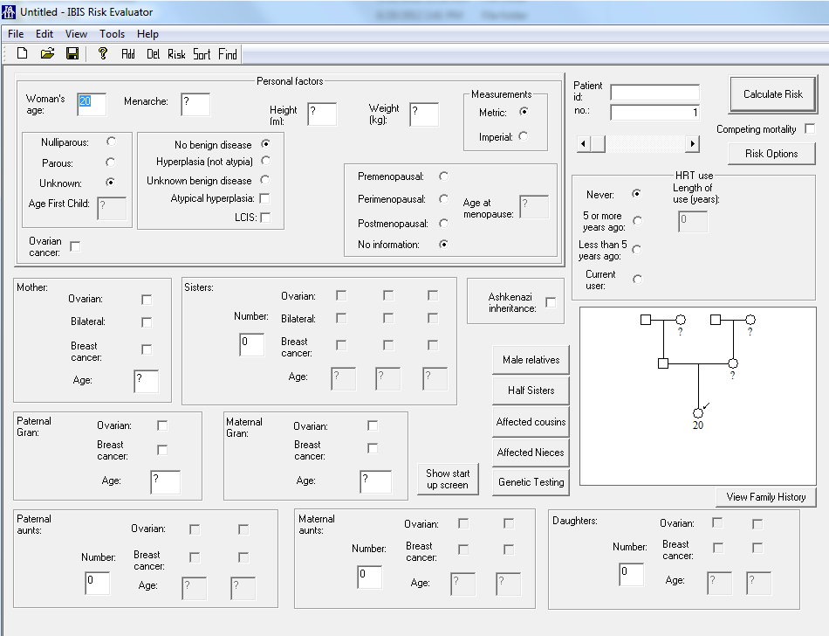
Who should be offered genetic testing/consultation?
Probability of 10% or higher to carry a BRCA mutation

Slide 27
What do the genetic test results mean?
Positive test result: Gene mutation known to be pathogenic found

Slide 28
What do the genetic test results mean?
Positive test result: Gene mutation known to be pathogenic found
The patient has an increased lifetime risk to develop certain cancers

Slide 29
Cancer type | Cancer risk in a mutation carriers of: |  | General Population
 | BRCA1 | BRCA2
Cumulative lifetime invasive breast cancer risk in women (by age 70) | 57% | 49% | ~12%
Cumulative lifetime ovarian cancer risk (by age 70) | 40% | 18% | ~1.3%
Cumulative lifetime breast cancer risk in men (by age 70) | Increased (controversial) | 6-7% | 0.1%
Lifetime prostate cancer risk (by age 70) | n/a | 2-6x increased risk | ~14%
Carroll CMAJ 2012
Notes:
29

Slide 30
What do the genetic test results mean?
Positive test result: Gene mutation known to be pathogenic found
The patient has an increased lifetime risk to develop certain cancers
Screening and surveillance recommendations to improve outcome and options for treatment

Slide 31
Screening and Surveillance for BRCA gene mutation carriers
Increased screening
MRI + mammography from age 25-30

Slide 32
Screening and Surveillance for BRCA gene mutation carriers
Chemoprevention
Selective estrogen receptor modulators (SERMs)
Tamoxifen/Raloxifene:
~50% reduction in RR of breast cancer
~60% reduction in BrCaA risk in healthy BRCA2 carriers
Aromatase inhibitors (exemestane, anastrozole, letrozole) under investigation

Slide 33
Screening and Surveillance for BRCA gene mutation carriers
Risk-reduction surgery
Bilateral mastectomy
~ 90% risk-reduction in Br Ca
Bilateral Salpingo-Oophorectomy (BSO)
80% reduction in risk of ovarian/fallopian tube cancer
50% reduction in risk of BrCa
Optimal age of BSO is pre-menopause

Slide 34
Screening and Surveillance for BRCA gene mutation carriers
Lifestyle modification
Maintain healthy lifestyle with proper diet, healthy BMI, regular exercise and limited alcohol consumption
Stay up-to-date on current screening recommendations

Slide 35
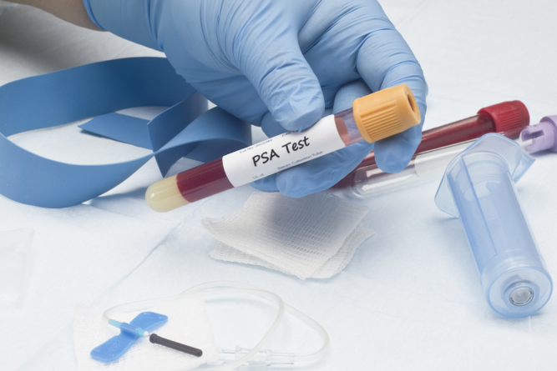
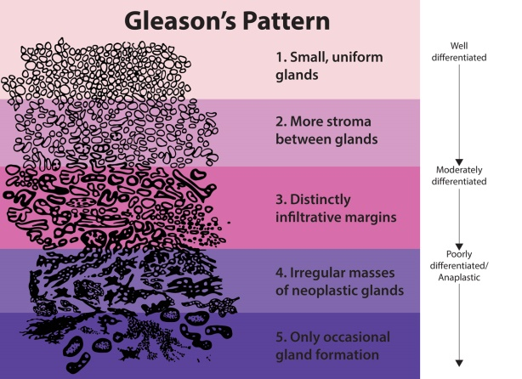
Screening and Surveillance for BRCA gene mutation carriers
Prostate Cancer
Controversial
Consider screening beginning at age 40 (e.g. annual digital rectal examination +/- PSA) for BRCA2 mutation carriers
PrCA in BRCA2 carriers present at a younger age with aggressive disease, and a higher mortality rate as compared with non-carriers
Notes:
NCCN Clinical Practice Guidelines in Oncology (NCCN Guidelines®) for Genetic/familial high risk assessment: Breast and ovarian V.1.2015© National Comprehensive Cancer Network, Inc 2015. All rights reserved. Accessed [26/05/2015]. To view the most recent and complete version of the guideline, go online to www.nccn.org. NATIONAL COMPREHENSIVE CANCER NETWORK®, NCCN®, NCCN GUIDELINES®, and all other NCCN Content are trademarks owned by the National Comprehensive Cancer Network, Inc.
“Starting at age 40y –Recommend prostate cancer screening for BRCA2 mutation carriers; consider prostate screening for BRCA1 carriers” pg MS-5 describes studies showing PrCA in BRCA2 mutation carrier is more aggressive and associated decreased survival.
Mersch 2015 Cancers associated wtih BRCA1 and BRCA2 mutations other than breast and ovarian CANCER “Prostate cancer occurred approximately 5 times more frequently in males with BRCA2 mutations than expected in the general population. The increased risk for prostate cancer in our study population is consistent with previous studies, which have reported relative risk estimates ranging from 2.5 to 6.3. Our findings support the rationale for pancreatic and prostate cancer screening in individuals with a BRCA2 mutation….These suggestions [NCCN] currently include digital rectal examination and prostate-specific antigen serum testing beginning at the age of 40 years.”
Berliner JL, Fay AM, Practice Issues Subcommittee of the National Society of Genetic Counselors' Familial Cancer Risk Counseling Special Interest Group. Risk assessment and genetic counseling for hereditary breast and ovarian cancer: recommendations of the National Society of Genetic Counselors. J Genet Couns 2007; 16(3):241-60. “Follows NCCN guidelines”
Men with a BRCA1 or BRCA2 mutation are at increased risk for early onset, aggressive prostate cancer compared to men in the general population. Standard of care screening for men with a BRCA mutation includes PSA testing and digital rectal examination (DRE), the same as with men in the general population. This study is being done to assess whether there is value in using MRI as a screening tool to detect prostate cancer at an earlier stage than may otherwise be detected using standard of care screening (PSA, DRE). It is unclear whether MRI has utility as a screening tool in this specific population at high risk for aggressive disease. - Sunnybrook Health Sciences Centre
Women's College Hospital - Principal Investigator(s):Danny J Vesprini, MD, MSc, FRCPC, Shttp://www.ontario.canadiancancertrials.ca/trial/Default.aspx?TrialId=NCT01990521&lang=en

Slide 36
Treatment options for affected BRCA mutation carriers
More frequent, or intensive cancer screening
Risk-reducing medications
e.g. tamoxifen or raloxifene
Risk-reducing surgery
e.g. mastectomy or bilateral salpingo-oophorectomy(BS0)
New adjuvant, neoadjuvant, and metastatic treatments
e.g. PARP inhibitors
Moyer Ann Intern Med 2014, Livraghi and Livraghi BMC Medicine 2015
Notes:
Mean cumulative risks of contralateral BrCA by age 70 for BRCA1 carriers was a 83% and 62% for BRCA2 carrier.
Poly(ADP-ribose) polymerases (PARP) are enzymes involved in DNA-damage repair. Inhibition of PARPs is a promising
strategy for targeting cancers with defective DNA-damage repair, including BRCA1 and BRCA2 mutation-associated
breast and ovarian cancers.

Slide 37
What do the genetic test results mean?
Positive test result: Gene mutation known to be pathogenic found
The patient has an increased lifetime risk to develop certain cancers
Screening and surveillance recommendations to improve outcome
Family members are at risk of carrying the same mutation and of having similar cancer risks

Slide 38
What do the genetic test results mean?
Negative test result: Familial mutation not found

Slide 39
What do the genetic test results mean?
Negative test result: Familial mutation not found
This is a true negative result

Slide 40
What do the genetic test results mean?
Negative test result: Familial mutation not found
This is a true negative result
Reassurance for the patient

Slide 41
What do the genetic test results mean?
Negative test result: Familial mutation not found
This is a true negative result
Reassurance for the patient
Patient may still need to follow modified screening recommendations based on her/his family history and/or personal history factors (e.g. BMI, age at menarche, personal benign breast disease)

Slide 42
What do the genetic test results mean?
Negative test result: affected patient no mutation identified and there is no known familial mutation
This result is uninformative

Slide 43
What do the genetic test results mean?
Negative test result: affected patient no mutation identified and there is no known familial mutation
This result is uninformative
The diagnosis of hereditary breast and ovarian cancer syndrome is neither confirmed nor ruled out

Slide 44
What do the genetic test results mean?
Negative test result: affected patient no mutation identified and there is no known familial mutation
Genetics specialist may offer genetic testing for another hereditary cancer syndrome
Depending on family history (e.g. other cancers) or clinical findings (e.g. head circumference) testing for one specific gene OR by a hereditary cancer panel (multiple cancer predispositions genes tested at one time) may be offered on case-by-case basis

Slide 45
What do the genetic test results mean?
Generally, hereditary cancer panels are available as physician ordered private-pay test
Caution when ordering hereditary cancer panels
Clinical utility of panels is not yet defined
Variants of unknown significance: challenges in interpreting results
Some hereditary cancer panels may contain 7-26 genes

Slide 46
What do the genetic test results mean?
Variant of uncertain significance (VUS): a gene change that has not yet been categorized as benign or as pathogenic
Notes:
Variants are periodically re-classified and patients are often encouraged to recontact their genetics clinic
Other hereditary cancer syndromes may be considered

Slide 47
What do the genetic test results mean?
Variant of uncertain significance (VUS): a gene change that has not yet been categorized as benign or as pathogenic
The diagnosis of hereditary breast and ovarian cancer syndrome is neither confirmed nor ruled out
Notes:
Variants are periodically re-classified and patients are often encouraged to recontact their genetics clinic
Other hereditary cancer syndromes may be considered

Slide 48
What do the genetic test results mean?
Variant of uncertain significance (VUS): a gene change that has not yet been categorized as benign or as pathogenic
The diagnosis of hereditary breast and ovarian cancer syndrome is neither confirmed nor ruled out
Some variants may be interpreted as ‘likely pathogenic’, generally meaning greater than 90% certainty of being disease causing
Screening and management may be modified
Other family members may be offered genetic testing to try to track the familial gene change and to see if it is associated with cancer
Notes:
Variants are periodically re-classified and patients are often encouraged to recontact their genetics clinic
Other hereditary cancer syndromes may be considered

Slide 49
Risks/Benefits/Limitations of Genetic Testing
Positive test result: Gene mutation known to be pathogenic found
Clinical intervention may improve outcome
Family members at risk can be identified
Potential Benefits
Potential Risks

Slide 50
Risks/Benefits/Limitations of Genetic Testing
Positive test result: Gene mutation known to be pathogenic found
Adverse psychological reaction
Family issues/distress
Uncertainty (e.g. incomplete penetrance)
Clinical intervention may improve outcome
Insurance/job discrimination
Family members at risk can be identified
Confidentiality issues
Potential Benefits
Potential Risks

Slide 51
Risks/Benefits/Limitations of Genetic Testing
Negative test result: Familial mutation not found (true negative)
Emotional (e.g. relief)
Children can be reassured
Avoidance of unnecessary clinical interventions
Potential Benefits

Slide 52
Risks/Benefits/Limitations of Genetic Testing
Negative test result: Familial mutation not found (true negative)
Emotional (e.g. relief)
Adverse psychological reaction (e.g. survivor guilt)
Children can be reassured
Avoidance of unnecessary clinical interventions
Complacent attitude to health
Potential Benefits
Potential Risks

Slide 53
Back to case 1: Judy
Judy’s family is at “high risk” for hereditary breast and ovarian cancer
Doctor, should I have genetic testing?

Slide 54
Case 1: Judy
Ideal to test affected (person with cancer) first
May not be possible because:
Deceased
Unwilling to contact:
Guilt
Relationship difficulties
Illness
Family member may be unwilling to have genetic testing

Slide 55
Case 1: Judy
LEGEND
Breast cancer
Ovarian cancer
Judy’s test results
+
Judy
BRCA1 185delAG

Slide 56
Other ways to assess your patient’s risk

Slide 57
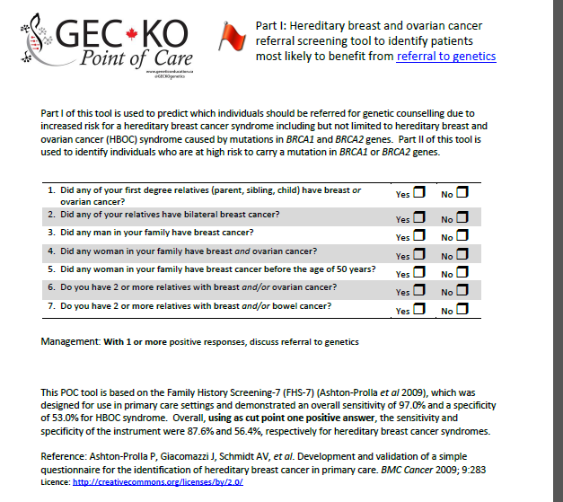

Slide 58
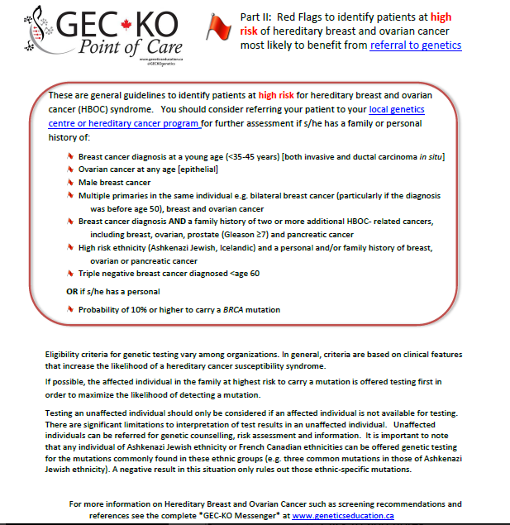

Slide 59
Resources
GEC-KO Website www.GeneticsEducation.ca
Point of Care tool
GEC-KO on the run
GEC-KO Messenger
Couch FJ, Nathanson KL, Offit K. Two decades after BRCA: setting paradigms in personalized cancer care and prevention. Science 2014; 343(6178):1466-70
Livraghi L, Garber JE. PARP inhibitors in the management of breast cancer: current data and future prospects. BMC Med 2015;13:188
Moyer VA; U.S. Preventive Services Task Force. Risk assessment, genetic counseling, and genetic testing for BRCA-related cancer in women: U.S. Preventive Services Task Force recommendation statement. Ann Intern Med 2014;160(4):271-81
NCCN Clinical Practice Guidelines in Oncology (NCCN Guidelines®) for Genetic/familial high risk assessment: Breast and ovarian V.2.2016© National Comprehensive Cancer Network, Inc 2015. All rights reserved. Accessed [05/05/2016].

Slide 60
Pearls
5-10% of breast cancer is hereditary
Mutations in BRCA1 and BRCA2 account for ~30% of high-risk breast cancer families
HBOC is an autosomal dominant condition that results in an increased lifetime risk of breast and ovarian cancer in addition to other cancers
High risk individuals should be referred for a genetic consultation for consideration of genetic testing
Surveillance and management of breast, ovarian and other cancers should be guided by genetic test results and/or family/ personal history
Studies show that conversations between patients and their healthcare providers are the strongest driver of screening participation

