Slide 1
Autism spectrum disorder and genetics
Developed by Ms. Shawna Morrison, Dr. June Carroll and Dr. Judith Allanson
Last updated June 2017

Slide 2
Disclaimer
This presentation is for educational purposes only and should not be used as a substitute for clinical judgement. GEC-KO aims to aid the practicing clinician by providing informed opinions regarding genetic services that have been developed in a rigorous and evidence-based manner. Physicians must use their own clinical judgement in addition to published articles and the information presented herein. GEC-KO assumes no responsibility or liability resulting from the use of information contained herein.

Slide 3
Objectives
Following this session the learner will be able to:
Refer to their local genetics centre and/or order genetic testing appropriately for autism spectrum disorders
Find high quality genomics educational resources appropriate for primary care

Slide 4
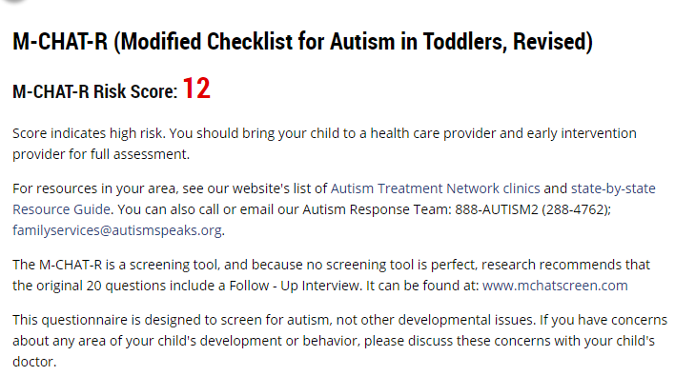
Case 1
Mother brings in son as child care provider suggests he be assessed
She describes her son as ‘spirited’ and a little slow, but catching up
She brings M-CHAT-R for review
34
36
A&W
A&W
16
5
?ASD
A&W
Mild social anxiety
Floppy
Balance & coordination difficulties
Difficulty establishing sleep pattern
Hypersensitive to noise
Language delay

Slide 5
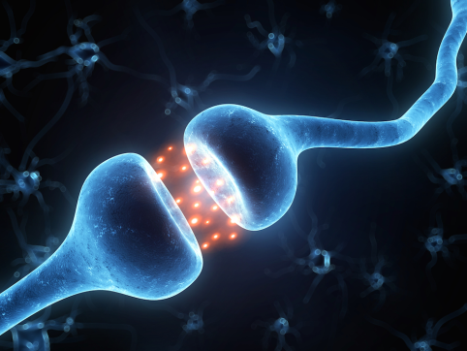
What is autism spectrum disorder?
ASD is a complex group of neurodevelopmental disorders
Evidence suggests dysfunction at the level of the synapse
autistic disorder
Asperger syndrome
childhood disintegrative disorder
pervasive developmental disorder-not otherwise specified

Slide 6
What is autism spectrum disorder?
ASD is a complex group of neurodevelopmental disorders
Evidence suggests dysfunction at the level of the synapse
Core features are:
Communication impairments
Repetitive behaviors and/or restricted interests
Social and behavioral challenges
Notes:
communication deficits: such as responding inappropriately in conversations, misreading nonverbal interactions, or having difficulty building friendships appropriate to their age
overly dependent on routines, highly sensitive to changes in their environment, or intensely focused on inappropriate items
ndividuals with ASD must show symptoms from early childhood,

Slide 7
What is autism spectrum disorder?
ASD is a complex group of neurodevelopmental disorders
Evidence suggests dysfunction at the level of the synapse
Core features are: communication and social interaction deficits, repetitive behaviours and/or restricted interests.
1 in 68 children are affected
Males affected at a ratio of about 4:1

Slide 8
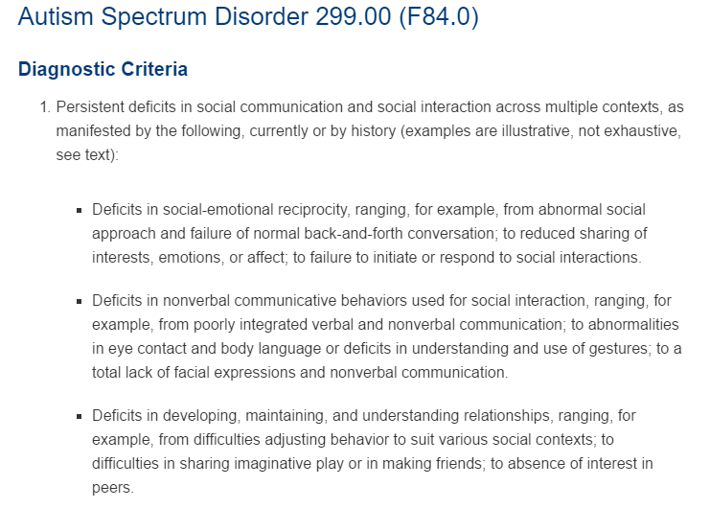
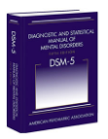
How is autism spectrum disorder diagnosed?
Diagnostic and Statistical Manual of Mental Disorders [DSM] criteria
www.autismspeaks.ca/about-autism/diagnosis/dsm-5-diagnostic-criteria/
Notes:
https://www.psychiatry.org/psychiatrists/practice/dsm/educational-resources/dsm-5-fact-sheets

Slide 9
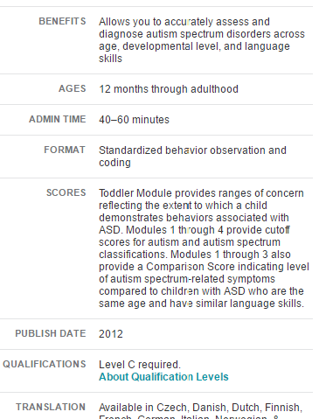
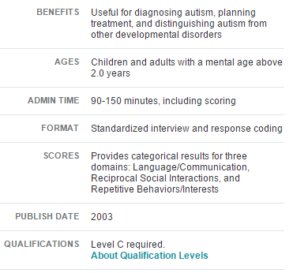
How is autism spectrum disorder diagnosed?
Other diagnostic tools:
Autism Diagnostic Observation Schedule-2 [ADOS]
Autism Diagnostic Interview [ADI]
Notes:
The Modified Checklist for Autism in Toddlers-Revised (M-CHAT-R™) is a scientifically validated tool for screening children between 16 and 30 months of age that assesses risk for autism spectrum disorder (ASD) for parents on autismspeaks.ca site.

Slide 10
Is autism spectrum disorder genetic?
Genetically influenced disorder, caused by factors including:
Genetic
Epigenetic
Non-genetic
environmental exposures
factors that affect gene expression and activity
~15-40% of individuals with ASD will have an identifiable genetic cause
15-40%, known genetic etiology
60%, no known genetic etiology
Notes:
this broad range is explained by the cohort and technology used in the studies (e.g. karyotype versus gene sequencing)

Slide 11
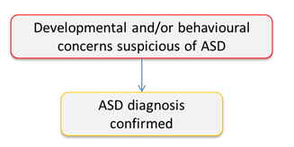
How do I know if my patient’s autism spectrum disorder is genetic?

Slide 12
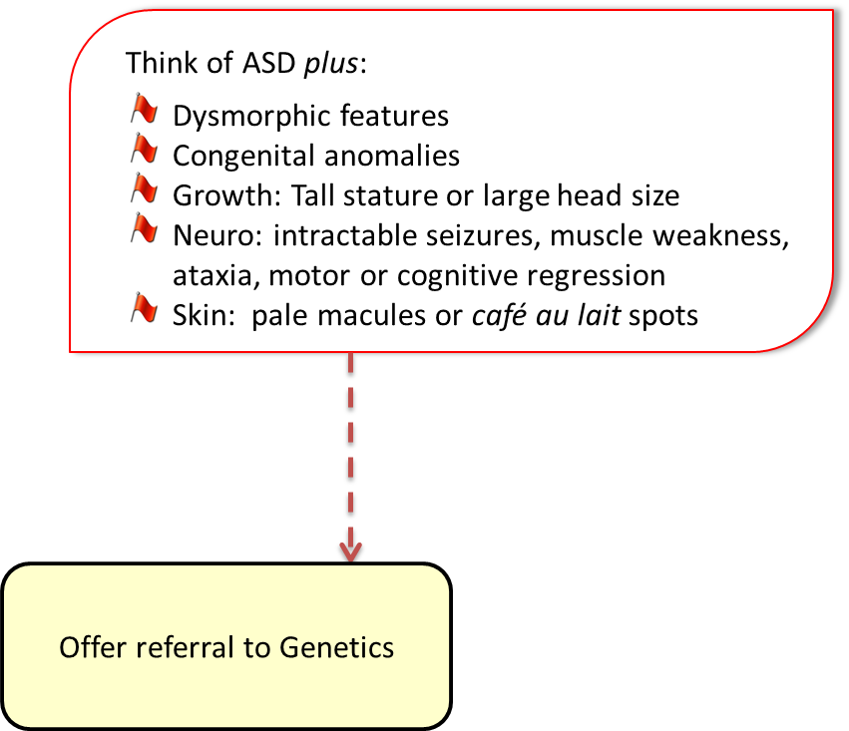
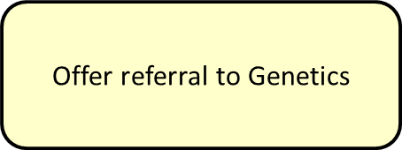
How do I know if my patient’s autism spectrum disorder is genetic?
25%
75%
Notes:
Once ASD is confirmed as per DMS criteria, one should consider whether or not the child may have additional clinical features that suggest ASD plus, or a specific genetic diagnosis. ASD plus accounts for about 25% of all ASD cases. If this is the case one may consider direct referral to Genetics for assessment – OR one may also consider organizing first tier genetic testing

Slide 13
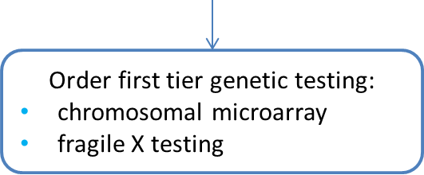
How do I know if my patient’s autism spectrum disorder is genetic?

Slide 14
What is chromosomal microarray?
Genomic technology to assess for small extra (micro-duplication) or missing (micro-deletion) pieces of genetic information
These gains and losses are called copy number variants (CNVs)
Higher resolution genetic test than karyotype
Yield for individuals with ASD is~7-14%
Finucane 2016 Curr Genet Med Rep
Karyotype
Microarray
Deletion/duplication analyses
Sequencing
Notes:
Finucane 2016 Curr Genet Med Rep
Whole genome CMA reveals a pathogenic CNV in 15–20 % of individuals with unexplained developmental delay, ID, ASD, or multiple congenital anomalies
The reported yield is 7–14 %in studies restricted to the evaluation of individuals with ASD

Slide 15
Chromosomal microarray results
Cannot completely rule out a CNV in all areas of the genome
Cannot exclude a syndrome caused by a mutation within a single gene
Cannot detect balanced chromosome differences
Negative
No significant CNVs detected
CNV – Copy Number Variant

Slide 16
Chromosomal microarray results
Negative
No significant CNVs detected
Screening/surveillance/treatment
Positive
Pathogenic or likely pathogenic CNV detected
Diagnostic
Recurrence risk counselling
Familial testing
Clinical trial
16p11.2 CNVs
Deletion or duplication
~1% of individuals with ASD
Support organization
Offer referral to Genetics
CNV – Copy Number Variant
Notes:
Recurrent CNVs at 16p11.2 are present in 1% of patients with ASDs.
Phenotype is variable
Penetrance incomplete
The deletion is more often de novo compared to the duplication.
deletion often have intellectual disability (usually mild), with particular difficulty in expressive language, vaguely defined behavioral manifestations, tend to become overweight in mid-childhood and have relative or absolute macrocephaly
duplication carriers tend to be underweight due to restrictive eating behaviors, and have smaller head circumference than expected for body size [carter 2013]
They are also found at lower frequencies in studies of schizophrenia (particularly the duplication) and idiopathic developmental delay with or without congenital anomalies (particularly the deletion).

Slide 17
Chromosomal microarray results
Negative
No significant CNVs detected
Positive
Pathogenic or likely pathogenic CNV detected
Variant of Uncertain Significance (VUS)
A CNV that has not yet been classified as benign or pathogenic
Test the parents (trio)
Offer referral to Genetics
CNV – Copy Number Variant

Slide 18
Chromosomal microarray results
Negative
No significant CNVs detected
Finding in child is new, de novo
Likely pathogenic
Positive
Pathogenic or likely pathogenic CNV detected
Both parents have normal array results
Variant of Uncertain Significance (VUS)
A CNV that has not yet been classified as benign or pathogenic
Test the parents (trio)
One parent has same array result as child
Finding in the child is pathogenic, but parent displays reduced penetrance (not everyone with the CNV will have symptoms), variable expressivity (individuals with this CNV have varied presentation)
A second predisposing factor is needed to cause problems
Finding in the child is normal familial variant
Not pathogenic
CNV – Copy Number Variant

Slide 19
Chromosomal microarray results
Negative
No significant CNVs detected
Positive
Pathogenic or likely pathogenic CNV detected
Variant of Uncertain Significance (VUS)
A CNV that has not yet been classified as benign or pathogenic
Incidental finding
A genetic variant that is unrelated to the primary indication for testing
Offer referral to Genetics
Predisposition to adult onset disorder
e.g. Lynch syndrome
Carrier status
e.g. cystic fibrosis
CNV – Copy Number Variant

Slide 20
How do I know if my patient’s autism spectrum disorder is genetic?

Slide 21
Fragile X syndrome
Most common inherited form of intellectual disability
1 in 4,000 boys and 1 in 6,000 girls
Global DD & intellectual disability
Large head, long face, prominent forehead and chin, protruding ears
Behavior differences e.g. hyperactivity, hand flapping, tactile defensiveness
25% will have ASD
Of children with ASD, 1-5% will have a fragile X syndrome diagnosis
Notes:
Characteristic appearance: may not be apparent in young children: large head, long face, prominent forehead and chin, protruding ears

Slide 22
Fragile X syndrome
Caused by a triplet repeat expansion in the FMR1 gene
CGG
CGG
CGG
CGG
CGG
CGG
CGG
CGG
CGG
CGG
CGG
200+ repeats is a full expansion
Associated with abnormal methylation (shutting off the gene)
Pre-mutation carriers (55-200 CGG repeats) are at risk for fragile X- associated tremor/ataxia syndrome (FXTAS) [men>women] and women are at risk for premature ovarian failure (~20%)
Notes:
Dr. Carlo Paribell, M.S.M., M.D., President & Medical Director Fragile X Research Foundation of Canada 167 Queen St. W. , Brampton, ON L6Y 1M5 Phone: 1-905-453-9366 E-mail: medical@fragilexcanada.ca

Slide 23
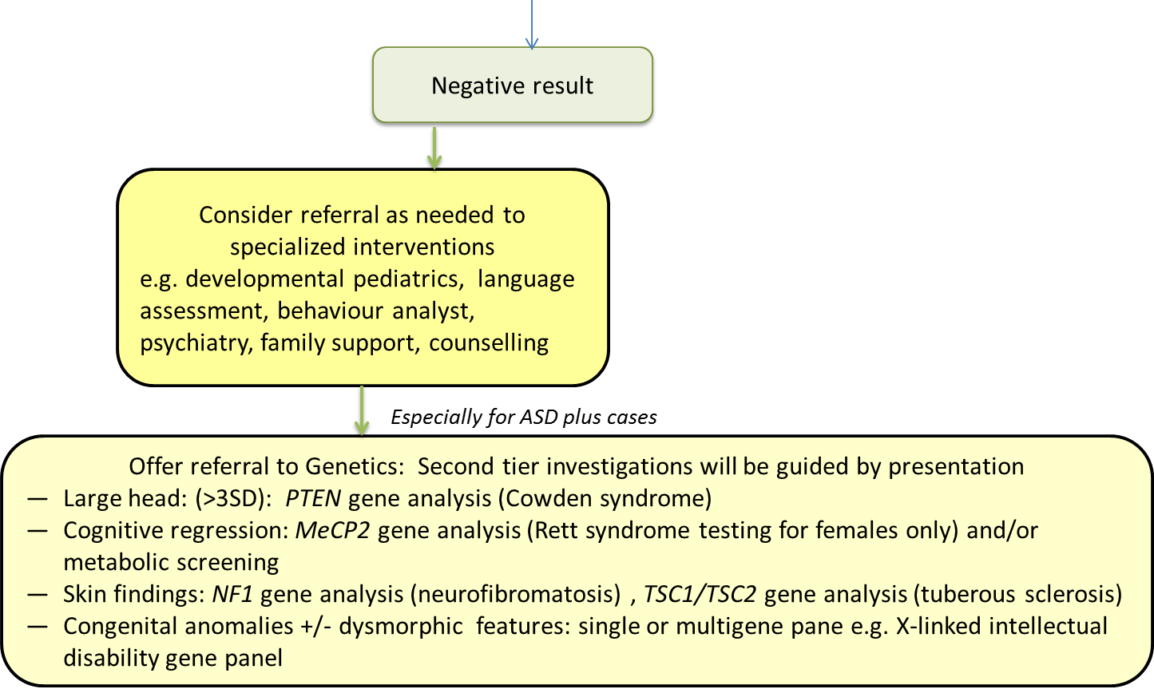
How do I know if my patient’s autism spectrum disorder is genetic?

Slide 24
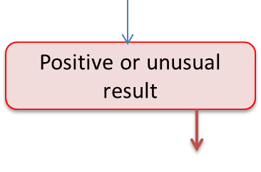
How do I know if my patient’s autism spectrum disorder is genetic?

Slide 25
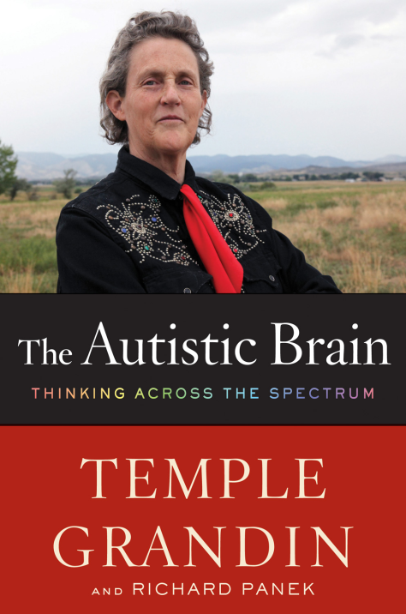
Three facts about genetic testing in autism spectrum disorder
1. A genetic etiology can be identified in up to 40% of individuals with ASD
Clinical presentation
Technology
Isolated
ASD plus
CMA (10%)
Fragile X syndrome (1–5%)
Rett syndrome (MeCP2) (4% of females)
Cowden syndrome (PTEN) (5%)
Karyotype (3%)
Other (10%)

Slide 26
Three facts about genetic testing in autism spectrum disorder
1. A genetic etiology can be identified in up to 40% of individuals with ASD
2. First tier genetic testing for ASD may be ordered by primary care providers, with appropriate pre- and post-test counselling
Be sure to use the appropriate requisition and provide as much information as possible, or the test may be canceled
Microarray is a cytogenetic test
Fragile X syndrome molecular genetic test

Slide 27
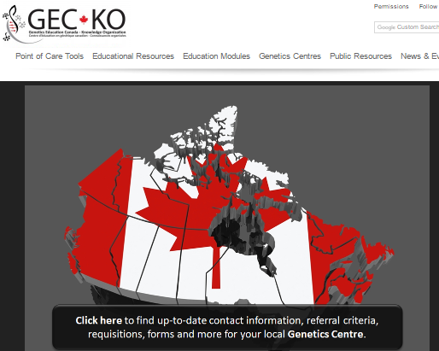
Three facts about genetic testing in autism spectrum disorder
1. A genetic etiology can be identified in up to 40% of individuals with ASD
2. First tier genetic testing for ASD may be ordered by primary care providers, with appropriate pre- and post-test counselling
Check with your local genetics clinic about how testing may be organized
Geneticseducation.ca > Genetics Centres > Canada

Slide 28
Three facts about genetic testing in autism spectrum disorder
1. A genetic etiology can be identified in up to 40% of individuals with ASD
2. First tier genetic testing for ASD may be ordered by primary care providers, with appropriate pre- and post-test counselling
3. Genetic test results can benefit patients and their families
Diagnosis
Better care
Management guidelines
Cowden syndrome, PTEN
High risk for benign and malignant tumors of the thyroid, breast, and endometrium and intestinal polyposis

Slide 29
Three facts about genetic testing in autism spectrum disorder
1. A genetic etiology can be identified in up to 40% of individuals with ASD
2. First tier genetic testing for ASD may be ordered by primary care providers, with appropriate pre- and post-test counselling
3. Genetic test results can benefit patients and their families
Diagnosis
Better care
Management guidelines
Familial testing
At-risk family members may need screening
Cowden syndrome is autosomal dominant
50% risk to parents and sibs
Prenatal diagnosis

Slide 30
Three facts about genetic testing in autism spectrum disorder
1. A genetic etiology can be identified in up to 40% of individuals with ASD
2. First tier genetic testing for ASD may be ordered by primary care providers, with appropriate pre- and post-test counselling
3. Genetic test results can benefit patients and their families
Diagnosis
Better care
Management guidelines
Rett syndrome (MeCP2)
Progressive neurodevelopmental disorder
Normal development until 6-18 months
Developmental stagnation and then regression
Familial testing
Prognosis
Notes:
classic Rett syndrome (MeCP2 gene mutations) there is a progressive neurodevelopmental disorder. Babies develop normally during the first 6 to 18 months of life, followed by a short period of developmental stagnation, then rapid regression in language and motor skills, followed by long-term stability. Skills will not be regained. [Christodoulou/GeneReviews]

Slide 31
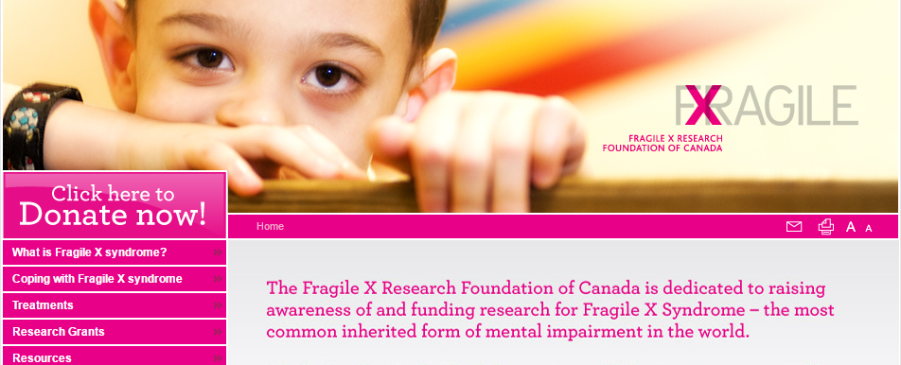
Three facts about genetic testing in autism spectrum disorder
1. A genetic etiology can be identified in up to 40% of individuals with ASD
2. First tier genetic testing for ASD may be ordered by primary care providers, with appropriate pre- and post-test counselling
3. Genetic test results can benefit patients and their families
Diagnosis
Support

Slide 32
Three facts about genetic testing in autism spectrum disorder
1. A genetic etiology can be identified in up to 40% of individuals with ASD
2. First tier genetic testing for ASD may be ordered by primary care providers, with appropriate pre- and post-test counselling
3. Genetic test results can benefit patients and their families
Diagnosis
Support
Genetic counselling can provide:
Information
psychosocial support both immediate and in the long term
guidance and help to prepare for the future
facilitate family communication
aid in decision making
Even when a diagnosis cannot be made
Notes:
Image Credits: Gipom

Slide 33
Three facts about genetic testing in autism spectrum disorder
1. A genetic etiology can be identified in up to 40% of individuals with ASD
2. First tier genetic testing for ASD may be ordered by primary care providers, with appropriate pre- and post-test counselling
3. Genetic test results can benefit patients and their families
Diagnosis
Support
Recurrence risk counselling
Genetic Etiology
Recurrence risk estimate
Unknown
10-19% (empirical risk)
~32% when 2 children affected
de novo
<1%
Autosomal recessive
25%
Autosomal dominant
50%
X-linked
50% different presentation in males and females
Notes:
More accurate recurrence risk (RR) counselling for families:
In the absence of an identifiable genetic etiology a general RR range can be quoted for families based on empirical studies. For families where one child has ASD, the RR is about 10-19% [Ozonoff, 2011; Sandin 2014]. If the second child is a male, the RR is expected to be towards the higher end of that range. [Carter] If two siblings are affected, the risk for future siblings can be as high as 32% [Carter]. The more distant an affected relative is, the more the RR falls off. The risk for half-siblings is about 3% and for cousins it is estimated to be about 2%. [Sandin]
If a genetic etiology is identified, the RR depends on how the responsible genetic change is inherited.
Autosomal recessive disorders: 25% RR, e.g. Smith-Lemli-Optiz
Autosomal dominant disorders: 50% RR, e.g. Cowden syndrome (PTEN) or neurofibromatosis (NF1) if one parent is also affected.
X-linked recessive disorders: 50% RR in males and 50% RR in females however clinical presentation in females likely to vary e.g. fragile X syndrome
de novo disorders (a new gene change in the affected individual, not inherited from either parent) <1% RR for siblings; for de novo dominant there would be a 50% risk to offspring of the affected individual

Slide 34
Case 1
ASD diagnosis confirmed
34
36
A&W
A&W
What are your next steps?
Refer to Genetics and/or a developmental pediatrician
Take a more detailed family history
Order first line testing
None of the above
All of the above
16
5
A&W
Social anxiety
ASD
Floppy
Balance & coordination difficulties
Difficulty establishing sleep pattern
Hypersensitive to noise
Language delay

Slide 35
Case 1
First tier genetic testing:
CMA = Negative
Fragile X testing = Positive
34
36
A&W
A&W
16
5
A&W
Social anxiety
ASD
Floppy
Balance & coordination difficulties
Difficulty establishing sleep pattern
Hypersensitive to noise
Language delay

Slide 36
Case 1
70
64
56
55
Parkinson disease
A&W
A&W
A&W
A&W
44
42
34
36
26
A&W
Menopause at age 38
A&W
A&W
A&W
10
10
14
16
5
Developmental delay
A&W
Social anxiety
ASD
Floppy
Balance & coordination difficulties
Difficulty establishing sleep pattern
Hypersensitive to noise
Language delay
Parkinson disease or fragile X- associated tremor/ataxia syndrome (FXTAS)?
Premature ovarian insufficiency/early menopause
Developmental delay
X-Linked pattern of inheritance

Slide 37
Case 1
70
64
56
55
Parkinson disease
A&W
A&W
A&W
A&W
44
42
34
36
26
A&W
Menopause at age 38
A&W
A&W
A&W
10
10
14
16
5
Developmental delay
A&W
Social anxiety
ASD
Floppy
Balance & coordination difficulties
Difficulty establishing sleep pattern
Hypersensitive to noise
Language delay
50% risk for pre- or full mutation
16yo may be sexually active

