Slide 1
Direct-to-Consumer Genetic Testing
Developed by Ms. Shawna Morrison, Dr. June Carroll, and Dr. Judith Allanson
Last updated May 2016

Slide 2
Disclaimer
This presentation is for educational purposes only and should not be used as a substitute for clinical judgement. GEC-KO aims to aid the practicing clinician by providing informed opinions regarding genetic services that have been developed in a rigorous and evidence-based manner. Physicians must use their own clinical judgement in addition to published articles and the information presented herein. GEC-KO assumes no responsibility or liability resulting from the use of information contained herein.

Slide 3
Objectives
Following this session the learner will be able to:
Discuss and address patient concerns regarding direct-to-consumer genetic testing (DTC-GT)
Find high quality genomics educational resources appropriate for primary care

Slide 4
Pearls
Direct-to-consumer (DTC) genetic testing is over-the-counter genetic testing available online to consumers through private companies
Generally, results report an individual’s probabilistic risk to develop a medical condition based on genome wide association studies (GWAS)
Interpret DTC results with caution
Family health history-based risk assessment is still the gold standard in initial assessment for heritable conditions

Slide 5
Case 1: Jenny
33 years old and in good health
6 months ago she learned that her paternal aunt, who is dying from ovarian cancer, was found to carry a mutation in the BRCA1 gene
+
BRCA1 pos
She didn’t feel this was the best time to approach the family to inquire further, so she purchased a DTC-GT kit online which tests the BRCA1 gene with the hope of being proactive, like Angelina Jolie

Slide 6
Case 2: Clark
50 years old
and in good health
d.85
d.87
MI
90
88
86
80
75
arthritis
AD
dx 80
IDDM
50
A&W
Recently purchased a DTC-GT kit out of curiosity after reading a news article

Slide 7
Case 3: Jane
45 years old, in good health
Began experiencing low mood about 3 months ago
She has been seeing a therapist but having a hard time with day-to-day and meets criteria for depression
You plan to prescribe Citalopram as you usually have success treating patients with this medication
Last year she had pharmacogenomic testing through a private lab

Slide 8
What is direct-to-consumer genetic testing?
Direct-to-consumer genetic testing (DTC-GT), also referred to as personal genome testing, refers to genetic testing available for ‘over-the-counter’ purchase without health care provider involvement.
without

Slide 9
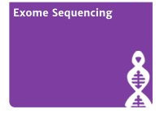
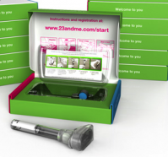
What is direct-to-consumer genetic testing?
Generally, available online to anyone for a cost
Usually performed on a saliva sample
Notes:
Costs vary depending on company and testing panel
Some presented here are DTC companies and some are provider ordered, private pay

Slide 10
What does direct-to-consumer genetic testing test for?
Hereditary breast and ovarian cancer caused by mutations in BRCA1 and BRCA2
Complex health conditions/
Genetic risk factors
Asthma
Alzheimer disease
Diabetes
Hypertrophic cardiomyopathy
Notes:
23andMe looks for a 25 base pair deletion MYBPC3 gene I – affects about 4% of individuals of South Asian descent – one of 23 genes on HCM panel at CHEO

Slide 11
What does direct-to-consumer genetic testing test for?
Complex health conditions/
Genetic risk factors
Clopidogrel
Simvastatin
Pharmacogenomics
Codeine
Pantoprazole
Citalopram
Phenytoin

Slide 12
What does direct-to-consumer genetic testing test for?
Complex health conditions/
Genetic risk factors
Pharmacogenomics
Cystic fibrosis
MCAD
Inherited conditions
i.e. carrier testing
PKU
Tay Sachs disease
Canavan disease
β-thalassemia

Slide 13
What does direct-to-consumer genetic testing test for?
Complex health conditions/
Genetic risk factors
Pharmacogenomics
Inherited conditions
i.e. carrier testing
Curly hair
Eye colour
Bitter taste
Height
Traits
Cilantro aversion

Slide 14
How does direct-to-consumer genetic testing work?
Complex health conditions/
Genetic risk factors
Uses data from Genome Wide Association Studies (GWAS)
Pharmacogenomics
Inherited conditions
i.e. carrier testing
Traits

Slide 15
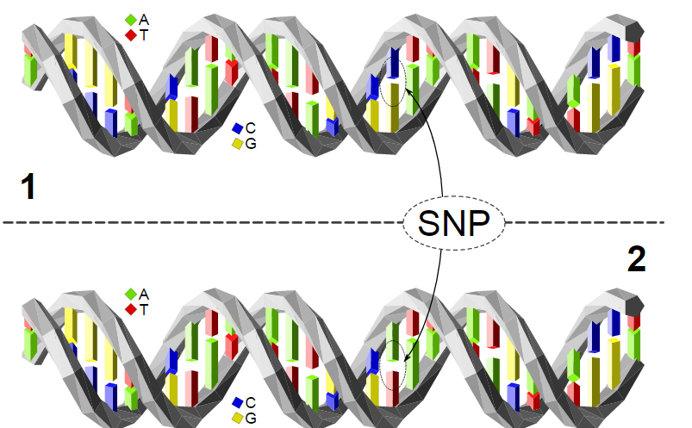
How does direct-to-consumer genetic testing work?
Complex health conditions/
Genetic risk factors
Genome Wide Association Studies (GWAS)
Pharmacogenomics
Case-control studies which examine Single Nucleotide Polymorphisms [SNPs]
Traits
Each SNP represents a difference in a single DNA building block, a nucleotide
Notes:
These are case-control studies which examine single nucleotide polymorphisms [SNPs]
SNPs (pronounced ‘snips’) are the most common type of genetic variation
Each SNP represents a difference in a single DNA building block, a nucleotide
GWAS compare large groups of individuals (unaffected controls versus individuals with symptoms of a specific disease) in an attempt to distinguish between non-harmful changes in the DNA code and pathogenic, disease-causing/predisposing changes

Slide 16
How does direct-to-consumer genetic testing work?
Complex health conditions/
Genetic risk factors
Genome Wide Association Studies (GWAS)
Pharmacogenomics
Compare large groups of individuals
Traits
Non-harmful changes
Pathogenic, disease-causing/predisposing changes
VS
2. Individuals with symptoms of a specific disease
1. Unaffected controls
Notes:
These are case-control studies which examine single nucleotide polymorphisms [SNPs]
SNPs (pronounced ‘snips’) are the most common type of genetic variation
Each SNP represents a difference in a single DNA building block, a nucleotide
GWAS compare large groups of individuals (unaffected controls versus individuals with symptoms of a specific disease) in an attempt to distinguish between non-harmful changes in the DNA code and pathogenic, disease-causing/predisposing changes

Slide 17
What do direct-to-consumer genetic test results mean?
Complex health conditions/
Genetic risk factors
Results
Pharmacogenomics
Traits
Low risk
Lower than average
Average risk
Population risk
High risk
Higher than average
Increased risk
Notes:
These are case-control studies which examine single nucleotide polymorphisms [SNPs]
SNPs (pronounced ‘snips’) are the most common type of genetic variation
Each SNP represents a difference in a single DNA building block, a nucleotide
GWAS compare large groups of individuals (unaffected controls versus individuals with symptoms of a specific disease) in an attempt to distinguish between non-harmful changes in the DNA code and pathogenic, disease-causing/predisposing changes

Slide 18
What do direct-to-consumer genetic test results mean?
Complex health conditions/
Genetic risk factors
Results
Pharmacogenomics
Assess the kinetics and dynamics of specific drugs
Traits
Aim to:
Avoid adverse effects
Improve efficiency
For example
Genotype associated with increased risk of adverse effects
Genotype associated with decreased therapeutic benefit
Notes:
Example

Slide 19
What do direct-to-consumer genetic test results mean?
Complex health conditions/
Genetic risk factors
Common gene mutations, generally ethnicity based
BRCA1 and BRCA2
Pharmacogenomics
3 Ashkenazi Jewish founder mutations (common mutations in a population arising from a small number of individuals) are generally offered
Over 3800 mutations have been identified in BRCA1 and BRCA2
Inherited conditions
i.e. carrier testing
CFTR (mutations in this gene cause cystic fibrosis)
Traits
A core panel of 23 mutations is generally offered vs over 70 mutations at most clinical labs
Notes:
https://www.23andme.com/en-ca/health/ethnicity/
Ashkenazi Jewish population, with 3% of individuals carrying one of the three founder mutations, namely BRCA1 c.68_69delAG [185delAG] (1%), BRCA1 c.5266dupC [5382insC] (0.13%), or BRCA2 c.5946delT (Couch, 2014)
More than 1800 distinct rare variants BRCA1and 2000 in BRCA2 (Couch, 2014)
ACMG/ACOG CFTR mutation panel would identify 49–98% of carriers, depending on ethnic background

Slide 20
What do direct-to-consumer genetic test results mean?
Do not take into account numerous important factors that are a significant contribution to common complex disease in interpretation
Family history
Age
Lifestyle (e.g. smoking obesity)
Other environmental factors
Different companies use different GWAS reports and different SNPs for analysis

Slide 21
Potential Risks/Benefits/Limitations
Patient autonomy
Encourage positive behaviour modifications (e.g. increase exercise, smoking cessation)
Information for medication choice and/or dose
Information for individuals who have no or limited information about their family history (e.g. an individual who was adopted)
Reveal carrier status of a genetic condition that could have implications for family planning or medical management
Potential Risks/Limitations
Potential Benefits

Slide 22
Potential Risks/Benefits/Limitations
Recent meta-analysis (Holland 2016 BMJ) found no significant effect of communicating DNA based risk estimates on several health behaviours
Limited data to support the clinical validity (ability to predict clinical outcome) and utility (the likelihood of improving patient outcome)
Discrepant results between companies, different studies may be used for result interpretation (Kalf 2013 Genet Med)
Truth in advertising (potential for consumers to be misled about the benefits versus risks and limitations)
Privacy and Regulation
How much is your genome worth?
Potential Risks/Limitations
Potential Benefits

Slide 23
Potential Risks/Benefits/Limitations
Concerns re downstream testing and costs as result of direct-to-consumer genetic test (DTC-GT) results
Limited data: One study showed DTC-GT results seem not to be associated with an overall increase in health care utilization (Reid 2012 Genet Med)
Recent study reported that 63% of customers planned to share DTC-GT results with PCP, at 6 month follow-up 27% had done so and 35% were very satisfied with the encounter, 18% not at all satisfied (van der Wouden 2016 Ann Intern Med)
Several other studies report that more than a quarter of customers shared DTC-GT results with their PCP
Potential Risks/Limitations
Potential Benefits
Notes:
DTC results may be consistent with motivating compliance with current recommended guidelines Scott Roberts 2013 Curr Genet Med Rep

Slide 24
Potential Risks/Benefits/Limitations
“Misattributed equivalence”
DTC-GT reports
test indicates a lower than average lifetime risk for condition A
Family history (FH) indicates a higher than average risk for condition A
Could lead to:
False reassurance
Less vigilance about medical interventions indicated by FH
Potential Risks/Limitations
Potential Benefits
Notes:
DTC results may be consistent with motivating compliance with current recommended guidelines Scott Roberts 2013 Curr Genet Med Rep

Slide 25
Case 1: Jenny
She receives her results and tells you that she is very relieved because she does not have a mutation in BRCA1
BRCA1 pos
What are your next steps?
Review the report
DTC-GT testing companies generally only screen for a few founder mutations
Need to confirm that Jenny was tested for the familial mutation – still need the familial mutation report
If she truly is negative for the familial mutation, this is reassuring, should still confirm result in a clinical lab

Slide 26
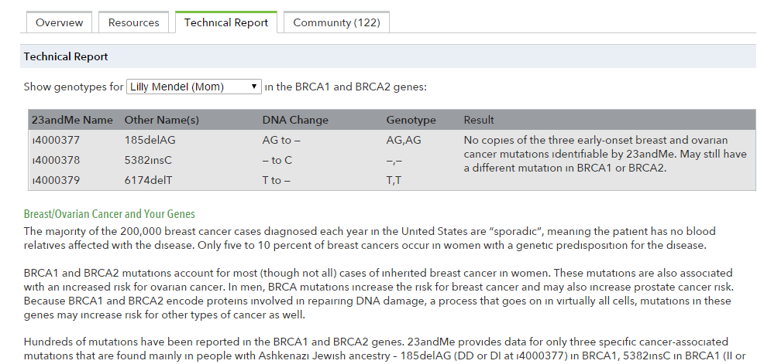
Sample report

Slide 27
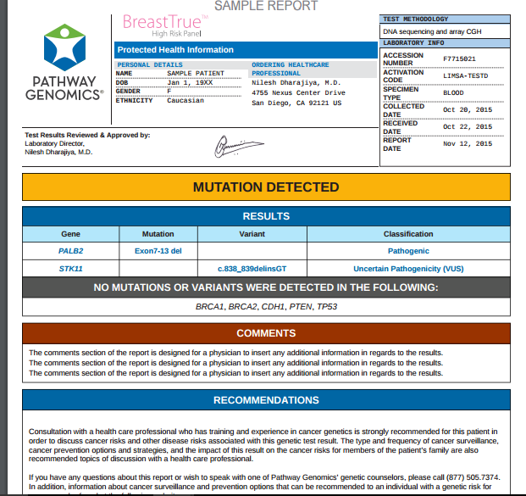
Sample report

Slide 28
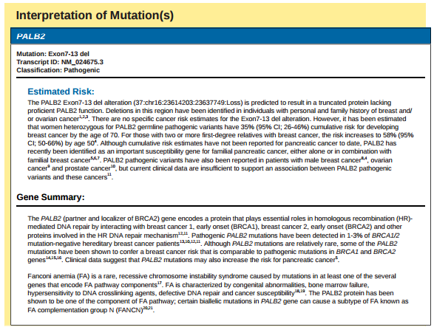
Sample report

Slide 29
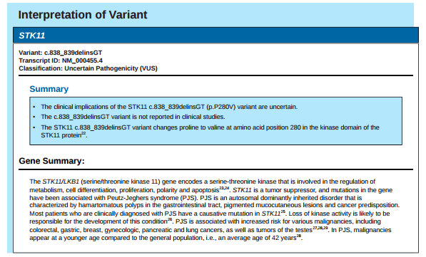
Sample report

Slide 30
Case 2: Clark
d.85
d.87
MI
Purchased DTC for curiosity
90
88
86
80
75
arthritis
AD
dx 80
IDDM
He brings in his laptop to show you his results
50
A&W
He is distraught to learn that he has an increased genetic risk for Alzheimer disease, he had thought that he could stave off the disease by healthy lifestyle choices

Slide 31
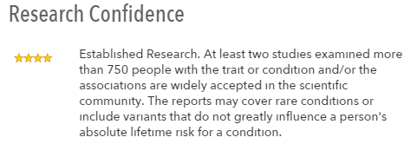
Sample report

Slide 32
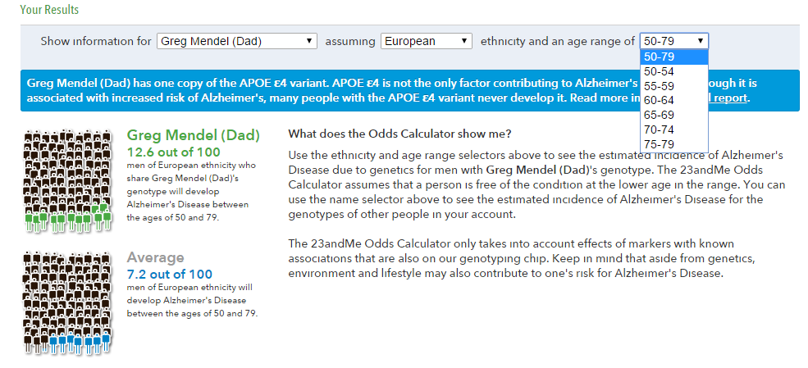
Sample report

Slide 33
How can you counsel Clark?
APOE is a susceptibility gene and is not a predictive test
With a first-degree relative with AD, even individuals with no copies of the ε4 allele still face [about a 2x] increased lifetime risk
Regardless of his DTC result, based on Clark’s family history, his AD risk is about 20-25% because his mother was affected
He should still continue with his healthy lifestyle as AD develops from a complex interaction between genetic and environmental factors
Notes:
Because the e4 allele is neither necessary nor sufficient to cause AD, there have been numerous consensus statements and articles that have recommended against using APOE genotyping for predicting AD risk.
The primary reasons for this recommendation include low sensitivity and specificity of testing, lack of preventive options, and the difficult nature of effectively conveying probabilistic risk. APOE is a susceptibility gene and is not a predictive test. Thus, individuals with no copies of the e4 allele still face a 2–4-fold increased lifetime risk of developing AD if they have a first-degree relative with AD
risk conferred by APOE differs between genders and possibly by ethnic group
The lifetime risk of AD in the general population is approximately 10–12% in a 75–80-year lifespan.

Slide 34
Case 3: Jane
She brought her pharmacogenomic testing to you to add to her medical record
It had never been useful as Jane is healthy and has not been prescribed anything in the last 2 years
You revisit the report

Slide 35
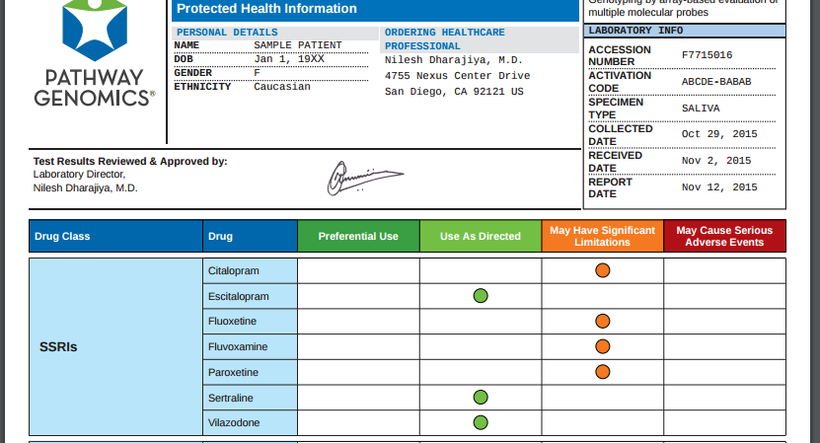
Sample report
Notes:
Example of a pharmacogenomic report from an executive health clinic

Slide 36
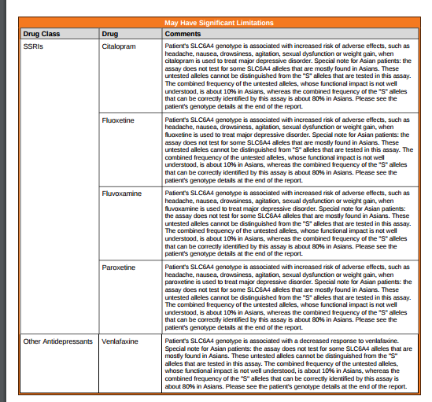
Sample report

Slide 37
What action can you take?
Jane’s report reveals a variant that means she is an ultrarapid metabolizer of medications that are catalyzed by CYP2C19, such as citalopram
Notes:
The Clinical Pharmacogenetics Implementation Consortium (CPIC) was formed as a shared project between PharmGKB and the Pharmacogenomics Research Network. CPIC guidelines are peer-reviewed and published in a leading journal (in partnership with Clinical Pharmacology and Therapeutics) with simultaneous posting to PharmGKB with supplemental information/data and update

Slide 38
What action can you take?
Jane’s report reveals a variant that means she is an ultrarapid metabolizer of medications that are catalyzed by CYP2C19, such as citalopram
As a result, she could be at increased risk of pharmacotherapy failure with this medication
You consider alternative medications which are metabolized by other CYP enzymes, such as fluoxetine (CYP2D6 and CYP2C9 ) or venlafaxine (CYP2D6)
Notes:
The Clinical Pharmacogenetics Implementation Consortium (CPIC) was formed as a shared project between PharmGKB and the Pharmacogenomics Research Network. CPIC guidelines are peer-reviewed and published in a leading journal (in partnership with Clinical Pharmacology and Therapeutics) with simultaneous posting to PharmGKB with supplemental information/data and update

Slide 39
Resources
GEC-KO on the run and other resources at www.GeneticsEducation.ca
Direct-to-Consumer genetic testing
Hereditary breast and ovarian cancer
Alzheimer disease
Aiyar L, Shuman C, Hayeems R et al. Risk estimates for complex disorders: comparing personal genome testing and family history. Genet Med 2014; 16(3):231-7
Heald B, Edelman E, Eng C. Prospective comparison of family medical history with personal genome screening for risk assessment of common cancers. Eur J Hum Genet 2012; 20(5):547-51
Hollands GJ, French DP, Griffin SJ, et al. The impact of communicating genetic risks of disease on risk-reducing health behaviour: systematic review with meta-analysis. BMJ 2016;352:i1102
Kalf RR, Mihaescu R, Kundu S, et al. Variations in predicted risks in personal genome testing for common complex diseases. Genet Med 2014;16(1):85-91
van der Wouden CH, Carere DA, Maitland-van der Zee AH, et al. Consumer Perceptions of Interactions With Primary Care Providers After Direct-to-Consumer Personal Genomic Testing. Ann Intern Med 2016;164(8):513-22
Reid RJ, McBride CM, Alford SH, Price C, et al. Association between health-service use and multiplex genetic testing. Genet Med. 2012 Oct;14(10):852-9
Roberts JS, Ostergren J. Direct-to-Consumer Genetic Testing and Personal Genomics Services: A Review of Recent Empirical Studies. Curr Genet Med Rep 20131(3):182-200
Skirton H, Goldsmith L, Jackson L, O’Connor A. Direct to consumer genetic testing: a systematic review of position statements, policies and recommendations. Clin Genet 2012; 82(3):210-8

